Slide 1

02FG part B
Explore the profession
RAC Champlain College
SPECIAL EDUCATION TECHNIQUES
Cluster A: Social Participation

Slide 2
Resources to help with this competency
Code of Conduct
Code of Conduct vs. Code of Ethics - What's the Difference? | This vs. That
https://www.verywellmind.com/morality-vs-ethics-what-s-the-difference-5195271
https://www.betterup.com/blog/meaning-of-personal-values
Values and Behaviours
Clarifying Your Personal Values

Slide 3
02FG Explore the profession (PART B)
02FG- 3 Examine professional behaviours
Acceptance of the rules of ethics applicable to the profession
Identification of the behaviour expected of professionals
Accurate analysis of the consequences of inappropriate behaviour
40% of the final grade for 02FG will be evaluated in this assignment

Slide 4
02FG Explore the profession (PART B)
Written part of the evaluation (3 pages minimum)
Describe an ethical dilemma you have experienced while working in the helping field.
  Describe the situation while respecting confidentiality.
  Describe what you would change about your actions if faced with this dilemma today
  Identify 3 points from the Code of Conduct that relate to your actions in this dilemma and provide a rationale for these choices.
Attitudes and skills
  List and explain in detail at least 3 appropriate attitudes required of the Specialized Educator that were not mentioned by the SET you interviewed in 02FG. For each attitude, provide an example from your work where you demonstrated this attitude.
  List and explain in detail at least 3 appropriate skills required of the Specialized Educator in relation to their ability to create and implement interventions. These should be different skills from those mentioned by the SET you interviewed. For each skill, provide an example from your work where you or the SET demonstrated using the skill.

Slide 5
02FG Explore the profession (PART B)
Interview part of the evaluation
The content specialist will present you with an ethical dilemma. You will have time to consult the Code of Conduct to determine what actions you would take.
Link your actions to at least 3 points in the Code of Conduct, and provide a rationale for your actions.
Identify 2 aspects of your own ethical conduct you want to improve upon and how you will continue to work on those goals.

Slide 6

What is an Ethical Dilemma?
It is not against the law
Two or more outcomes
It is a grey area: no clear choice

Slide 7
Laws vs Ethics https://keydifferences.com/difference-between-law-and-ethics.html#ComparisonChart
Meaning | The law refers to a systematic body of rules that governs the whole society and the actions of its individual members. | Ethics is a branch of moral philosophy that guides people about the basic human conduct.
What is it? | Set of rules and regulations | Set of guidelines
Governed By | Government | Individual, Legal and Professional norms
Expression | Expressed and published in writing. | They are abstract.
Violation | Violation of law is not permissible which may result in punishment like imprisonment or fine or both. | There is no punishment for violation of ethics.
Objective | Law is created with an intent to maintain social order and peace in the society and provide protection to all the citizens. | Ethics are made to help people to decide what is right or wrong and how to act.
Binding | Law has a legal binding. | Ethics do not have a binding nature.

Slide 8
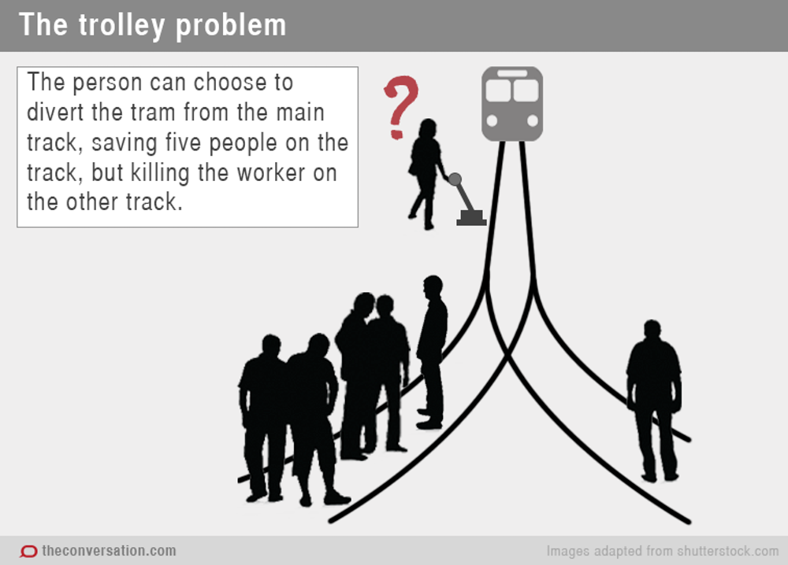
Ethical decision making is influenced by moral development
Philippa Foot, 1920s Philosopher

Slide 9

Values
(a person’s principles or standards)

Slide 10

What determines a person’s value system?
Value: A person’s principles or standards, the beliefs /attitudes that direct their day to day living
Determined by: upbringing/ experiences/ environment /culture
Read about your values

Slide 11
What factors might influence / change your personal values?
Video

Slide 12
Scenario 1: in groups react to this. Determine if you could continue to work with this family without imposing your values
You are an SCC working with a family who are very religious. The 16 year old you are working with has ASD. She is verbal but has some difficulty with social skills and sensory integration. Her family has made arrangements for her to marry next year. She will meet her future husband this month.

Slide 13
Scenario 2: in groups react to this. Determine if you could continue to work with this family without imposing your values
You are the SCC working with a family where there is three wives. When you enter the home they state they would feel more comfortable if you would sit with them while they pray.

Slide 14
Scenario 3: in groups react to this. Determine if you could continue to work here without imposing your values
You are working in an agency that uses punishment as part of their ABA interventions. They have the parent’s permission to keep the child under an electronic hand dryer whenever he self harms. He is scared of the hand dryer and appears to be hyper sensitive to the sound which is why the administration chose this form of punishment. You are going to be his educator.

Slide 15
Scenario 4
Your client is a 16 year old who has had 4 abortions. She is pregnant again (16 weeks) and plans to get another abortion

Slide 16
Code of Ethics vs Code of Conduct
A Code of Ethics is a set of guidelines that establish ethical principles and standards that govern the conduct of a particular profession or group. It is based on the values and morals by which an organization makes decisions about what is right or wrong. A code of ethics helps its employees to understand the difference between right and wrong and use that understanding to make decisions.
A Code of Conduct is a body of rules and regulations that explain the acceptable actions and behaviour expected of professionals within an organization. It basically determines what is appropriate and inappropriate behaviour. The code of conduct explains what professionals must do to implement the code of ethics of the organization. In other words, the code of conduct is the practical application of the code of ethics.

Slide 17
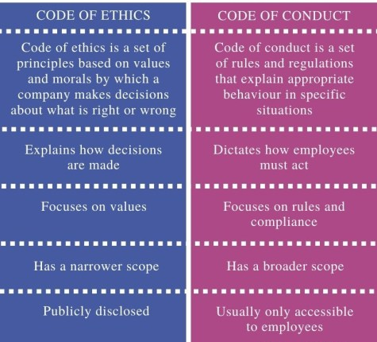
Code of Ethics vs Code of Conduct

Slide 18

SET (SCC) Code of Conduct
2.1.1. The S.C.C. supports The Association by adhering to the goals and objectives of the Code of Ethics while respecting their duties and obligations to the profession

Slide 19

Important parts of the Code of Conduct
All parts are important
Chapter 2: duties and obligations towards the profession
Chapter 4: duties and obligations towards the client
Chapters 3, 5 and 6 are important for your role however you will likely be using 2 and 4 most often for this class

Slide 20

If you disagreed with a colleague ….
Where would you look to find parts of the code to guide you?
Which 2 codes relate to how you would handle it?

Slide 21

Do you abide by this?
4.2.3. The S.C.C. shall provide opinions to a client only if they have sufficient professional and scientific information.

Slide 22

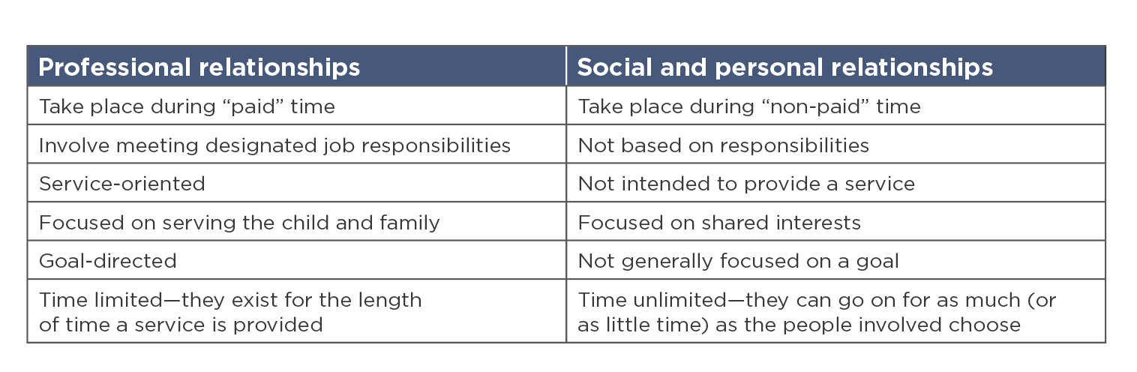
Personal vs professional

Slide 23
Boundaries
Dual or multiple relationships
Dual or multiple relationships occur when helpers relate to clients in more than one type of role or relationship, whether professional, social, or business.
Examples of dual relationships: when the client is also a student, friend, family member, employee or business associate of the helper.
This may be prevalent in small or remote communities where citizens wear multiple hats and interact with one another in a number of roles and locations. In these areas with few professional helpers, it may be impossible not to have some other relationship with a client. In those circumstances, the helper must use professional judgment, and ensure that safeguards are in place. For example: ensure appropriate supervision, resist disclosing confidential information, ensure that any conflict-of-interest concerns are addressed.

Slide 24
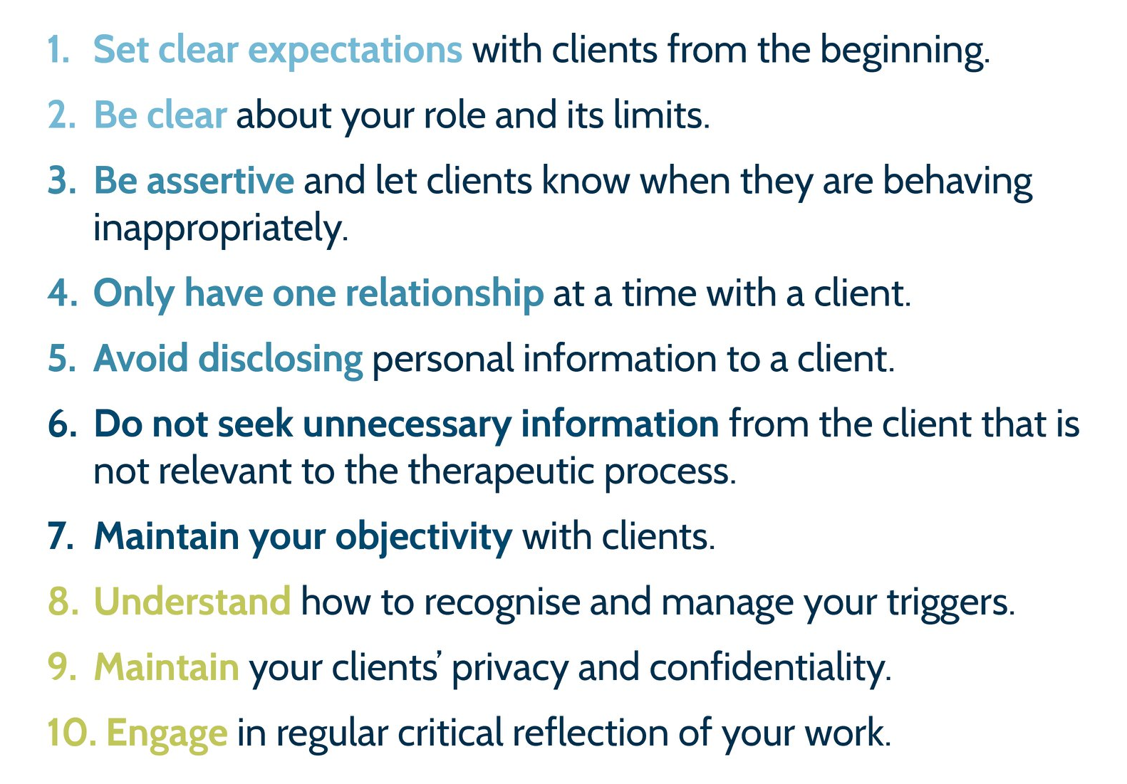
Tips for maintaining professional boundaries
Notes:
Image from Relationships Australia Victoria

Slide 25

Confidentiality
Social Media
Photographs
Conversations
Written / verbal

Slide 26
Limits of confidentiality:
Even if a client requests secrecy, know what can or cannot be promised to be kept confidential. Examples include:
Danger to self (threats of suicide)
Danger to others (threats of homicide, femicide)
Evidence or suspicion of abuse, neglect (child, domestic, elder)
Accusations of sexual harassment

Slide 27

Informed consent
Ensure your client is aware that you will break confidentiality if they appear to be at risk of harming self, others
Video

Slide 28
Informed consent
a fundamental ethical standard (and legal concept) that refers to the process of obtaining permission from a client before engaging in a particular activity or providing a specific treatment or service.
requires that clients receive comprehensive and accurate information about the nature, purpose, risks, benefits, alternatives, and potential consequences of the proposed activity or intervention.
ensures that clients have the autonomy and agency to make informed decisions about their own well-being and to participate in their own care.

Slide 29

Steps when solving an ethical dilemma
1. Identify the problem (personal or professional?)
2. What are the options?
3. Are there any laws? (not a dilemma)
4. What does the code of conduct tell you about your role?
5. What are the pros and cons of each of your options?
6. What can you live with?
7. Decision

Slide 30
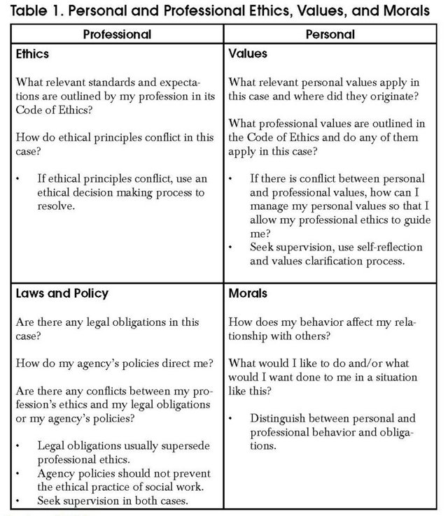
Aspects to consider

Slide 31

Skills vs Attitudes
An SET requires a variety of skills and attitudes to perform their job effectively
Read about skills and attitudes

Slide 32
Categorize the following as skill or attitude
Active listening
Patience
Crisis intervention
Creativity
Non judgmental
Problem solving
Self reflection
Critical thinking
Empathetic

Slide 33
Professional growth
What are some ways we can improve our own ethical practices?

Slide 34
Reminders for writing your paper
Ensure you are describing your dilemma cIearIy
Use Non-Judgmental Language
Discuss anything you would change about your actions and why
Identify THREE parts of the code that apply to your actions
Remember to provide a rationale for how these items from the code apply to your actions
You want to avoid evaluating the actions of the others involved

Slide 35

Interview Reminders
Make sure you have the code of conduct with you (you can read from this)
Remember to talk about your attitudes and behaviours
You will have time to go through the code and think about your decision
Prepare at least 2 parts of the code that relate to your decision
Finally, be prepared to share at least two (more is better) way to improve your own ethical conduct

Slide 36
Evaluation rubric
Accomplished: Thorough, clear, supported with examples, strong links to Code of Conduct
Competent: Covers main points, some examples, minor gaps
Developing: Missing depth, few/no examples, vague references to Code of Conduct; will need to revise

