Slide 1
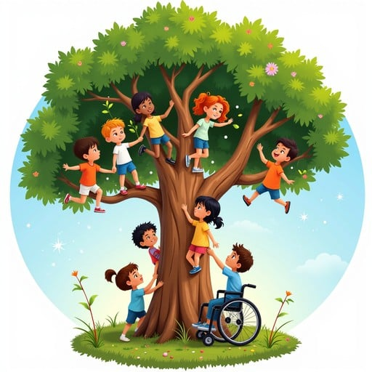

Competency 02FH: Analyze the issues associated with participation in society
Cluster A: Social Participation
Recognition of Acquired Competencies (RAC)
Special Education Techniques (SET)
Notes:
Image from <a href="https://stockcake.com/i/inclusive-tree-adventure_2537645_1498353">Stockcake</a>

Slide 2
Competency overview
Three elements to evaluate:
02FH-1. Examine the complexity of social interactions
02FH-2.Examine the phenomenon of inequality.
02FH-3.Examine the effects of the social context on social participation.

Slide 3
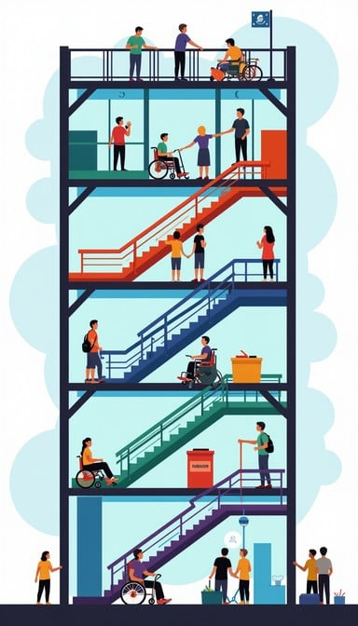
Why it matters
SETs support clients who face barriers at school, work, home, and in the larger world.
Understanding social dynamics helps us:
  provide better support
  honour clients' dignity
  promote inclusion
Notes:
Image from <a href="https://stockcake.com/s?q=inclusion%20barriers">Stockcake</a>

Slide 4
1. Social interactions
Social interactions are the ways people connect, communicate, and relate to each other.
Why they matter for SETs:
🌍 Influenced by culture (values, communication styles)
👨‍👩‍👧 Shaped by family and community experiences
❤️ Affected by emotions (fear, trust, hope, anxiety)
🧠 Rooted in life history (trauma, success, exclusion/inclusion)
In our role as SETs:
Our words, behaviours, and actions impact how safe, respected, and included our clients feel.
We must reflect on how our own biases or habits shape interactions.
Every interaction is a chance to build trust and support participation.

Slide 5

Influences on social interactions
Culture:
communication styles, values, language
Identity:
gender, religion, language, ability, other dimensions of diversity
Life history:
past experiences, trauma, education, family background
Emotions:
feelings like trust, fear, anxiety, or hope

Slide 6
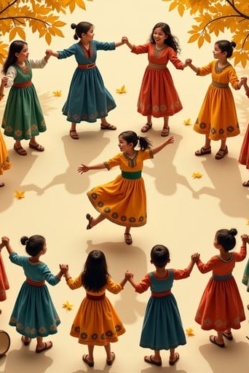
Culture and social interactions
Includes customs, values, beliefs, proximity, food, clothing, music, …
Influences expectations about behaviour
Affects how people express respect, emotion and conflict
Can create misunderstandings if not recognized
Notes:
Image from <a href="https://stockcake.com/s?q=culture">Stockcake</a>

Slide 7

Identity and social interactions
Includes gender, skin colour, language, religion, ability, and many other dimensions of diversity
Shapes how people see themselves and are seen by others
Can be a source of strength or discrimination
Intersects with privilege and marginalization

Slide 8

Life history and social interactions
Past experiences shape trust and participation
Trauma can lead to PTSD, and create fear, anxiety, or withdrawal
Success and support can build resilience
Family background influences behaviour and expectations
Understanding a client's journey supports respect and empathy.

Slide 9
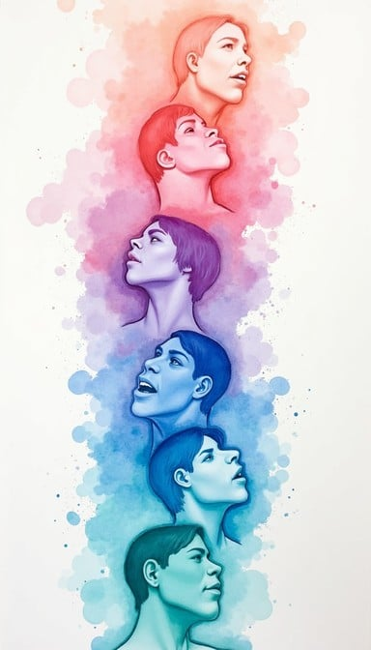
Emotions and social interactions
Emotions affect confidence and engagement
Anxiety, fear, or stress can block participation
Trust and safety encourage sharing and growth
Our responses to clients can either calm or inflame emotions
Notes:
Image from <a href="https://stockcake.com/s?q=emotions">Stockcake</a>

Slide 10
Case study: Daniel
Daniel is a 9-year-old boy in Grade 4. He was born in Syria, and moved to Canada with his parents four years ago. He was recently placed in a mainstream classroom after attending a specialized behavioural program for two years. His parents are newly separated, and he now lives with his mother, who works long hours and struggles to attend school meetings. Daniel is quiet and withdrawn in class. He rarely makes eye contact with teachers or peers and often isolates himself during group activities. He follows instructions well but never volunteers to participate. At recess, he stays close to the wall and doesn’t join games unless someone invites him directly. His new teacher notices that he becomes anxious when routines change. He also seems especially uncomfortable when asked to share personal information in class, such as during “show and tell” or personal writing assignments.
You have been asked, as a SET, to support Daniel’s integration and help him participate more fully. See questions for discussion below.

Slide 11
Questions for discussion - Daniel
History and context
  What important aspects of Daniel’s background should be considered?
  How might his family situation and past schooling influence his behaviour now?
Feelings and emotional world
  What emotions might Daniel be experiencing in his new environment?
  How might anxiety or fear show up in his behaviour?
Challenges in social interactions
  What makes social participation difficult for Daniel right now?
  What might his silence or withdrawal be communicating?
Your behaviour as an SET
  How might your tone, language, or assumptions affect Daniel's sense of safety?
  What specific steps could you take to build trust and promote inclusion?
Next steps
  What specific, realistic intervention strategies could you try to improve Daniel’s social engagement?

Slide 12
Feelings analysis - Daniel
Based on what you know about Daniel’s situation, list 3–5 emotions he might be feeling. For each feeling, explain what part of the case study supports that feeling and how that emotion might be showing up in his behaviour?
EMOTION | WHAT IN THE CASE STUDY SUGGESTS HE MIGHT BE FEELING THIS EMOTION? | HOW DOES/MIGHT IT SHOW UP?

Slide 13
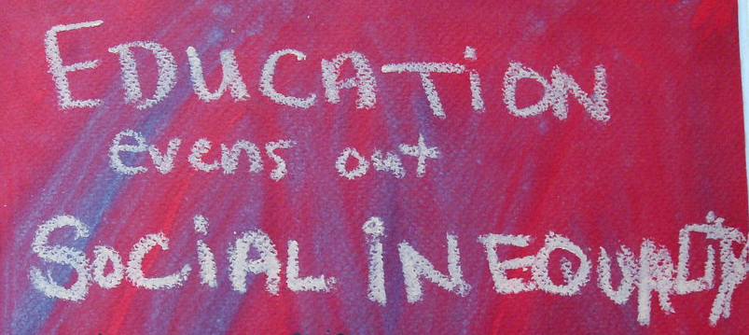
2. Understanding inequality
means unequal access to rights, resources, and respect
inequality is often built into larger systems (not just individual behaviour)
affects education, employment, housing, health, inclusion

Slide 14
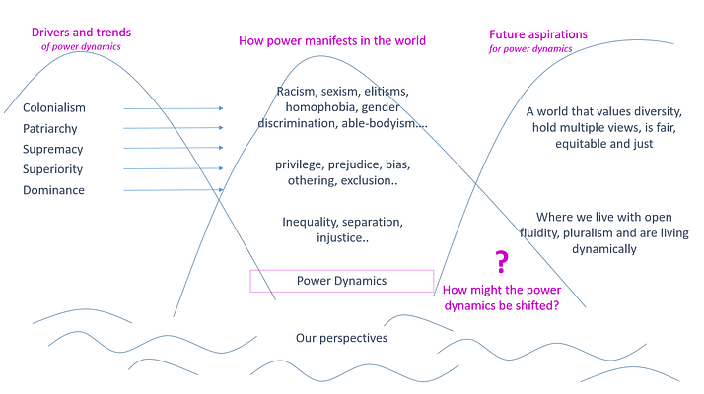
Power
Power = the ability to make decisions or influence others
Can be personal, positional, or systemic (laws, policies)
Power affects: who gets heard, who decides, who is ignored
Notes:
Image from https://medium.com/school-of-system-change/power-dynamics-a-systemic-inquiry-c30e2e658d3e

Slide 15

Power
Power is relational. We as individuals have different positions in the web of our social relationships. Having an awareness of your privilege and positionality and therefore any assumptions and bias you bring to any given situation is therefore critical to understanding power.
Power exists in schools, workplaces, and family systems. If you decide the rules and others have to follow - you have power. Many clients feel powerless, especially in systems they don’t understand or control.
Acknowledge the power and privileges you have. Be prepared to be open about it, find ways to talk about it, be humble with what you are doing — practice vulnerability.
Notes:
Quote from Anna Birney, adapted - https://medium.com/school-of-system-change/power-dynamics-a-systemic-inquiry-c30e2e658d3e

Slide 16
Privilege
Rights, advantages and protections enjoyed by some at the expense of others
Unseen advantages linked to identity (race, gender, ability)
Privilege is socially constructed to benefit members of the dominant group
Because dominant groups occupy the positions of power, their members receive social and institutional advantages
One automatically receives privilege by being a member of a dominant group

Slide 17
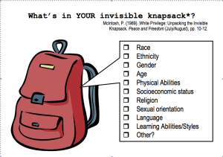
Dominant majority privilege
I can be pretty sure that my neighbours will be neutral or pleasant to me.​
I can go shopping alone most of the time, pretty well assured that I will not be followed or harassed.​
If a cop pulls me over, I can be sure I haven’t been singled out because of the colour of my skin.​
I see people who look like me in leadership roles.
My religious holidays are recognized at school or work.

Slide 18
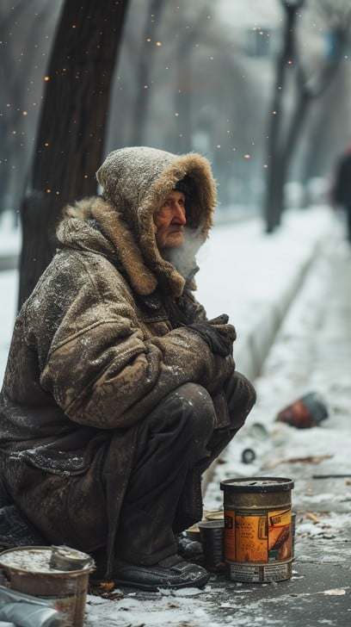
Marginalization
Happens when individuals or groups are pushed to the edges of society
Examples: racism, ableism, sexism, homophobia, poverty
They are made to feel less valuable, less heard, less visible
Happens through policies, attitudes, stereotypes, exclusion

Slide 19
The vicious circle of stereotyping and prejudice
1. Lack of knowledge or negative experience
5. Continued avoidance
2. Avoid
interaction
4. Intolerance, fear, discomfort, hostility, discrimination
3. Negative stereotypes formed
Notes:
Our reactions to other people are largely processed through the filter of experience:
We may be taught prejudice or we may adopt a stereotype due to a negative experience.
This leads us to avoid interaction with that group.
The less we know about another group or culture, the more we tend to apply negative stereotypes we have learned or heard. These stereotypes inhibit the interaction needed to help us learn about each other.
When contact is required, we are less tolerant of differences, we will be uncomfortable, perhaps fearful…this only reinforces negative reactions.
Continued avoidance: the more negative the attitudes, the less likely we are to seek the contact that would add new information and help us break the stereotype.

Slide 20
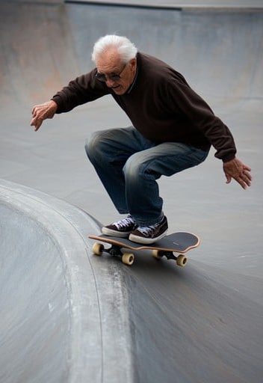
Stereotypes
Simplified characteristics attributed to a whole group
Over-generalizations
Fixed mental images
Belief that all people in a group have a certain trait
Learned from parents, school, friends, media
Lead to prejudice and discrimination
Examples:
  All Americans like fast food
  All Canadians are polite, love hockey, and end sentences with “eh”
  Old people can’t skateboard

Slide 21
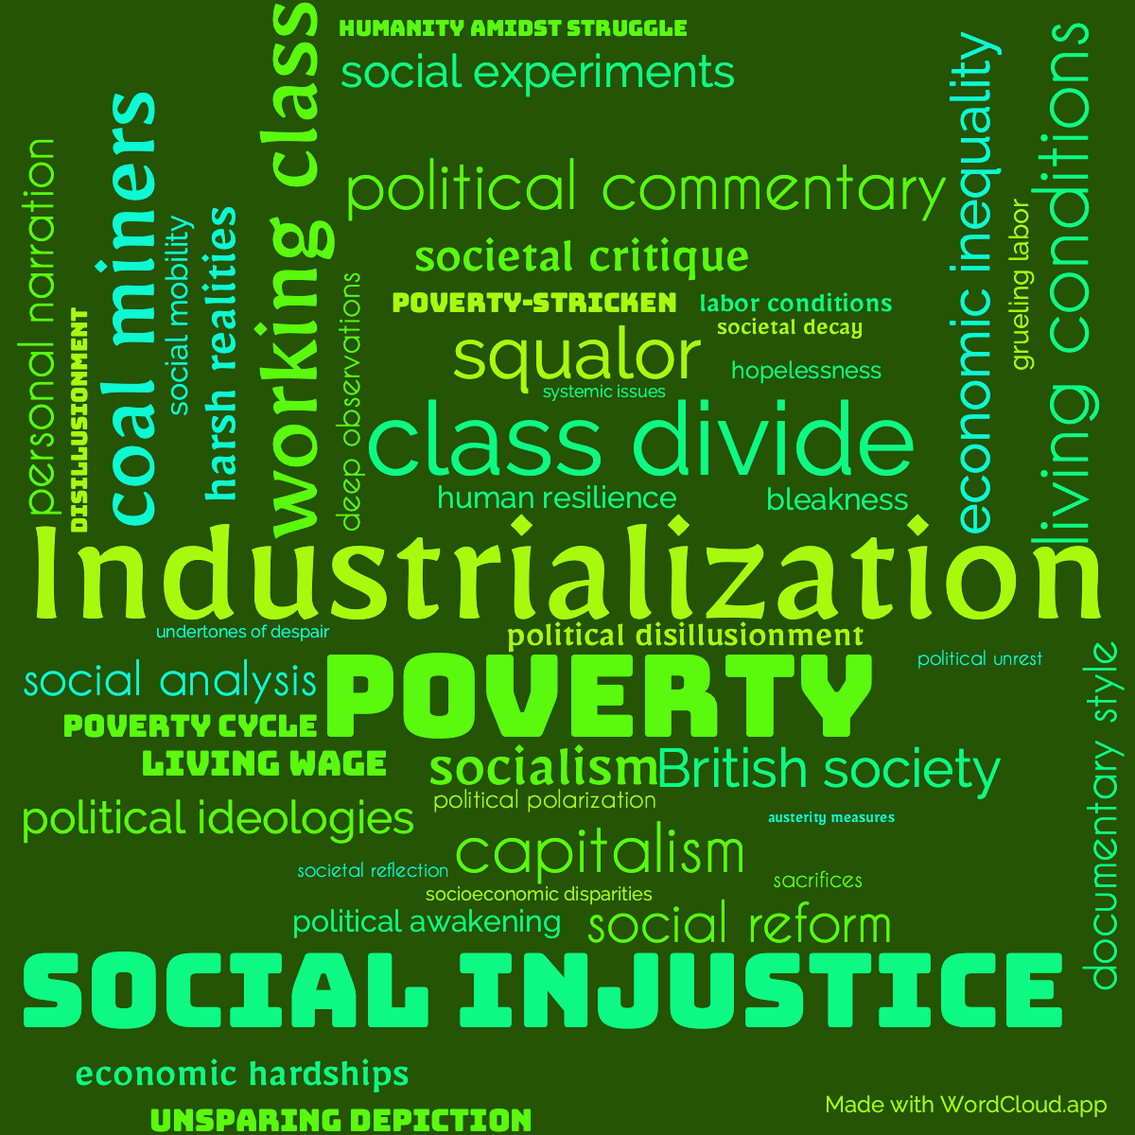
Consequences of inequality
When clients face inequality, they may experience:
Limited access to services and support
Poorer health, housing, or employment outcomes
Less confidence, self-worth, and voice
Exclusion from school, work, or community spaces

Slide 22
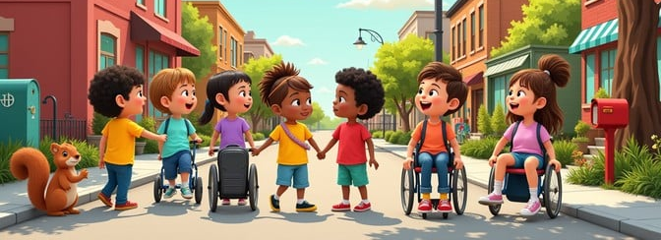
How SETs can contribute to inclusion
SETs can:
notice when someone is being left out
speak up when systems create barriers
adjust communication and expectations
build trust through empathy and reflection
what else?

Slide 23
Reflect
“I used to believe that when parents missed meetings, they didn’t care. I’ve since learned that many are juggling jobs, caregiving, and barriers I don’t see. That belief came from privilege and made me less compassionate. Now, I check in and offer flexible options.”
Answer these questions on your own:
Think of a time when you made an assumption about a client or family
Where might privilege or bias have played a role?
What would you do differently now?

Slide 24
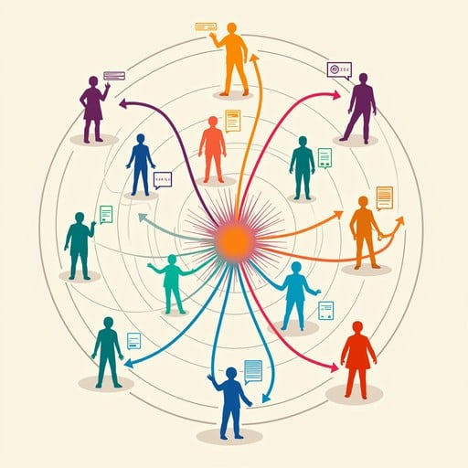
3. Social Context
Social context refers to the environments, relationships and cultural factors that shape a person or group’s everyday life.
Social context includes:
  family, peers, neighbourhoods, communities
  schools, education, and health care systems
  social services
  laws and legislation
  social policies that affect participation (inclusive education policy, access to services)
  cultural norms and societal expectations
Notes:
Image from <a href="https://stockcake.com/s?q=social%20context">Stockcake</a>

Slide 25
Social constructs shape policies
Social constructs are shared ideas or beliefs society treats as ‘natural’ (even though they are created).
They are often related to customs and culture.
They influence how policies are made.
Examples of social constructs:
  What counts as a ‘normal’ family, or ‘normal’ behaviour
  Expectations around gender roles
  Ideas about ability and disability
  Language and ‘official’ communication styles

Slide 26
Social policies that affect participation
Policies can either support or block social inclusion.
For example:
  ✅ An inclusive education policy can mean that students with disabilities get classroom support
  ❌ No transportation subsidies can mean that rural clients have limited access to services
  ✅ Translation services for parents means that their participation in their children’s school life can improve
  ❌ Strict attendance rules might penalize children in unstable homes

Slide 27
Example: Daniel’s case study
Policies can either support or block social inclusion.
POLICY | EFFECT
Inclusive Education law | Allows Daniel to be placed in mainstream classroom with support (protective factor)
No translation services for IEP meetings | Mother cannot fully participate in planning (risk factor)

Slide 28
The more
obstacles, challenges,
lack of support,
and liabilities,
that a client has,
the less that client will be able
to manage their life.
These are risk factors.
The more
strengths,
supports,
and assets,
that a client has,
the better that client will be able
to manage their life.
These are protective factors.
Notes:
Risk factors and protective factors
Excellent information and chart about risk and protective factors here:
http://ctb.ku.edu/en/table-of-contents/analyze/choose-and-adapt-community-interventions/risk-and-protective-factors/main

Slide 29
Risk factors and protective factors
Risk and protective factors exist at many levels:
  Personal/individual (temperament, coping skills, trauma history, resilience)
  Family (parental support, family conflict)
  Peer (supportive friends, bullying)
  Environmental (community engagement, neighbourhood safety, access to services)
  Societal/structural (laws, social policies, discrimination)
All levels interact: social context can shape, strengthen, or weaken personal risk or protective factors
As SETs, we need to look at the whole picture, not just the individual

Slide 30
Risk factors and protective factors
RISK FACTORS | PROTECTIVE FACTORS
Make it harder for someone to participate | Help a person feel safe and included
Conditions or barriers that increase the likelihood of negative outcomes | Conditions or supports that increase the likelihood of positive outcomes
Contribute to exclusion, isolation, or disengagement | Help individuals feel accepted and valued
Can lead to withdrawal, emotional distress, or reduced opportunities | Encourage resilience, participation, and personal development
Often related to systemic issues, personal challenges, or social disadvantages | Often found in the individual’s environment (family, school, services, community)
May intensify the impact of stress, trauma, or marginalization | Can buffer the impact of challenges or adversity

Slide 31
Social determinants of health that can be risk factors or protective factors
Aboriginal status
Gender
Disability
Housing
Early life
Income, income distribution
Education
Race
Employment, working conditions
Social exclusion
Food insecurity
Social safety net
Health services
Unemployment, job security
Notes:
Among the variety of models of the social determinants of health that exist, the one developed at a York University Conference held in Toronto in 2002 has proven especially useful for understanding why some Canadians are healthier than others.
Each of these social determinants of health has been shown to have strong effects upon the health of Canadians. Their effects are actually much stronger than the ones associated with behaviours such as diet, physical activity, and even tobacco and excessive alcohol use.
In which of these 14 areas do you think SETs can intervene effectively?

Slide 32
Categories of risk and protective factors
Individual/personal factors
Biology/genetics/mental health
Knowledge and skills
Experience and history
Coping style/temperament
Social/environmental factors
Family (support, stability)
Peer relationships
Community/neighbourhood
Support and services
Culturela identity and belonging
Access, barriers, and opportunities
Policies and living conditions/poverty
Notes:
All of these factors can increase risk (make things harder) or build protection (help buffer challenges).

Slide 33
Social context: the link to risk and protection
Social context shapes which risk and protective factors are present or possible.
Examples:
  A supportive school (social context) can build self-esteem (personal protection).
  Living in poverty (social context) increases stress and can impact mental health (personal risk).
  Community programs (social context) offer coping skills and connections (personal and social protection).
We should consider both personal and social/environmental factors in every client’s story.
Notes:
All of these factors can increase risk (make things harder) or build protection (help buffer challenges).

Slide 34
ACTIVITY: Identify Daniel’s risk & protective factors
CATEGORY | RISK FACTOR | IMPACT | PROTECTIVE FACTOR | IMPACT
SOCIAL / ENVIRONMENTAL
EDUCATIONAL
FAMILY / PEER
SOCIETAL / SYSTEMIC
INDIVIDUAL / PERSONAL
Notes:
Review Daniel’s case study once again, and fill in the chart with possible or actual risk and protective factors.
For each one, describe the impact it might be having on Daniel.
Identify how these different risk and protective factors might be interacting? Where can we, as SETs, intervene?

