Slide 1

02FL part A
Adopt Safe Working Practices
CLUSTER A
Social Participation

Slide 2
Resources to help with this competency
Ergonomics in the workplace
CNESST
Health and safety act (Quebec)
Workplace Sanitary Standards

Slide 3
02FL Adopt Safe Working Practices (Part A)
02FL-1 Mitigate the risks in the work environment
Stringent application of infection prevention and hygiene measures
Compliance with the rules governing workplace ergonomics
Application of appropriate injury and accident prevention methods
02FL-2 Help the person with medical care and movement
Application of medication distribution and administration protocols Application of the principles for moving a person safely
Careful application of first aid techniques
55% of the final grade for 02FG will be evaluated in this assignment

Slide 4
02FL Adopt Safe Working Practices (Part A)
Written portion of the evaluation
1. Candidates will write about an agency’s policies on infection, ergonomics
2. Candidates will complete charts for breaths/ pulse and SAMPLE.
3. Candidates will complete medication distribution form and describe protocol for documenting errors.

Slide 5
Important Terms
Infection control – the set of methods used to control and prevent the spread of disease
Infections - are caused by pathogens (germs)
Communicable disease – disease spread from one person to another
Infectious disease – disease caused by a pathogen (germ or bacteria)
Contaminated – means dirty, soiled, unclean
Disinfection – cleaning so that germs (pathogens) are destroyed
Mode of transmission – the way germs are passed from one person to another
Mucous membranes – membranes that line body cavities that open to the outside of the body

Slide 6
Modes of transmission
Body fluids – tears, saliva, sputum (mucus coughed up), urine, feces, semen, vaginal secretions, pus or other wound drainage, blood
Touching the infected person or their secretions
Touching something contaminated by the infected person.
Droplets – coughing, sneezing, laughing, spitting, talking

Slide 7
Portals of Entry
Any body opening of an uninfected person which allows pathogens to enter
Nose, mouth, eyes, rectum, genitals and other mucous membranes
Cuts, abrasions or breaks in the skin

Slide 8
WHO IS AT RISK?
Anyone whose resistance to disease decreases – youngest and oldest members of society
Reasons for lowered resistance: age, existing illnesses, fatigue and stress
Older adults have weaker immune systems and a lower resistance to pathogens – recovery is also longer
Older adults are hospitalized more often, increasing the chance for hospital-acquired infections

Slide 9
UNIVERSAL PRECAUTIONS
Universal precautions are infection control guidelines designed to protect workers from exposure to diseases spread by blood and certain body fluids
Always treat blood, body fluids, broken skin and mucous membranes as if they were infected
Always follow Universal Precautions because you cannot tell by looking at a person whether they have a contagious disease
Use practical, common sense
Wash your hands before putting on gloves and immediately after removing gloves
Do not touch clean objects with contaminated gloves
Wear gloves if you may come in contact with blood, body fluids, secretions and excretions, broken or open skin, human tissue of mucous membranes
Bag all disposable contaminated supplies
Clean all surfaces that may be contaminated with infectious waste, such as beds, wheelchairs and shower chairs

Slide 10
Policies / actions
Good hand washing is the most effective method to prevent the spread of infection
May use an alcohol-based hand cleaner in place of washing with soap and water
Avoid touching eyes, nose or mouth
Cover your nose and mouth with a tissue every time you cough or sneeze
Throw used tissue in a wastebasket
If you don’t have a tissue, sneeze or cough into your sleeve
Always clean your hands after coughing or sneezing

Slide 11
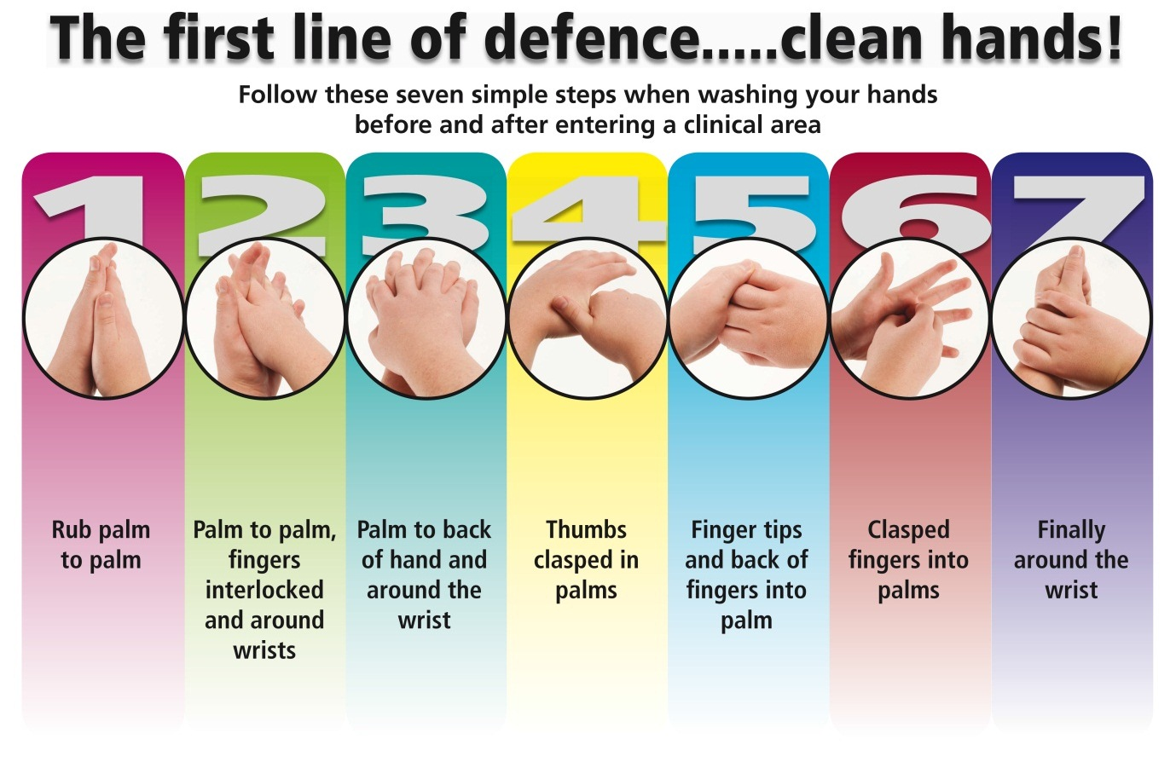
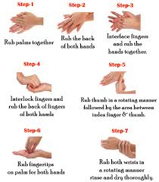
HAND WASHING
Video
Remove any jewelry or watch
Wet hands with warm, running water
Add soap
Rub hands vigorously for 20 seconds, washing all surfaces (about the time it takes to sing “Happy Birthday” twice)
Rinse, keeping fingers pointing down
Dry with paper or clean cloth towel
Turn off faucet with towel and open door with towel

Slide 12
WATERLESS HAND SANITIZER
Make sure all visible dirt is removed from your hands. They are not effective if dirt is visible on your hands.
Apply a dime sized amount of waterless hand sanitizer to the palm of one hand or use a waterless hand sanitizer wipe
Rub hands together covering all surfaces of hands and fingers
Rub until waterless hand sanitizer is absorbed

Slide 13
WHEN SHOULD I USE GLOVES ?
When you may come in contact with blood or any body fluids, open wounds, or mucous membranes
Performing or helping with mouth care
Performing or helping with perineal care
Performing care on a consumer who has broken skin
When you have open sores or cuts on your hands
When shaving a consumer
When disposing of soiled bed linens, gowns, dressings and pads

Slide 14
WHEN SHOULD I CHANGE GLOVES?
When touching surfaces that may be contaminated
Right before contact with mucous membranes or broken skin
Immediately if they become wet, worn, soiled or torn

Slide 15
Protocol for putting on GLOVES
1. Remove any sharp jewelry
2. Remove glove from box. Gloves come in small, medium and large. Most are rubber latex and are pre-powdered. Those who are allergic to latex should use vinyl gloves.
3. Hold glove with your thumb and forefinger and insert hand into gloves
4. Work fingers into proper places

Slide 16
REMOVING GLOVES WITHOUT CONTAMINATING YOUR HANDS
1. Pinch the palm of one glove and pull away from the palm.
2. Push the fingers of the pinching hand up inside the other glove, stretching the material of the glove towards the cuff of the other glove until it emerges by the wrist.
3. Pull the fold down until the glove is almost off (you will be pulling the glove inside-out).
4. DO NOT take the glove completely off.
5. Hook the ungloved thumb between the wrist and the skin of the other gloved hand and pull down, pulling both gloves off. (Both gloves will now be inside out.)
6. Dispose of the gloves properly.
VIDEO

Slide 17
GENERAL GUIDELINES
Wear gloves when handling soiled linens
Fold or roll linen so that the dirtiest area is inside
Hold and carry dirty linen away from your body
Do not shake dirty linen or clothes
Use appropriate receptacles for disposal
Do not touch the inside of any disposal container
Do not use “re-usable” equipment again until it has been properly cleaned
Never use disposable equipment more times than recommended by the manufacturer

Slide 18
SPILLS
Put on clean gloves
Wipe up immediately by cleaning from the outside (cleanest) to the inside (dirtiest)
Use the appropriate cleaning agent
Never pick up glass, even with gloved hands
Dispose of gloves and cleaning equipment and supplies

Slide 19


Ergonomics
Ergonomics in your workplace
Webster Dictionary: an applied science concerned with designing and arranging things people use so that the people and things interact most efficiently and safely called also biotechnology, human engineering, human factors
the design characteristics of an object resulting especially from the application of the science of ergonomics

Slide 20
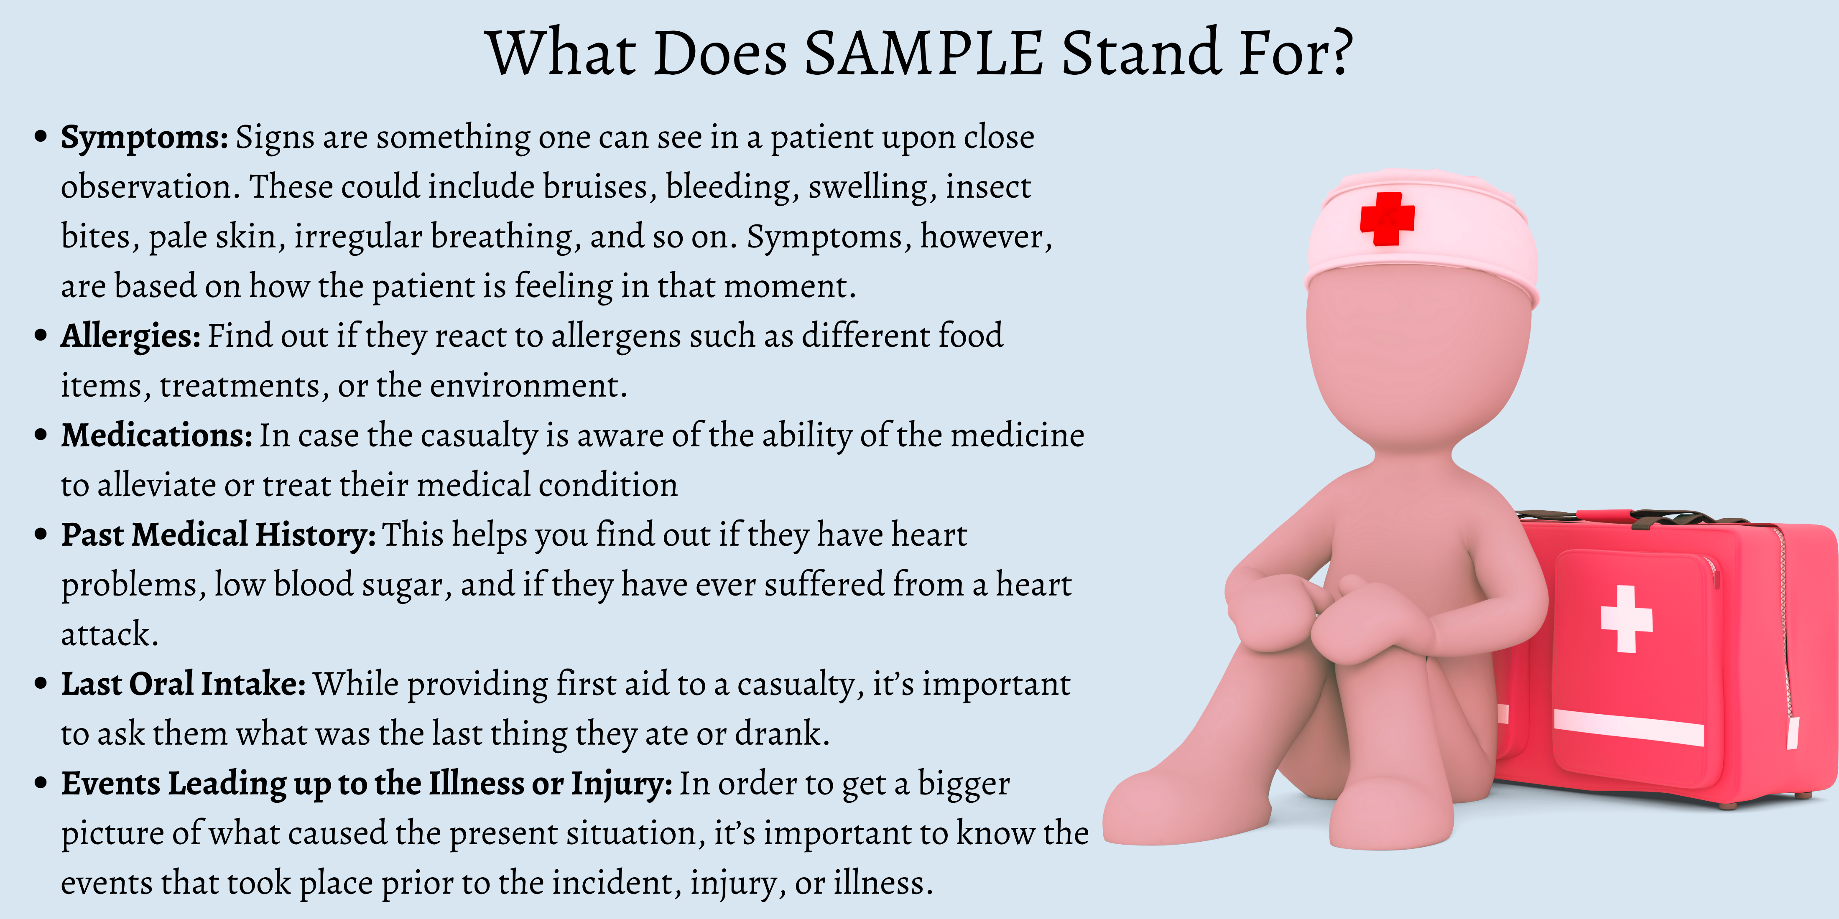
S.A.M.P.L.E. Video

Slide 21

Medications
PRN
Policies
Dangers

Slide 22


Ensure you read through the resources on the website

