Slide 1

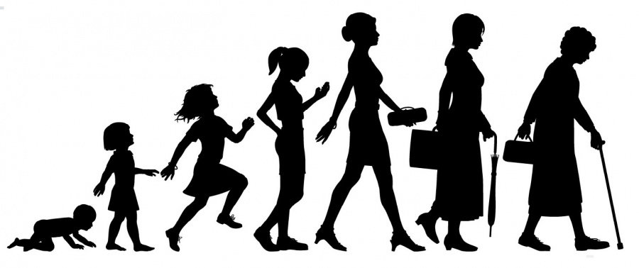
Cluster A
02FJ
Situate the person from a developmental standpoint
SPECIAL EDUCATION TECHNIQUES

Slide 2

Introduction to the Theories
Related to Human Development

Slide 3
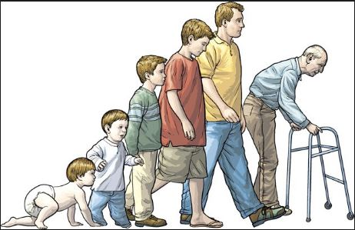

Introduction: A Framework for Understanding
This is the first seminar in a series of seminars in which
we explore human development across the lifespan.
Notes:
SETs need to know and understand human development in order to make accurate observations and plan effective interventions.

Slide 4

Normal Development- A Lifespan Approach
A lifespan approach to normal development recognizes the great complexity in factors that contribute to human change. Studying development using the lifespan perspective illustrates how lives are unique.
Notes:
This approach recognizes the great complexity in factors that contribute to human change. Studying development using the lifespan perspective illustrates how lives are unique.
It contains information about who we are and how we came to be the way we are and where our future will lead us.
This perspective shows that development involves both growth and decline as well as changes that occur from conception to birth.
Understanding the lifespan perspective helps us to answer questions about pressures on the family and problems facing educators.
This approach helps us explain and understand the extend to which our development is affected by biological inheritance and environmental experiences.

Slide 5
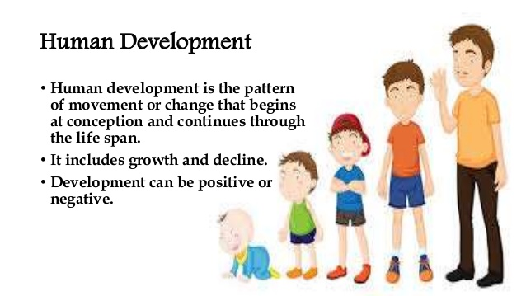

Slide 6

Theories of Human Development
To understand human development across the lifespan, it is helpful to understand some of the theories of human development.

Slide 7
Theories
What is a theory?
  Orderly set of ideas which describe, explain, and predict behavior.
Why are theories important?
  To give meaning to what we observe.
  As a basis for action -- finding ways to improve the lives and education of children.

Slide 8
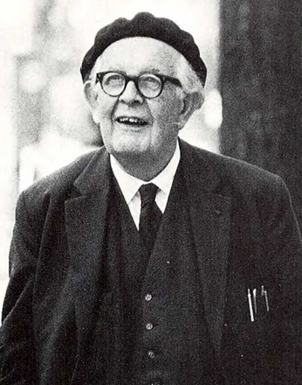
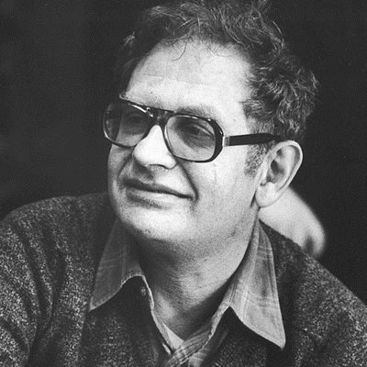
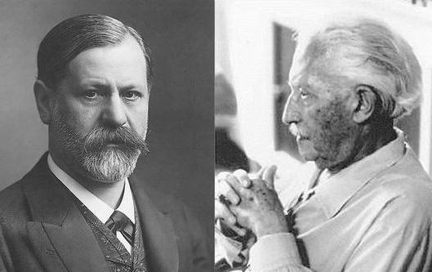
Theories Related to Normal Development
Piaget, Erikson, Freud and Kohlberg are theorists who have contributed greatly to our understanding of human development.

Slide 9
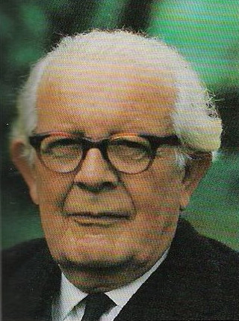
Jean Piaget (1896-1980)
Cognitive development theory
Children "construct" their understanding of the world through their active involvement and interactions.
Studied his 3 children to focus not on what they knew but how they knew it.
Described children's understanding as their "schemas” and how they use:
  assimilation
  accommodation

Slide 10
Piaget’s Cognitive
Development Stages
Sensori-motor
  Ages birth - 2: the infant uses his senses and motor abilities to understand the world
Preoperation
  Ages 2-7: the child uses metal representations of objects and is able to use symbolic thought and language
Concrete operations
  Ages 7-11; the child uses logical operations or principles when solving problems
Formal operations
  Ages 12 up; the use of logical operations in a systematic fashion and with the ability to use abstractions

Slide 11
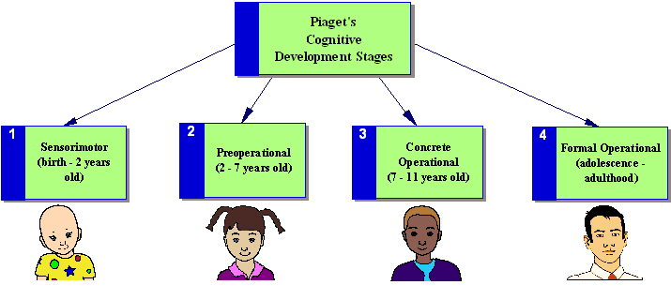
Watch this short video about
Piaget’s Theory of Cognitive Development
Piaget’s Theory of Cognitive Development
Notes:
Watch this short video and then be prepared to discuss 2 examples of child behaviour related to the stages of development.

Slide 12
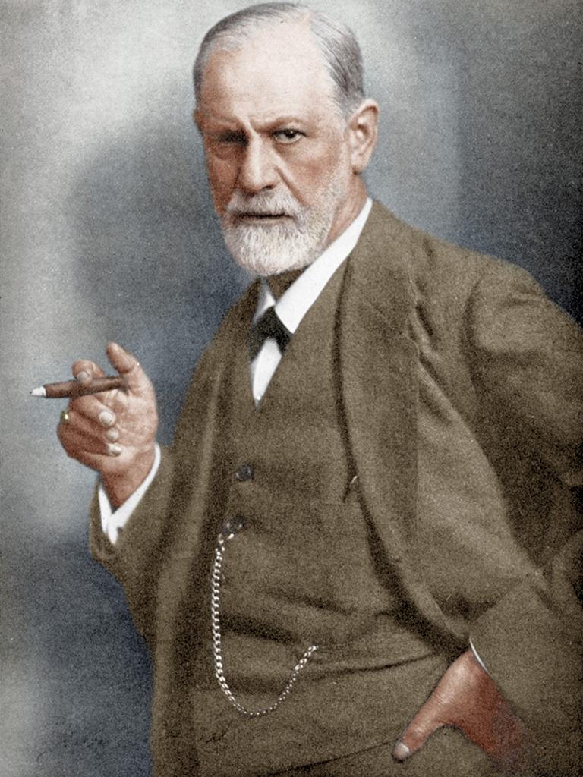
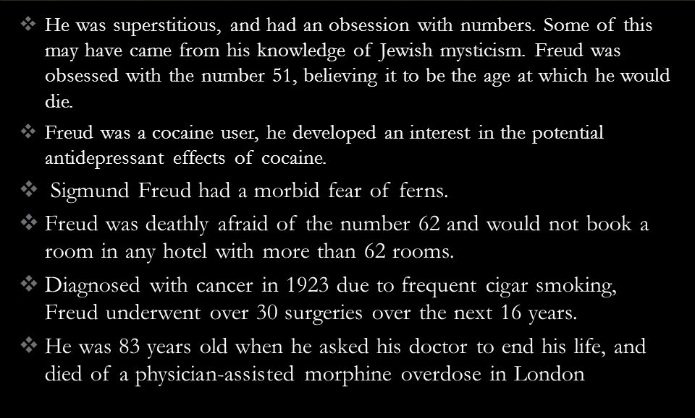
SIGMUND FREUD (1856-1939)

Slide 13
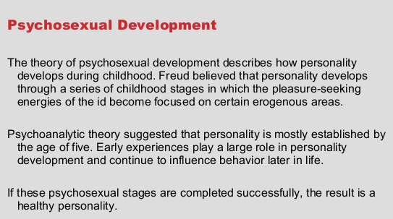
FREUD’S THEORY OF PSYCHOSEXUAL DEVELOPMENT

Slide 14
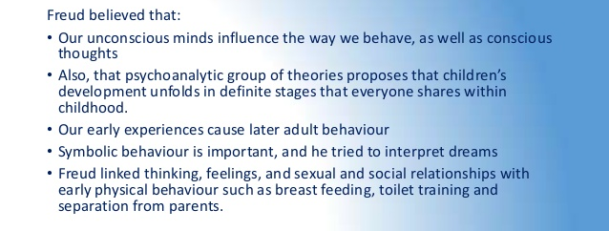
Notes:
Click on the link above: Erik Erikson’s Theory of Development: A Teacher’s Observations and read the article
Make sure to also read the Erik Erikson Article: click on the link above

Slide 15
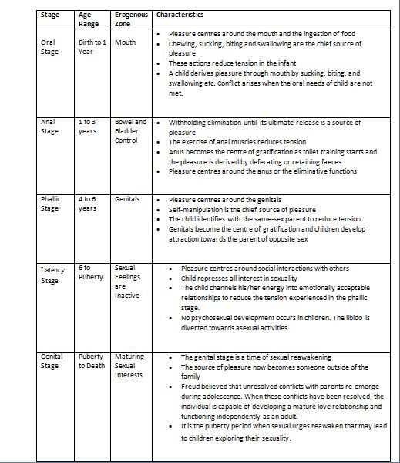
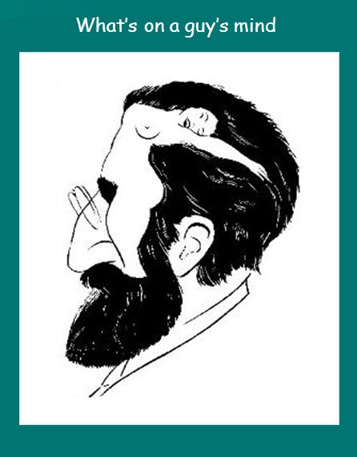
FREUD’S FIVE STAGES

Slide 16
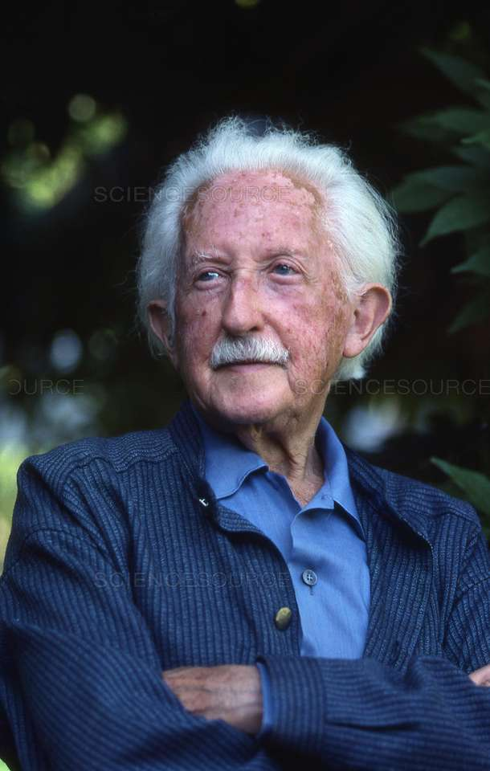
Erik Erikson (1902 -1994)
Father abandoned before born
irriguIar work in Europe without identity
Took a job as a teacher for children of Freud’s patients
Trained in psychoanalysis (ie Freud)
Took name of Erikson (son of himseIf) symboIyzing fuII attainment of sense of identity

Slide 17

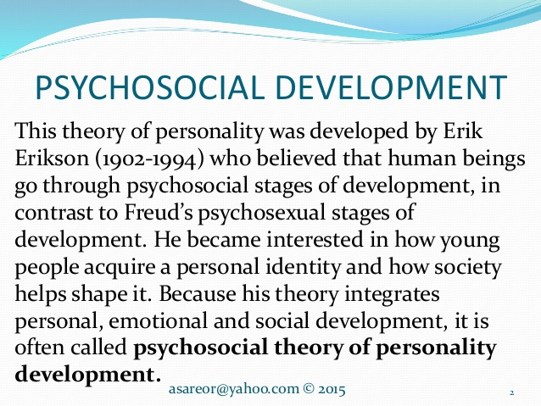
Erik Erikson – Psychosocial Theory

Slide 18
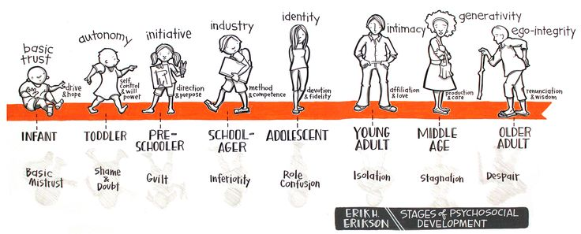
Erikson

Slide 19
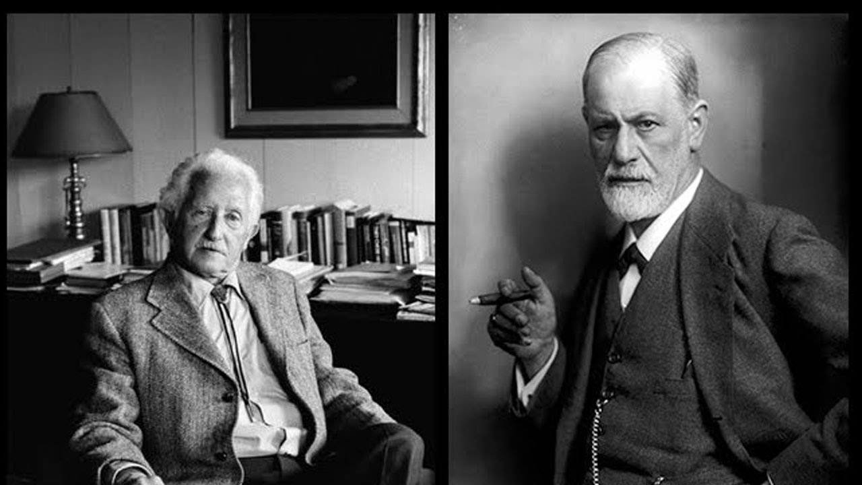
Erikson’s Theory of development
Erik Erikson did most of his work in the post-Freudian era, in the 1930s to the 1950s.

Slide 20
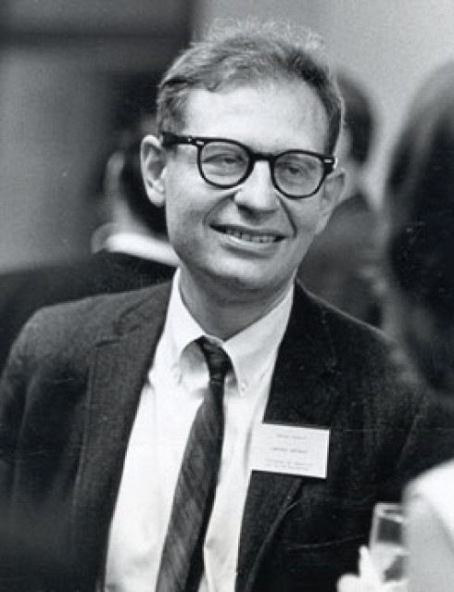
Lawrence Kohlberg (1927 -1987)
American Psychologist
After World War II he helped smuggle Jewish refugees into Palestine & was imprisoned in Cyprus
When he returned to the US he completed his PhD in Psychology and went on to create the theories on Moral development
His stages were influenced by Piaget’s work
Heinz dilemma
His work was criticized for focusing on Individualistic societies and men
Battled depression and a parasitic infection. Died by suicide

Slide 21
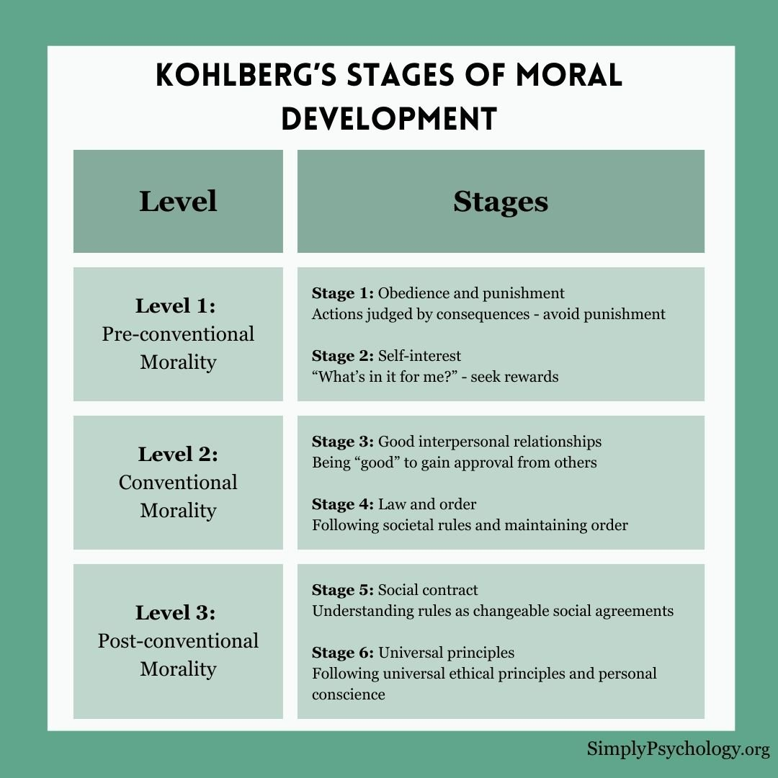
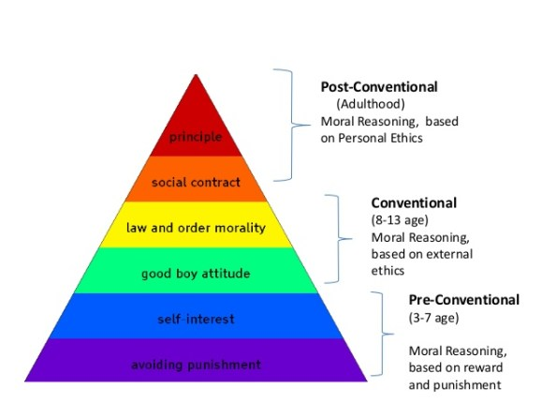

Slide 22
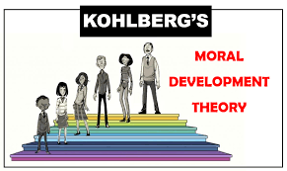
Video & reading
Kohlberg video
Kohlberg’s stages of Moral Development Reading

Slide 23
Developmental Domains Explained
Physical /Sexual domain includes:
  body size, body proportions, appearance, brain development, motor development, perception capacities, physical health. Sexual identity, gender identity, intimate relationships, sexual pleasure and stimulation, hormonal changes, Freud’s stages
Social/Emotional/ moral domain includes:
  self-knowledge (self-esteem, sexual identity, ethnic identity), moral reasoning (Kohlberg's theory) , affect, understanding and expression of emotions, self-regulation, temperament, personality, understanding others, interpersonal skills, and friendships, Erikson’s stages
Cognitive domain includes:
  thought processes and intellectual abilities including attention, memory, problem solving, imagination, creativity, academic and practical knowledge, development of speech, vocabulary, learning styles, conversation, grammar, reading skills, retrieving words, expressing oneself, metacognition, Piaget’s stages

Slide 24

What is child development?
For the purpose of this seminar, early child development entails the biological, psychological and emotional changes that occur in human beings between birth and age 5, as the individual progresses from dependency to increasing autonomy.
This process involves learning and mastering skills like sitting, walking, talking, and tying shoes. Children learn these skills, called developmental milestones, during predictable periods.
Notes:
What a child experiences during the early years sets a critical foundation for the entire life course. This is because early child development, including health, physical, social/emotional and language/cognitive domains strongly influences basic learning, school success, economic participation, social citizenry and health.

Slide 25

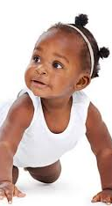
PHYSICAL/ SEXUAL DOMAIN
(0-12)

Slide 26
PHYSICAL/SEXUAL | SOCIAL/ EMOTIONAL / MORAL | COGNITIVE
Average North American newborn: 20 inches long, 7.5 pounds
Most newborns lose 5-7 % of their birth weight upon adjustment to feeding
Birth weight is doubled by 4 months; tripled by 1st birthday
Infants grow about 1 inch per month during their first year
Watch this video:
Physical and Cognitive Development in Early Childhood

Slide 27
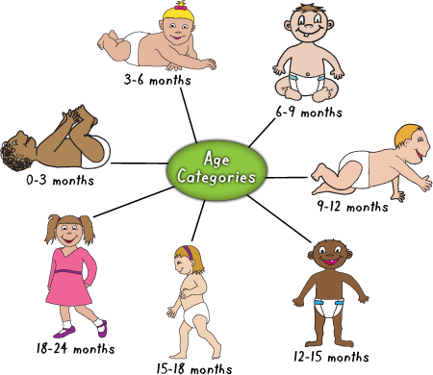
PHYSICAL/SEXUAL | SOCIAL/ EMOTIONAL / MORAL | COGNITIVE
Children 0-2: Stepping/Walking
Children can alternate feet by 6-7 months
Children must be able to stand to step before they are able to step spontaneously (10 months)
The alternate stepping motion is evident long before they start walking
Walking at this time is not possible until other component skills are mastered
Most children only master walking at the age of 12-15 months when all the component skills have been mastered
Notes:
The alternate stepping motion is evident long before they start walking.
Walking at this time is not possible until other component skills are mastered.
Infants learn to run a few months after they learn to walk
Running is more complex because children must learn to propel themselves into the air and to maintain their balance when they land.

Slide 28

PHYSICAL/SEXUAL | SOCIAL/ EMOTIONAL / MORAL | COGNITIVE
Children 2 years: Growth
Weigh approximately 26-32 pounds
About 32-35 inches tall
Children gain approximately ¼ - ½ pound per month
Children attain about 1/5 of their adult weight
Nearly half of their adult height
Notes:
At 2 years:

Slide 29

PHYSICAL/SEXUAL | SOCIAL/ EMOTIONAL / MORAL | COGNITIVE
Reaching and Grasping
Children can reach for objects at 4 months but are very clumsy
They don’t reach directly towards the desired object
At 4 months, most use their fingers to hold an object
They begin using their thumb at 7-8 months
4 month olds use both hands but not in sync
At 5-6 months, they begin to be able to use both hands to do different actions
2 year olds rotate their hand at the wrist
Notes:
Eye-hand coordination improves quickly
Children are ready to eat with a spoon at about 1 year
They don’t use their wrist
Development involves mastering the separate elements and then putting them together in sequence to form a smoothly functioning whole

Slide 30
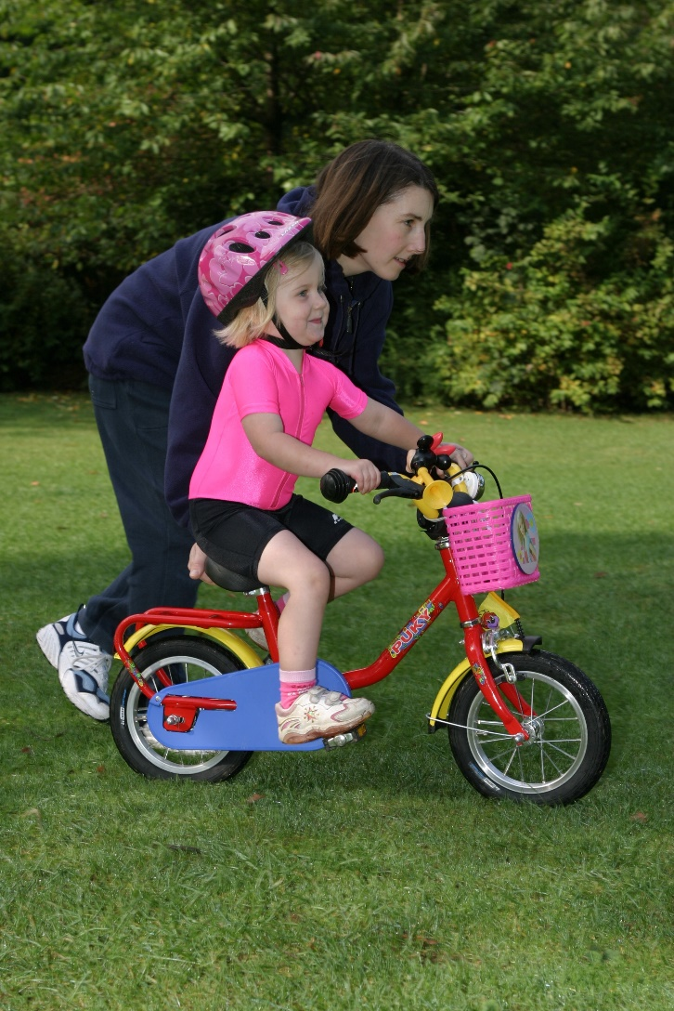
PHYSICAL/SEXUAL | SOCIAL/ EMOTIONAL / MORAL | COGNITIVE
Motor Skills
Motor skills = coordinated movements of the muscles and limbs
Fine-motor skills = reaching, grasping, holding and manipulating
Gross-motor skills = coordination of large muscle groups (crawling & walking)
Locomotion = using the body to move about in the world

Slide 31
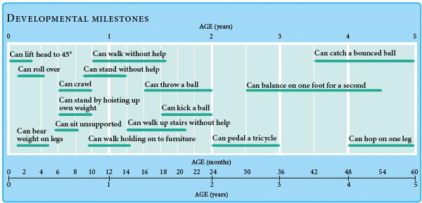
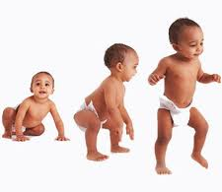
PHYSICAL/SEXUAL | SOCIAL/ EMOTIONAL / MORAL | COGNITIVE
Children 0-5: Motor Skills
Notes:
2 months: can sit with support
6-7 months: can sit upright without support
8 months: can pull themselves up and hold onto a chair
10-12 months: can stand alone
13-18 months: can use hands and legs to climb up a few stairs
18-24 months: can walk quickly or run stiffly; can walk backwards without losing balance; can jump in place

Slide 32

PHYSICAL/SEXUAL | SOCIAL/ EMOTIONAL / MORAL | COGNITIVE
At 2 years old:
Children become more comfortable with motion, increasing speed, and coordination
Most begin to:
    Run forward
    Jump in place with both feet together
    Stand on one foot, with aid
    Walk on tiptoe
    Kick ball forward
Notes:
Eye-hand coordination improves quickly
Children are ready to eat with a spoon at about 1 year
They don’t use their wrist yet
Development involves mastering the separate elements and then putting them together in sequence to form a smoothly functioning whole

Slide 33
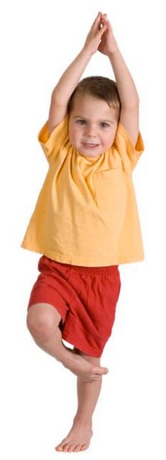
PHYSICAL/SEXUAL | SOCIAL/ EMOTIONAL / MORAL | COGNITIVE
At 3 years old:
Movement and balance improve
Most children can:
    Run around obstacles
    Walk on a line
    Balance on one foot
    Push, pull, and steer toys
    Ride a tricycle
    Use a slide without help
    Throw and catch a ball

Slide 34

PHYSICAL/SEXUAL | SOCIAL/ EMOTIONAL / MORAL | COGNITIVE
At 4 years old:
Children are now more confident, and most are able to:
  Walk backwards
  Jump forward many times without falling
  Jump on one foot
  Walk up and down stairs without assistance, alternating feet
  Turn somersaults

Slide 35
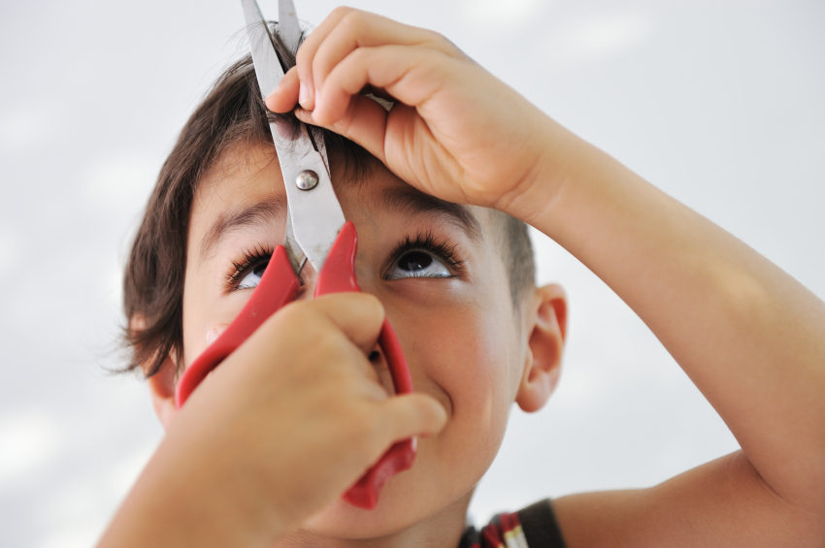
PHYSICAL/SEXUAL | SOCIAL/ EMOTIONAL / MORAL | COGNITIVE
At 5 years old:
Children develop fine motor skills that will help them as they enter school and begin writing.
Most can:
  Use safety scissors
  Cut on a line continuously
  Copy squares and crosses
  Print a few capital letters

Slide 36

PHYSICAL/SEXUAL | SOCIAL/ EMOTIONAL / MORAL | COGNITIVE
Posture / Balance
Newborns can’t sit upright because of the shape of their body and large heads
Only with normal growth of the legs and muscles will the infant maintain an upright posture
Practice, behavioural control and the development of the large muscle groups help locomotion

Slide 37
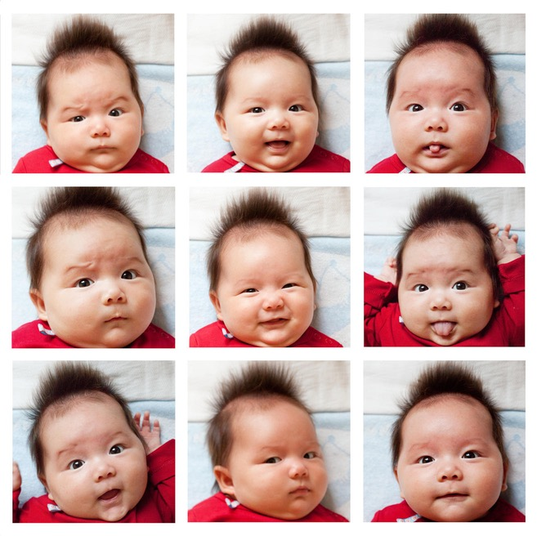
PHYSICAL/SEXUAL | SOCIAL/ EMOTIONAL / MORAL | COGNITIVE
Infants: Facial expressions
Emotions are evident very early in life
Facial expressions are one component of emotion
Some of the physiological responses that accompany facial expressions are the same in infants and adults
By 5-6 months, facial expressions change predictably and meaningfully in response to events
Half way through the first year of life, facial expressions are quite reliable indicators of an infant’s emotional state
Notes:
Milestones
1 month – responsive smile
2-3 months – recognizes parents
6 - 8 months – stranger anxiety, responds to name
10 months – repeats performance laughed at, waves bye, separation anxiety, social games
15 months – “mine”, gives hugs
18 months – seeks affection
24 months – parallel play, smiles with praise, tantrums, imitates
30 months – transitional objects, independence
36 m – make-believe, cooperative play, delayed gratification, shows off

Slide 38

Visit this website where you can read and/or listen to understand more about children’s early sexual development.
http://kidshealth.org/en/parents/development.html
Notes:
“Naming”:
By 12 months - may understand 100 words – will understand simple command with gesture
By 24 months - no gesture needed with command
By 18 months - uses 25 words spontaneously
Will use word combinations when expressive vocabulary reaches 50 words

Slide 39
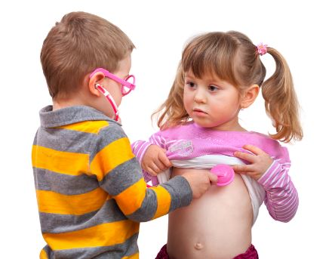
PHYSICAL/SEXUAL | SOCIAL/ EMOTIONAL / MORAL | COGNITIVE
Sexual development
Sexual pleasure by stimulation is present from birth
Sexual drive persists throughout childhood, increases in early adolescence to peak in late adolescence - early adulthood
Masturbation common in toddlers and preschoolers
Sex play - undressing, sexual exploration, interest in the genitalia of siblings and playmates: common and normal during this period
Notes:
Orzu, how can I format photo so text is in between or behind?

Slide 40
PHYSICAL/SEXUAL | SOCIAL/ EMOTIONAL / MORAL | COGNITIVE
Gender identity = the degree to which children regard themselves as male or female
  Established by 4 years
Gender role = ability of an individual to carry out the repertoire of behaviours considered appropriate for his or her sex.
  By 3 years children show a preference to particular activities and sex-appropriate toys.

Slide 41
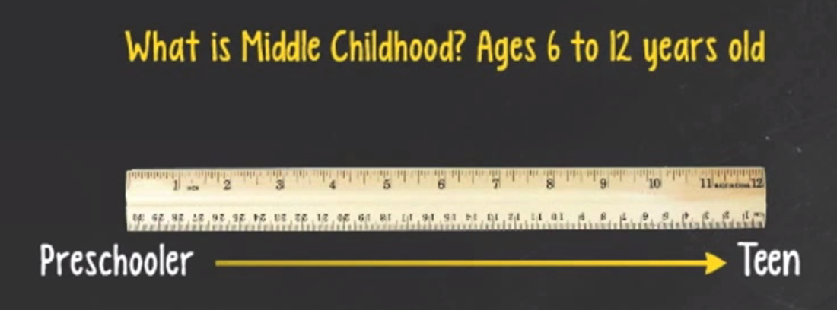
Overview of Development 6-12 years
Watch this video for an overview of the many changes that occur in middle childhood:
https://www.youtube.com/watch?v=OtpiBtL_7zc

Slide 42
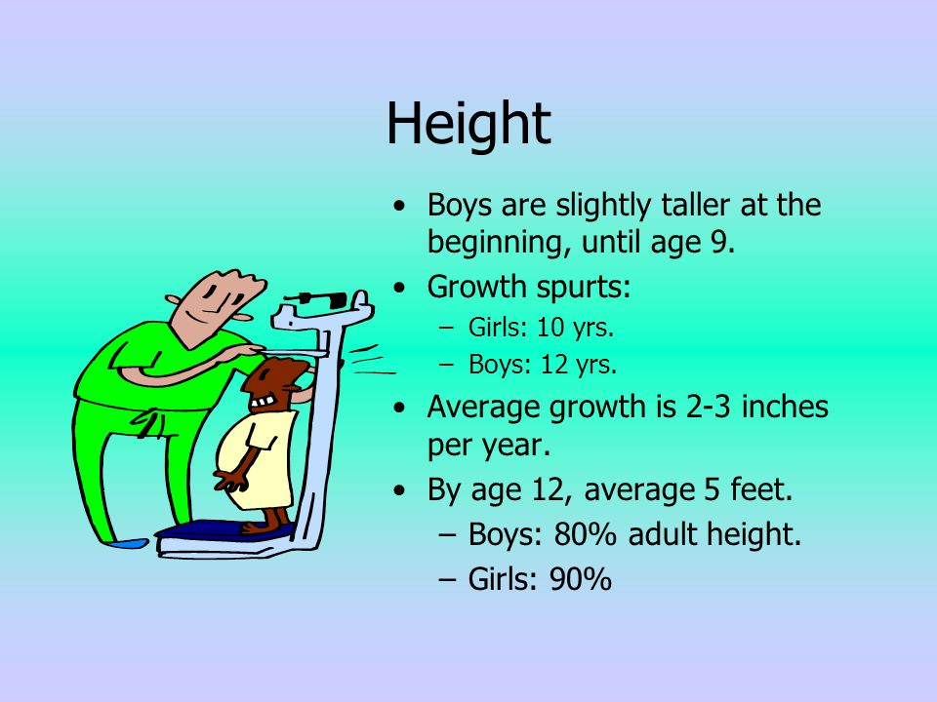
PHYSICAL/SEXUAL | SOCIAL/ EMOTIONAL / MORAL | COGNITIVE
Height
Compared with the swift growth during the first 5 years, physical growth during middle childhood is slow but steady
Growth is about 2-3 inches in height per year
Only time during the life span when girls are, on average, taller than boys
By age 11, the average girl is 4' 10"
The average 11-year-old boy is 4' 9 1/2 “
Variations of a half a foot in children the same age are not uncommon

Slide 43
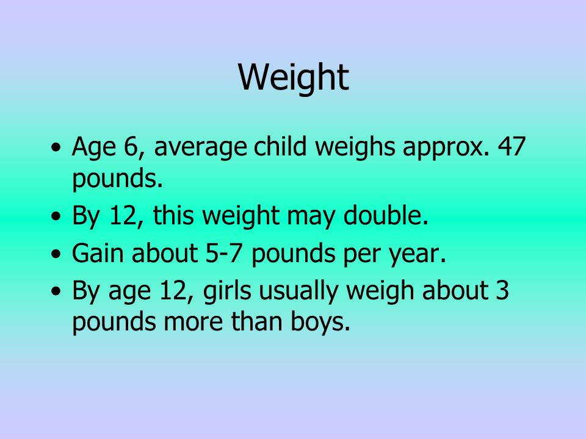

PHYSICAL/SEXUAL | SOCIAL/ EMOTIONAL / MORAL | COGNITIVE
Notes:
Height and weight variations can be affected by poor nutrition and racial or ethnic background

Slide 44
PHYSICAL/SEXUAL | SOCIAL/ EMOTIONAL / MORAL | COGNITIVE
Motor Skills
Motor skills = coordinated movements of the muscles and limbs
Fine-motor skills = reaching, grasping, holding and manipulating
Gross-motor skills = coordination of large muscle groups (crawling & walking)
Locomotion = using the body to move about in the world

Slide 45
PHYSICAL/SEXUAL | SOCIAL/ EMOTIONAL / MORAL | COGNITIVE
Motor Skills
Greater size and strength contribute to better motor skills
Fine motor skills also improve
Boys excel in gross-motor skills which include strength
Girls excel in fine-motor skills as well as gross-motor skills including flexibility and balance

Slide 46
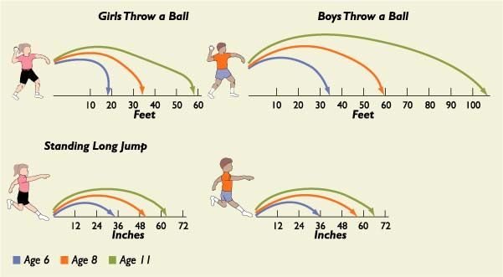
PHYSICAL/SEXUAL | SOCIAL/ EMOTIONAL / MORAL | COGNITIVE
Gross Motor Skills
Notes:
Gross Motor Development
During middle childhood, running, jumping, hopping, and ball skills become more refined.
Motor skills improve in the capacities of flexibility, balance, agility, and force.
Steady improvements also occur in reaction time—11-year-olds can respond almost twice as quickly to a stimulus as 5-year-olds.

Slide 47
PHYSICAL/SEXUAL | SOCIAL/ EMOTIONAL / MORAL | COGNITIVE
Gross Motor Skills

Slide 48
PHYSICAL/SEXUAL | SOCIAL/ EMOTIONAL / MORAL | COGNITIVE
Fine Motor Skills
Improve steadily over the school years.
Gains especially evident in writing and drawing.
Writing tends to be large at first, and legibility gradually increases.
Drawings show gains in organization, detail, and representation of depth.
School-age children not only depict objects in considerable detail, they also relate them to one another as part of an organized whole.

Slide 49
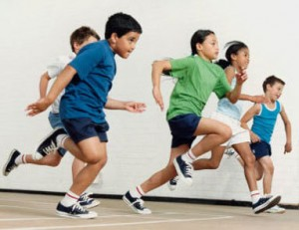
PHYSICAL/SEXUAL | SOCIAL/ EMOTIONAL / MORAL | COGNITIVE
Watch this video on middle childhood physical development:
https://www.youtube.com/watch?v=GLnUHF6717A
Notes:
This video on middle childhood development mentions motor development, gender differences, physical fitness, and children with disabilities

Slide 50
Sexual development
Most sexual play is an expression of children’s natural curiosity and should not be a cause for concern or alarm
In general, “typical” childhood sexual play and exploration…
  Occurs between children who play together regularly and know each other well
  Occurs between children of the same general age and physical size
  Is spontaneous and unplanned
  Is infrequent
  Is voluntary (children agreed to the behaviour, none of the involved children seem uncomfortable or upset)
  Is easily diverted when parents tell children to stop and explain privacy rules
Notes:
For more information on sexual development in middle childhood, see this article: http://nctsn.org/nctsn_assets/pdfs/caring/sexualdevelopmentandbehavior.pdf

Slide 51
Gender identity / role / diversity
Video on gender diversity: https://www.youtube.com/watch?v=c_ACTN-Ua8M
Interesting article on Gender Identity and Stereotyping in Early and Middle Childhood: http://www.csulb.edu/~mhalim/pub/Halim_Ruble_2010_Gender_identity_stereotyping_handbook_chapter.pdf

Slide 52


SOCIAL/ EMOTIONAL/ MORAL

Slide 53

PHYSICAL/SEXUAL | SOCIAL/ EMOTIONAL / MORAL | COGNITIVE
Crying
Newborns spend 2-3 hours crying each day
3 different cries: basic, mad, pain cry
Crying is the first attempt at communicating
LISTEN TO THIS VIDEO: crying child

Slide 54
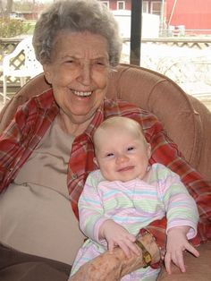
PHYSICAL/SEXUAL | SOCIAL/ EMOTIONAL / MORAL | COGNITIVE
Infants: Smiling
Infants begin to smile a few weeks after birth
Related to internal physiological states
Might happen after feeding or while sleeping
Social smiles begin at 2 months
This happens when they see another human face
Smiling and cooing = expressing pleasure at seeing another person
Smiling is joined to laughter at 4 months
Usually happens when receiving physical stimulation

Slide 55


PHYSICAL/SEXUAL | SOCIAL/ EMOTIONAL / MORAL | COGNITIVE
Infants: Fear
Fear is rare in newborns
First signs evident at 6 months when they fear being in the presence of strangers stranger wariness
Infants are less fearful of strangers when in a familiar environment
Stranger wariness declines in the second year as toddlers learn to interpret facial expressions

Slide 56
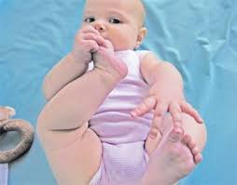
PHYSICAL/SEXUAL | SOCIAL/ EMOTIONAL / MORAL | COGNITIVE
Children 0-1 year: Social development
6-7 months: infants begin to distinguish facial expressions associated with different emotions
Baby girls are more accurate than boys at recognizing adults’ facial expressions of emotion
“Social referencing”: when an infant look at a trusted caregiver when they are in an unfamiliar situation. This helps them know how to react

Slide 57

PHYSICAL/SEXUAL | SOCIAL/ EMOTIONAL / MORAL | COGNITIVE
Attachment
Lays the basic foundation for an infant’s later social relationships in life
Types of attachment:
  Secure attachment
  Avoidant attachment
  Resistant attachment
  Disorganized (disoriented) attachment

Slide 58
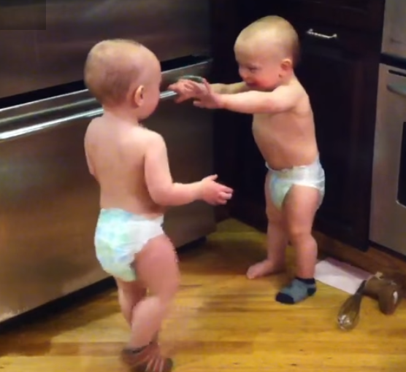
PHYSICAL/SEXUAL | SOCIAL/ EMOTIONAL / MORAL | COGNITIVE
Watch this video!
https://www.youtube.com/watch?v=_JmA2ClUvUY
Social relationships
First social relationship is usually with parent(s)
Peer interaction begins early in infancy
6 months olds will look, point and smile at each other
They then begin to babble and laugh in each other’s presence
From 1 to preschool years, peer relationships become more complex
Non-social play is when children play alone or watch others play
Notes:
Self-awareness begins between 18-24 months.
They will point to pictures in books, possibly recognize themselves in photos.

Slide 59
PHYSICAL/SEXUAL | SOCIAL/ EMOTIONAL / MORAL | COGNITIVE
Temperament= a child’s consistent mood and style of behaviour
Refers to how they do what they do
Evident in the first few weeks after birth
Easy - Happy and cheerful
  Adjusts well to new situations. Has regular routines for eating, sleeping and toileting
Difficult - Often unhappy
  Does not adjust well to new situations. Has irregular routines for eating and sleeping. Tends to withdraw from novel experiences. Reacts intensely to novel situations
Slow-to-warm-up
  Tends to be unhappy and does not adjust well when placed in new situations. Does not react intensely to novel situations
Notes:
Temperament remains important throughout life.
Temperament is somewhat stable during the infant and toddler years.
Newborns who cry under moderate stress tend to (at 5 months) cry when they are placed in a stressful situation.
Depending on the temperament a child has during infancy, the experiences that the parents offer them will be different.
This affects development over the years.
Infants and toddlers with difficult temperaments (resisting control) tend to have behaviour problems and aggression when older

Slide 60
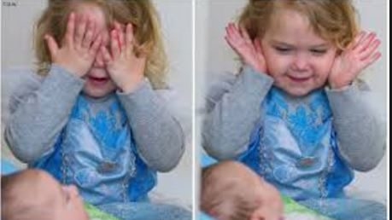
PHYSICAL/SEXUAL | SOCIAL/ EMOTIONAL / MORAL | COGNITIVE
Children 0-2: Play
A few weeks old: social, smiling, moving head to catch the eye of another, copying movements, copy sounds, rhythms
By end of 1st year - claps, smiles, hide and seek
2 years: rhythm, rhymes, stories, songs, dancing, imitation of adults at work, giving and receiving
Notes:
Through play, children learn about themselves, others and the world they live in.
A few weeks old: social, smiling, moving head to catch the eye of another, copying movements, copy sounds, rhythms
By end of 1st year - claps, smiles, hide and seek
2 years: rhythm, rhymes, stories, songs, dancing, imitation of adults at work, giving and receiving

Slide 61
PHYSICAL/SEXUAL | SOCIAL/ EMOTIONAL / MORAL | COGNITIVE
Play at 3 years:
Children enjoy parallel play, engaging in solitary activities near other children
They are likely to:
  Watch other children and briefly join in play
  Defend their possessions
  Begin to play house
  Use objects symbolically in play
  Participate in simple group activities, such as singing clapping or dancing
  Know gender identity

Slide 62
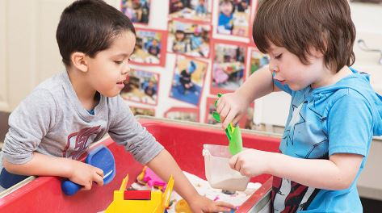
PHYSICAL/SEXUAL | SOCIAL/ EMOTIONAL / MORAL | COGNITIVE
Play at 4 years
:
Children become more interested in other children
They are now more likely to:
  Share toys, taking turns with assistance
  Initiate or join in play with other children and make up games
  Begin dramatic play, acting out whole scenes (such as traveling, pretending to be animals)
Notes:
http://www.pbs.org/wholechild/abc/social.html

Slide 63
PHYSICAL/SEXUAL | SOCIAL/ EMOTIONAL / MORAL | COGNITIVE
Compare themselves with others
Enjoy imaginative play
Express more awareness of other people's feelings
Develop friendships & relationships with other children
Are very interested in relationships with other children
Play at 5 years:
Notes:
Children at this age also show some understanding of moral reasoning, exploring ideas about fairness and good or bad behavior
Bring dramatic play closer to reality by paying attention to detail, time, and space
http://www.pbs.org/wholechild/abc/social.html

Slide 64
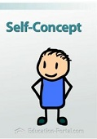
PHYSICAL/SEXUAL | SOCIAL/ EMOTIONAL / MORAL | COGNITIVE
Self-concept in middle childhood
Changes in self-concept during these years
Cognitive, social & cultural Influences
Development of self-esteem
Watch this video about self-concept: https://www.youtube.com/watch?v=naRK-OKOXV8

Slide 65
PHYSICAL/SEXUAL | SOCIAL/ EMOTIONAL / MORAL | COGNITIVE
Self-esteem in middle childhood
Children of this age begin to compare themselves to peers and siblings
Exposed to more feedback about skills and performance
Many do not view themselves positively
25% of 9-10 year olds had negative self-esteem

Slide 66

PHYSICAL/SEXUAL | SOCIAL/ EMOTIONAL / MORAL | COGNITIVE
Influences on self-esteem in middle childhood
High self-esteem linked to:
  Being better liked by peers
  Improved school achievement
Culture
  Social comparisons unhelpful
Child-rearing practices:
    Authoritative best
    Coercive (authoritarian) worst
    Indulgent (permissive) – underachievers
    Neglectful – antisocial, fearful, predelinquent

Slide 67
PHYSICAL/SEXUAL | SOCIAL/ EMOTIONAL / MORAL | COGNITIVE
Self-esteem in middle childhood
Children with low self-esteem are more likely to:
    have problems with peers
    have psychological disorders
    be involved in antisocial behavior
    do poorly in school
Sometimes difficult to establish cause and effect relations regarding low self-esteem
Important to remember that all children have some talents that can be nurtured

Slide 68
PHYSICAL/SEXUAL | SOCIAL/ EMOTIONAL / MORAL | COGNITIVE
Family relationships in middle childhood
Sibling relationships
    Siblings provide emotional support for each other
    Same sex and close in age increases parental comparisons, sibling rivalry
Firstborns under greater parental pressure
Laterborns tend to be more social & popular
Only children: achievement motivation
Parent-child relationships
    Time spent at home declines
    Reasoning becomes an effective parenting tool

Slide 69
PHYSICAL/SEXUAL | SOCIAL/ EMOTIONAL / MORAL | COGNITIVE
Family relationships in middle childhood
Divorce:
  Painful for most children, but most eventually make an adequate adjustment
  Majority live in mother-headed households, low income
  Many children blame themselves for divorce
  High conflict divorce may lead to trauma; maladjustment
  Boys act out, girls internalize
  1/3 have significant long-term problems, especially in high conflict divorces
  Declines in school achievement common
  Greater problems later in adolescence

Slide 70

PHYSICAL/SEXUAL | SOCIAL/ EMOTIONAL / MORAL | COGNITIVE
Peer relations
Peer relations change when children start school
Number of peers increases
Children are exposed to more diverse set of peers than before
Children learn to interact with peers in structured and unstructured times

Slide 71
PHYSICAL/SEXUAL | SOCIAL/ EMOTIONAL / MORAL | COGNITIVE
Peer relations
Children get along better than when they were younger
Better able to resolve conflicts because of greater cognitive and social skills
Perspective-taking plays a large role
They realize that others see the world differently
Spend more time with peers without adult supervision
Maltreatment and abuse can hinder the development of positive peer relations

Slide 72
PHYSICAL/SEXUAL | SOCIAL/ EMOTIONAL / MORAL | COGNITIVE
Peer relations
Development of shared values
Leaders and followers emerge
Peer “cultures” emerge
  Vocabulary similar
  Dress and music similar
  Loyalty to group
  Find neighbourhood places to “hang out”

Slide 73
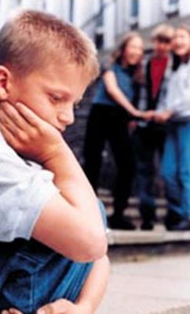
PHYSICAL/SEXUAL | SOCIAL/ EMOTIONAL / MORAL | COGNITIVE
Determinants of peer acceptance
Accepted children: sensitive, friendly, cooperative
Rejected aggressive children: conflict, hostility & ADHD
Rejected withdrawn children: passive, awkward & submissive
Controversial children: hostile, disruptive, positive & pro-social
Neglected children: shy but not unskilled

Slide 74
PHYSICAL/SEXUAL | SOCIAL/ EMOTIONAL / MORAL | COGNITIVE
Friendships
Children with both same- and opposite-sex friends are usually socially-skilled
Children with only opposite-sex friends tend to:
  Be less popular
  Be less academically and socially competent
  Have lower self-esteem
  Be rejected by same sex

Slide 75

PHYSICAL/SEXUAL | SOCIAL/ EMOTIONAL / MORAL | COGNITIVE
Friendships
Children with good friends…
  Have higher self esteem
  Are less likely to be lonely and depressed
  Act prosocially (sharing & cooperating)
  Cope better with life stresses
  Are less likely to be victimized by peers
  Have greater self-worth as young adults

Slide 76
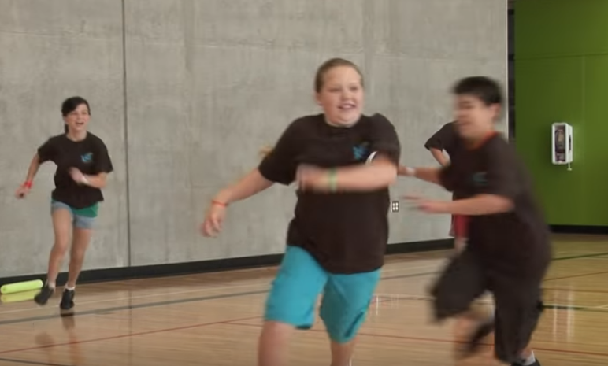
PHYSICAL/SEXUAL | SOCIAL/ EMOTIONAL / MORAL | COGNITIVE
Play
Organized games with rules become common in middle childhood
Maturity in perspective-taking allow children to understand the roles of several players in a game and permit the transition to rule-oriented games
Participation in organized games helps children form more concepts of fairness and justice
Watch this video about play:
  https://www.youtube.com/watch?v=mzpZIRJC82I
Notes:
Through play, children learn about themselves, others and the world they live in.

Slide 77

PHYSICAL/SEXUAL | SOCIAL/ EMOTIONAL / MORAL | COGNITIVE
Watch and listen to this video on middle childhood social/emotional development:
https://www.youtube.com/watch?v=Flhr7gxLp5U
Notes:
This video includes information on familial influences, maternal employment, same-sex parents, the effects of divorce, peer relationships, and school characteristics

Slide 78

Watch this video on development in middle childhood:
https://www.youtube.com/watch?v=swG2DQpNs-k
Notes:
This video explores Piaget’s theory of cognitive development, Kohlberg’s Moral Development Theory, information processing (learning, remembering, problem-solving), language development and literacy

Slide 79


COGNITIVE DOMAIN

Slide 80
PHYSICAL/SEXUAL | SOCIAL/ EMOTIONAL / MORAL | COGNITIVE
Children 0-2 years cognitive development
Babies are not only growing physically during the first 2 years of life, but also cognitively (mentally). Every day while they interact with and learn about their environment they are creating new connections and pathways between nerve cells both within their brains, and between their brains and bodies.
While physical growth and change is easily observed and measured in precise terms such as in inches and pounds, cognitive change and development is a little harder to determine as clearly.
Therefore, much about what experts know about mental and cognitive development is based on the careful observation of developmental theorists and their theories, such as Piaget's theory of cognitive development and Erickson's psychosocial stages.
Bronfenbrenner's ecological model also helps explain infant mental growth to some extent.
Notes:
Read the rest of this article on cognitive development in very young children here: http://www.gracepointwellness.org/461-child-development-parenting-infants-0-2/article/10112-infancy-cognitive-development

Slide 81
PHYSICAL/SEXUAL | SOCIAL/ EMOTIONAL / MORAL | COGNITIVE
Children 3-4 years cognitive development
At this age, most children can:
Identify parts of a whole, like a slice of pie
Draw, name, and briefly explain recognizable pictures that are meaningful to them
Actively seek information through why and how questions
Tell you their full name and age
Attend to an activity for a longer stretch of time (between 5 and 15 minutes)
Learn both by observing and listening to adults' explanations
Show awareness of past and present

Slide 82
PHYSICAL/SEXUAL | SOCIAL/ EMOTIONAL / MORAL | COGNITIVE
Children 3-4 years cognitive milestones
As children have more experiences in the world, their analytic powers grow. For some time, they have been observing and mentally "sorting" objects according to their physical properties. Now most children can:
  Understand concepts like grouping and matching (for example, recognizing and matching colors)
  Organize materials on their own, for example by stacking blocks or rings in order of size

Slide 83

PHYSICAL/SEXUAL | SOCIAL/ EMOTIONAL / MORAL | COGNITIVE
Children 4-5 years Cognitive Development
At this age, children actively seek information and new experiences from the people in their environment. Most can:
  Play with words, mimicking and creating sounds, and make rhymes
  Point to and name many colors
  Understand order and process
  Draw a person with detail
  Draw, name, and describe pictures
  Count to 5
  Tell you their street and town
Notes:
Infant intelligence tests tend to focus on sensorimotor skills and abilities.
Tests for older children and adults focus more on cognitive processes such as language, arithmetic and task of nonverbal problem solving.

Slide 84

PHYSICAL/SEXUAL | SOCIAL/ EMOTIONAL / MORAL | COGNITIVE
Children 0-2 years: Language milestones
1-2 months: cooing – gurgling sounds usually expressing pleasure
8 weeks: smiles and vocalises
12-16 weeks: babbling – strings of consonant-vowel combinations – “ba-ba”, “ma-ma”, ...
4-5 months: appears to be listening to adults
8-12 months: gestures such as showing, pointing, other non-verbal modes of communication: clinging, frowning, kissing, smiling, pushing away, turning head away
Notes:
Language = a form of communication – can be spoken, written, signed, gestured.
Infants make sounds from birth.
Three periods of language development:
– Pre-speech period (0 to 10 months)
– Naming period (10-18 months)
– Word combination period (18-24 months)

Slide 85
PHYSICAL/SEXUAL | SOCIAL/ EMOTIONAL / MORAL | COGNITIVE
Children 2-3 years: Language Milestones
Most 2-3 year-olds can
Point to common objects when they are named
Recount events that happened that day
Enjoy listening to stories and asking for favorite stories
Name objects based on their description
Respond to "what?" and "where?" questions
Join familiar words into phrases
Begin to use modifiers (adverbs and adjectives)
Notes:
Both understanding of language and speaking develop more rapidly at this stage

Slide 86
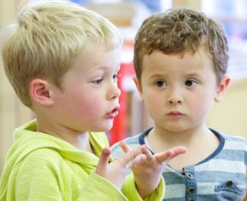
PHYSICAL/SEXUAL | SOCIAL/ EMOTIONAL / MORAL | COGNITIVE
Children 3-4 years: Language milestones
Most 3-4-year-olds can:
  Make themselves understood to strangers, despite some sound errors
  Use and understand sentences
  Use more complex grammar, such as plurals and past tense
  Understand sentences involving time concepts (for example, "Grandma is coming tomorrow") and narrate past experiences
  Understand size comparisons such as big and bigger
  Understand relationships expressed by "if… then" or "because" sentences
  Follow a series of two to four related directions
  Sing a song and repeat at least one nursery rhyme
Notes:
Language usage becomes more complex at this age

Slide 87
PHYSICAL/SEXUAL | SOCIAL/ EMOTIONAL / MORAL | COGNITIVE
Children 4-5 years: Language milestones
4-5-year-olds use language not only to converse, but also to exchange information
Most can:
  Retell a story (but may confuse facts)
  Combine thoughts into one sentence
  Ask "when?" "how?" and "why?" questions
  Use words like "can," "will," "shall," "should," and "might"
  Combine thoughts into one sentence
Notes:
Most 4-5 year old children can also:
Refer to causality by using "because" and "so“
Follow three unrelated commands appropriately
Understand comparatives like loud, louder, loudest
Listen to long stories (but may misinterpret the facts)
Understand sequencing of events when clearly explained (for example, "First we plug the drain, then we run the water, and finally we take a bath")

Slide 88
PHYSICAL/SEXUAL | SOCIAL/ EMOTIONAL / MORAL | COGNITIVE
Once children understand that words have meaning, their vocabulary grows slowly at first
10-15 months: first word spoken
15 months: will learn 2-3 new words a week
18 months: will learn many new words (mainly noun-words for objects)
18 months: can learn 10 or more new words a week
18-24 months: 2-word utterances
24 months: vocabulary of a few hundred words
36 months: 500 word vocabulary
Notes:
“Naming”:
By 12 months - may understand 100 words – will understand simple command with gesture
By 24 months - no gesture needed with command
By 18 months - uses 25 words spontaneously
Will use word combinations when expressive vocabulary reaches 50 words

Slide 89
PHYSICAL/SEXUAL | SOCIAL/ EMOTIONAL / MORAL | COGNITIVE
Intelligence
= the capacity to understand the world, think rationally, and use resources effectively when faced with challenges
IQ tests are reasonably good predictors of school performance, but are NOT good predictors of performance outside of school
School IQ tests are frequently inaccurate at predicting future success, income
Many theorists now believe that intelligence is multi-dimensional
Howard Gardner: 8 distinct intelligences
Notes:
Howard Gardner suggests there are 8 distinct intelligences (that work together at times):
Musical intelligence
Bodily kinesthetic intelligence
Logical mathematical intelligence
Linguistic intelligence
Spatial intelligence
Interpersonal intelligence
Intrapersonal intelligence
Naturalist intelligence

Slide 90

PHYSICAL/SEXUAL | SOCIAL/ EMOTIONAL / MORAL | COGNITIVE
Cognition
Cognitive advances continue and the development of concrete operational skills becomes more established
Piaget’s Concrete Operations Stage of Development:
  Child begins to understand numbers, space, classifications; applies logic to concrete problems; thinking is limited to the concrete
Watch the video: https://www.youtube.com/watch?v=mnnqpwbeiW0
Notes:
Piaget
Sensorimotor stage (0-4): child explores things that can be touched, seen, felt; develops motor skills
Preoperational (2-7 years): child thinks in terms of self; oriented to the present; intuitive rather than logical
Concrete operation (7-11 years): Child begins to understand numbers, space, classifications; and to apply logic to concrete problems; thinking is bound to the concrete
Formal operations (11-15 years): Child is able to think abstractly; hypothesize; generalize; reason, form different perspectives; develop ideals

Slide 91
PHYSICAL/SEXUAL | SOCIAL/ EMOTIONAL / MORAL | COGNITIVE
Concrete operational thinking
Children first use mental operations to solve problems and to reason
Mental operations are strategies and rules that make thinking more systematic and powerful
Give concrete operational thinking a rule-oriented, logical flavour that is missing in preoperational thought
Can be reversed (Reversal means that they can undo the effect of a problem. Ex: 5+3=8 and 8-3=5)

Slide 92
PHYSICAL/SEXUAL | SOCIAL/ EMOTIONAL / MORAL | COGNITIVE
Concrete Operational Thinking
More powerful and flexible than preoperational thinking
Preoperational = egocentric
Concrete operational is not
Has its limitations
Here and now
Not abstract and hypothetical thinking

Slide 93
PHYSICAL/SEXUAL | SOCIAL/ EMOTIONAL / MORAL | COGNITIVE
Memory skills
MEMORY = the process by which information is initially encoded, stored, and retrieved.
Children become increasingly able to handle information because their memories improve.
Encoding is the process by which information is initially recorded in a form usable to memory.
The information must be stored, or placed and maintained in the memory system.
Information must be retrieved, located and brought into awareness.

Slide 94

PHYSICAL/SEXUAL | SOCIAL/ EMOTIONAL / MORAL | COGNITIVE
Memory skills
Improve quickly during middle childhood due to:
    Use of effective strategies for remembering
    Increasing factual knowledge of the world, which allows a child to organize information and give it meaning
Preschool children use visuals and touch to remember
Middle childhood children begin to use more powerful strategies
Notes:
Memory strategies are the deliberate mental activities we use to store and retain information

Slide 95
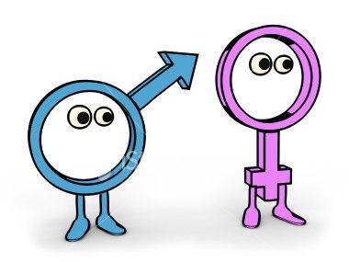
PHYSICAL/SEXUAL | SOCIAL/ EMOTIONAL / MORAL | COGNITIVE
Gender differences and intellectual ability
Gender differences in 3 areas of intellectual skills:
    Verbal ability
    Spatial ability
    Mathematics
Girls better at reading, art, music
Boys better at math, athletics, mechanical skills
More boys have reading and other language-related challenges

Slide 96
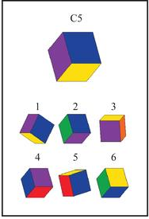
PHYSICAL/SEXUAL | SOCIAL/ EMOTIONAL / MORAL | COGNITIVE
Spatial ability
From childhood on, boys are better at spatial rotation
Spatial rotation throughout middle childhood is difficult for both sexes
From adolescence on, boys are better at spatial tasks

Slide 97
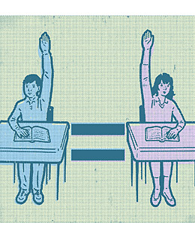
PHYSICAL/SEXUAL | SOCIAL/ EMOTIONAL / MORAL | COGNITIVE
Math ability
Girls often get better overall grades
Boys get higher scores on math achievement tests
Girls’ confidence levels play a role
Boys are more confident and like the challenge of standardized tests

Slide 98

PHYSICAL/SEXUAL | SOCIAL/ EMOTIONAL / MORAL | COGNITIVE
Verbal ability
Girls have greater verbal ability; also read, write and spell better
More boys have reading and other language-related problems

Slide 99
PHYSICAL/SEXUAL | SOCIAL/ EMOTIONAL / MORAL | COGNITIVE
Language development
Vocabulary: 40,000 words by 6th grade
Can adapt conversation to needs of listeners
Phrase things to get their way
Understand the difference between what people say & mean

Slide 100
PHYSICAL/SEXUAL | SOCIAL/ EMOTIONAL / MORAL | COGNITIVE
Language development
School-age children's mastery of grammar improves
Understanding of syntax* grows during middle childhood
Certain phonemes - units of sound - remain troublesome (j, v, h, zh)
Notes:
*Syntax = the rules that indicate how words and phrases can be combined to form sentences

Slide 101
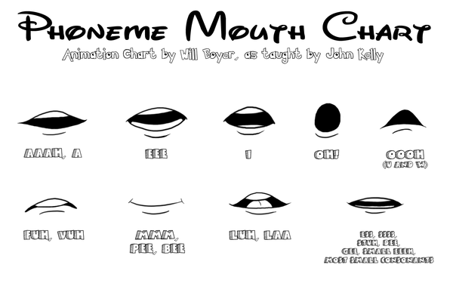
PHYSICAL/SEXUAL | SOCIAL/ EMOTIONAL / MORAL | COGNITIVE
TRY THIS!

Slide 102

PHYSICAL/SEXUAL | SOCIAL/ EMOTIONAL / MORAL | COGNITIVE
Reading skill development
Development of reading skill generally occurs in several broad, frequently overlapping stages
Notes:
Stage 0
lasts from birth to the start of first grade
children learn the essential prerequisites for reading, including identification of the letters in the alphabet, writing their names, reading a few words
Stage 1
1st and 2nd grade
the first real reading, but it is largely phonological decoding skill where children can sound out words by sounding out and blending letters
Stage 2, around 2nd and 3rd grades: children learn to read aloud with fluency
Stage 3, from 4th to 8th grades: reading becomes a means to an end and an enjoyable way to learn
Stage 4: children understand reading in terms of reflecting multiple points of view

Slide 103

Read this excellent chapter for an in-depth overview of middle childhood development:
http://www.sagepub.com/upm-data/16297_Chapter_5.pdf

Slide 104

Children 6-12: Indicators for concern
Child is not reaching developmental milestones
Child has known high-risk medical conditions
Child has biological risk factors for developmental problems
Child has significant environmental stresses
Child has parent/caregiver with concerns

Slide 105

Children 6-12: Child abuse
REPORTING OF CHILD ABUSE IS MANDATORY IN QUEBEC!
  Types of child abuse:
    Physical violence and abuse
    Sexual abuse
    Emotional/verbal/psychological abuse
    Neglect
    Cultural and religious abuse

Slide 106

Jeopardy!
http://www.superteachertools.us/jeopardyx/jeopardy-review-game.php?gamefile=2513233#.XKtpD5hKiUm
Test out your knowledge on the previous section!!

Slide 107
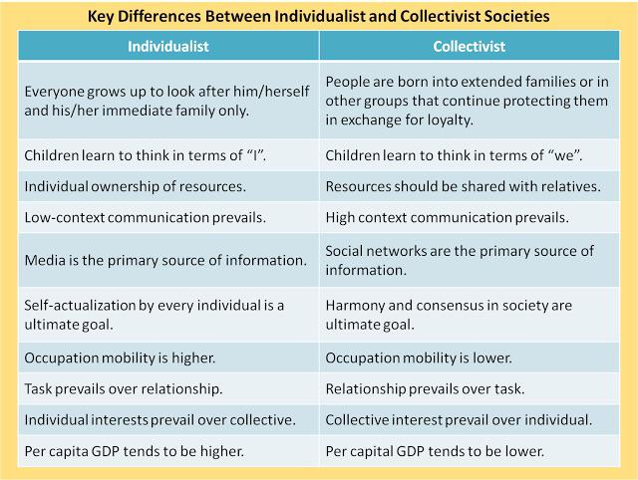

Culture

Slide 108
Development – Adolescence

Slide 109

Overview of Development 13-17 years
Watch this video for an overview of the many changes that occur in adolescence:
https://www.youtube.com/watch?v=xxQj72d-0kE

Slide 110

Adolescence
Adolescence, initiated by puberty, is the period of transition between childhood and adulthood
Early theories explained the impact of puberty on psychological development in terms of either biological or social forces.
Contemporary research shows that adolescence is a product of biological, psychological, and social forces.

Slide 111

PHYSICAL/SEXUAL | SOCIAL/ EMOTIONAL / MORAL | COGNITIVE
Physical Changes in Adolescence
Hormonal changes beginning in middle childhood initiate puberty, on average, two years earlier for girls than boys.
The first sign is the growth spurt.
As the body enlarges, girls’ hips and boys’ shoulders broaden. Girls add more fat and boys add more muscle.
Puberty brings improvement in gross motor performance, slower for girls than boys.
Preoccupation with physical prowess leads some boys to use dangerous performance-enhancing drugs.
Sports and exercise foster cognitive and social development.

Slide 112

Physical Changes in Adolescence
PHYSICAL/SEXUAL | SOCIAL/ EMOTIONAL / MORAL | COGNITIVE
At puberty, changes in primary and secondary sexual characteristics accompany rapid body growth.
Menarche occurs late in the girl’s sequence of pubertal events, after the growth spurt peaks.
In boys, the peak in growth occurs later, preceded by enlargement of the sex organs.
Heredity, nutrition, exercise, and overall physical health contribute to pubertal timing.
Trend to earlier menarche has occurred in industrialized nations as physical well-being increased.

Slide 113

Physical Changes in Adolescence
PHYSICAL/SEXUAL | SOCIAL/ EMOTIONAL / MORAL | COGNITIVE
There are many changes to the synapses in the brain in adolescence that support cognitive advances.
Increased responsiveness of neurons to excitatory neurotransmitters may play a role in teenagers’ drive for novel experiences.
Changes also occur in brain regulation of sleep.
Adolescents go to bed much later, and sleep deprivation increases.

Slide 114
Physical Changes in Adolescence
PHYSICAL/SEXUAL | SOCIAL/ EMOTIONAL / MORAL | COGNITIVE
Health issues
Nutritional requirements increase with rapid body growth.
Poor eating habits lead adolescence to have deficient diets.
Frequency of family meals is associated with healthy eating.
Early puberty, maladaptive family interactions and societal pressures heighten risk of eating disorders such as anorexia nervosa and bulimia nervosa.

Slide 115

Physical Changes in Adolescence
PHYSICAL/SEXUAL | SOCIAL/ EMOTIONAL / MORAL | COGNITIVE
Puberty is accompanied by psychological distancing from parents.
This reaction may be a modern substitution for physical departure from the family, which occurs at this time in primate species.
Early maturing boys and late maturing girls have higher body image as this matches cultural standards.
Early maturing girls and late maturing boys fit in least well with peers, experience emotional and social difficulties.

Slide 116

PHYSICAL/SEXUAL | SOCIAL/ EMOTIONAL / MORAL | COGNITIVE
Sexual behaviour
Read these articles on healthy sexual development in adolescence:
http://actforyouth.net/sexual_health/sexual_development/
https://www.ncbi.nlm.nih.gov/pmc/articles/PMC4477452/

Slide 117
PHYSICAL/SEXUAL | SOCIAL/ EMOTIONAL / MORAL | COGNITIVE
Sexual behaviour
Early, frequent sexual activity is linked to factors associated with economic disadvantage.
Many sexually active teenagers do not practice contraception consistently.
Adolescent cognitive processes and a lack of social support for responsible sexual behaviour, including access to birth control, underlie this failure to take precautions against pregnancy.

Slide 118

Sexuality in Adolescence
PHYSICAL/SEXUAL | SOCIAL/ EMOTIONAL / MORAL | COGNITIVE
About 2 to 3 percent of young people identify as lesbian, gay, or bisexual.
Biological factors, including heredity and prenatal hormone levels, play an important role in homosexuality.
Lesbian and gay teenagers face special challenges in developing a positive sexual identity.
High levels of STDs in teenagers due to early sexual activity, inconsistent contraceptive use, and limited knowledge about STDs.

Slide 119

Sexuality in Adolescence
PHYSICAL/SEXUAL | SOCIAL/ EMOTIONAL / MORAL | COGNITIVE
Adolescent pregnancy is associated with school drop-out, reduced chances of marriage, greater likelihood of divorce, and poverty - jeopardizing the well being of parent and child.
Effective sex education is important.
Teenage alcohol and drug use is pervasive reflecting sensation seeking and drug dependent culture.

Slide 120

PHYSICAL/SEXUAL | SOCIAL/ EMOTIONAL / MORAL | COGNITIVE
Emotional Changes in Adolescence
Psychological impact of pubertal events
Girls react to menarche with mixed emotion as do boys but girls generally receive more support.
Hormone levels, negative life events and adult-structured situations are associated with negative moods.
In contrast, teenagers are upbeat when with friends and in self-chosen activities.

Slide 121

Emotional/Social Changes In Adolescence
PHYSICAL/SEXUAL | SOCIAL/ EMOTIONAL / MORAL | COGNITIVE
According to Erikson’s theory, identity is the major personality achievement of adolescence.
Young people who successfully resolve the psychological conflict of identity versus role confusion construct a solid self-definition.
This consists of solid self-definition and self-chosen values and goals.
Cognitive changes lead adolescent self-descriptions to be more organized.
Personal and moral values appear as key themes.
For more on Erikson’s theory:
http://www.simplypsychology.org/Erik-Erikson.html

Slide 122

Emotional/Social Changes In Adolescence
PHYSICAL/SEXUAL | SOCIAL/ EMOTIONAL / MORAL | COGNITIVE
Self-esteem further differentiates and for most adolescents increases.
Authoritative parenting and encouragement from teachers support positive self-esteem.
Exploration of alternatives and commitment to self-chosen values and goals are important.
Healthy parental attachments, interaction with diverse peers, close friendships, schools and communities that provide varied opportunities are helpful.
A bio-cultural identity offers additional benefits.

Slide 123

Emotional/Social Changes In Adolescence
PHYSICAL/SEXUAL | SOCIAL/ EMOTIONAL / MORAL | COGNITIVE
Gender Typing
Biological, social, and cognitive factors contribute to gender identification.
As puberty changes occur and concern with what others think strengthens, teenagers focus on gender-linked attributes
Also, parents and dating partners encourage gender-appropriate behaviour.

Slide 124

Emotional/Social Changes In Adolescence
PHYSICAL/SEXUAL | SOCIAL/ EMOTIONAL / MORAL | COGNITIVE
Adolescence-Moral Development
According to Kohlberg, moral reasoning develops gradually through three levels.
Teenagers display more subtle reasoning about conflicts between personal choice and community obligations.
They are also increasingly aware of the moral implications of following social convention.
Experiences contributing to moral maturity include warm, rational parenting , years of schooling, and peer discussions of moral issues.
Moral action is also influenced by individual’s empathy and/or guilt, history of morally relevant experiences.
For more on Kohlberg’s theory:
http://www.simplypsychology.org/kohlberg.html

Slide 125

Emotional/Social Changes In Adolescence
PHYSICAL/SEXUAL | SOCIAL/ EMOTIONAL / MORAL | COGNITIVE
The Family
  In their quest for autonomy, adolescents strive to rely more on themselves and less on their parents.
  They question parental authority.
  Sibling relationships become less intense as they separate from their family and turn towards peers.

Slide 126

Emotional/Social Changes In Adolescence
PHYSICAL/SEXUAL | SOCIAL/ EMOTIONAL / MORAL | COGNITIVE
Peer Relationships
  Adolescent friendships are based on greater self-disclosure, loyalty.
  Girls friendships place more emphasis on emotional closeness and boys on shared activities.
  As long as these relationships are not characterized by jealousy and antisocial behaviour, these friendships promote self-concept and relieve stress.
  Intimacy in dating is enhanced by positive relationship with parents and peers.
Read this article:
https://www.urmc.rochester.edu/encyclopedia/content.aspx?contenttypeid=90&contentid=P01642

Slide 127

PHYSICAL/SEXUAL | SOCIAL/ EMOTIONAL / MORAL | COGNITIVE
Problems in Development
  Depression is the most common.
  Girls are at greater risk.
  Various biological, and environmental factors are implicated-heredity, maladaptive parenting, a learned helplessness and negative life events.
  Suicide rate increases dramatically at adolescence.
  Boys account for most deaths by suicide, while girls make more unsuccessful attempts.
  Teenagers at risk may be more intelligent, solitary, and withdrawn, but more often they are withdrawn.
  Most teenagers engage in some delinquent behaviour, only few are serious. Often explained by family dynamics.

Slide 128

Cognitive Development in Adolescence
PHYSICAL/SEXUAL | SOCIAL/ EMOTIONAL / MORAL | COGNITIVE
During Piaget’s formal operational stage, adolescence engage in hypothetico-deductive reasoning.
When faced with a problem, they start with a hypothesis about variables that might affect an outcome; deduce logical testable inferences and systematically isolate variables to see which inferences are confirmed.
For more on Piaget’s Stages of Cognitive Development:
https://www.simplypsychology.org/formal-operational.html

Slide 129

Cognitive Development in Adolescence
PHYSICAL/SEXUAL | SOCIAL/ EMOTIONAL / MORAL | COGNITIVE
Prepositional thoughts also develop - adolescents can evaluate the logic of verbal statements apart from real-world circumstances
Adolescents and adults are more likely to think abstractly and systematically in situations in which they have had extensive guidance and practice.
Cognitive gains in adolescence due to improved attention, more effective strategies greater knowledge, speed in processing.

Slide 130

Cognitive Development in Adolescence
PHYSICAL/SEXUAL | SOCIAL/ EMOTIONAL / MORAL | COGNITIVE
As adolescents reflect on their thoughts, they think more about themselves.
Teenagers’ capacity to think about themselves can prompt idealistic visions at odds with everyday reality and they often become fault-finding critics.
Compared with adults, adolescents have difficulty with decision-making.

Slide 131

Cognitive Development in Adolescence
PHYSICAL/SEXUAL | SOCIAL/ EMOTIONAL / MORAL | COGNITIVE
School transitions in adolescence can be stressful.
Teenagers who must cope with added stresses - especially those with both academic and mental health difficulties - are at greatest risk for adjustment problems.
Authoritative parenting and parents’ school involvement promote high achievement.
Teens whose parents encourage achievement are likely to choose similar friends.

Slide 132

Cognitive Development in Adolescence
PHYSICAL/SEXUAL | SOCIAL/ EMOTIONAL / MORAL | COGNITIVE
Contributing factors for drop-outs include a long history of poor school performance, lack of parental support for academic achievement, large impersonal classes, and unstimulating, unmotivating teachers.

Slide 133

Language & Learning in Adolescence
PHYSICAL/SEXUAL | SOCIAL/ EMOTIONAL / MORAL | COGNITIVE
Read these articles on Language and Learning in Adolescence:
http://www.speechlanguage-resources.com/adolescent-language-development.html
https://www.livestrong.com/article/226031-language-development-in-teenagers/

Slide 134

Culture
Culture and adolescent development

Slide 135

THE ADULT YEARS
19-64 years

Slide 136
PHYSICAL/SEXUAL | SOCIAL/ EMOTIONAL / MORAL | COGNITIVE
Physical Changes in Adulthood
Gradual physical changes take place in early adulthood and later accelerate.
Once body structures reach maximum capacity and efficiency, biological aging begins.
Athletic skills requiring speed, strength, and gross body coordination peak in the early twenties; those requiring endurance, arm-hand steadiness, and aiming peak in the late twenties and early thirties.
Less active lifestyles rather than biological aging account for the most of the age-related decline in athletic skill and motor performance.
Notes:
Apply….
Tom had been going to the health club 3 times a week after work, but job pressures convinced him that he no longer had time for regular exercise. Explain to Tom why he should keep up his exercise regiment, and suggest ways to fit it into his busy life.

Slide 137
PHYSICAL/SEXUAL | SOCIAL/ EMOTIONAL / MORAL | COGNITIVE
Physical Changes in Adulthood
Lifestyle and Physical Health
Economically advantaged, well-educated individuals tend to sustain good health over most of their lives.
The health of lower income individuals with limited education declines.
Overweight and obesity have increased dramatically in Western nations.
Many young adults show large increases because of sedentary lifestyles and diet high in sugar and fat.
Regular exercise reduces body fat, builds muscle, helps prevent disease and enhances psychological well-being.

Slide 138

PHYSICAL/SEXUAL | SOCIAL/ EMOTIONAL / MORAL | COGNITIVE
Physical Changes in Adulthood
Lifestyle
Cigarette smoking and alcohol consumption are the two most common substance abuses.
Most adults who smoke begin before the age of 21 and are at increase risk of a wide variety of health problems.
About one-third of heavy drinkers have alcoholism to which both heredity and environment contribute.
Alcohol is implicated in numerous diseases and physical disorders.

Slide 139

PHYSICAL/SEXUAL | SOCIAL/ EMOTIONAL / MORAL | COGNITIVE
Physical Changes in Middle Adulthood
The gradual physical changes begun in early adulthood continue in midlife, contributing to a revised physical self-image with less emphasis on hoped-for gains, and more on feared decline.
Vision is affected by presbyopia, or loss of the accommodative ability of the lens, reduced ability to see in dim light, increased sensitivity to glare, and diminished color discrimination.
  After age 40, risk of glaucoma, build up of pressure in the eye that damages the optic nerve.
Age-related hearing loss or presbycusis, first affects detection of high frequencies and then spreads to other tones.
Notes:
https://beresfordo.co.uk/10-annoying-signs-middle-age

Slide 140

PHYSICAL/SEXUAL | SOCIAL/ EMOTIONAL / MORAL | COGNITIVE
Physical Changes in Adulthood
The skin wrinkles, loosens, dries, and starts to develop age spots.
Muscle mass declines and fat deposits increase. A low fat diet and regular exercise that includes resistance training can offset excess weight and muscle loss.
Bone density declines in both sexes but to a greater extent in women, especially after menopause.
Height loss and bone fractures can result.

Slide 141

PHYSICAL/SEXUAL | SOCIAL/ EMOTIONAL / MORAL | COGNITIVE
Physical Changes in Middle Adulthood
Disease and Risk Factors
The death rate from cancer increases tenfold from early to middle adulthood. A complex interaction of heredity, biological aging and environment contribute to cancer.
**Annual screenings and various preventative steps can reduce the incidence of cancer and cancer deaths**

Slide 142

PHYSICAL/SEXUAL | SOCIAL/ EMOTIONAL / MORAL | COGNITIVE
Physical Changes in Middle Adulthood
Disease and Risk Factors
Although cardiovascular disease has declined in recent decades, it remains a major cause of death in middle adulthood, especially among men.
Symptoms include high blood pressure, high blood cholesterol, atherosclerosis, heart attack, arrhythmia, and angina.
  **Quitting smoking, reducing blood cholesterol through diet and drug therapy, exercising, and reducing stress can decrease risk and aid in treatment.**

Slide 143

PHYSICAL/SEXUAL | SOCIAL/ EMOTIONAL / MORAL | COGNITIVE
Physical Changes in Middle Adulthood
Disease and Risk Factors
  Osteoporosis affects 12% of people over age 50, most of whom are post-menopausal women.
  **Adequate calcium and vitamin D, weight bearing and strength training exercise and bone strengthening medications can help prevent and treat osteoporosis**

Slide 144

PHYSICAL/SEXUAL | SOCIAL/ EMOTIONAL / MORAL | COGNITIVE
Physical Changes in Adulthood
Disease and Risk Factors
  Expressed hostility is a component of type A behaviour pattern that predicts heart disease and other health problems. Because anger suppression is also related to health problems, a better alternative is to develop better ways of handling stress and conflict.
  **Effective stress management includes both problem- centered , and emotion-centered coping depending on the situation; constructive approaches to anger reduction and social support.**

Slide 145

PHYSICAL/SEXUAL | SOCIAL/ EMOTIONAL / MORAL | COGNITIVE
Sexuality in Adulthood

Slide 146

PHYSICAL/SEXUAL | SOCIAL/ EMOTIONAL / MORAL | COGNITIVE
Sexuality in Adulthood
Lifestyle
Most adults are less sexually active than popular media images suggest, but compared with earlier generations they display a wider range of sexual choices and lifestyles with more partners.
Only a minority of young adults report persistent sexual problems linked to low socio-economic status and stress.
Negative attitudes toward homosexual men and women have begun to change largely as a result of greater exposure and interpersonal contact.

Slide 147
PHYSICAL/SEXUAL | SOCIAL/ EMOTIONAL / MORAL | COGNITIVE
Sexuality in Adulthood
Reproductive Changes
The pre-menopausal phase occurs over a period of about 10 years and occurs gradually as estrogen levels drop and concludes with menopause sometimes accompanied by emotional and physical symptoms.
Hormone therapy is successful in reducing the discomforts of menopause but is controversial because of increased risk of cardiovascular disease, certain cancers and cognitive decline.
Though sperm production continues throughout life, quantity of semen diminishes after age 40. Erections become harder to attain and maintain but drugs are available to combat impotence.
Frequency of sexual activity among couples declines only slightly and is associated with marital unhappiness. Intensity of sexual response declines more due to physical changes associated with the menopausal phase.

Slide 148

PHYSICAL/SEXUAL | SOCIAL/ EMOTIONAL / MORAL | COGNITIVE
Sexuality in Adulthood
Women’s reproduction capacity declines with age due to reduced quality and quantity of ova.
Men show a decrease in semen volume and sperm quality after age 35.

Slide 149

Emotional, Social, MoraI Development in Adulthood
PHYSICAL/SEXUAL | SOCIAL/ EMOTIONAL / MORAL | COGNITIVE
Emerging adulthood
Young adults from about age 18 to 25 are released from parental oversight but have not yet taken on adult roles.
During these years of extended exploration, young people prolong identity development as they explore alternatives.
Increased education is required for entry level positions in many fields.
In trying out possibilities, emerging adults must adjust to disappointments in love and work, and their explorations also extend risky behaviors of adolescents.

Slide 150

Emotional, Social, MoraI Development in Adulthood
PHYSICAL/SEXUAL | SOCIAL/ EMOTIONAL / MORAL | COGNITIVE
Emerging adulthood
A wide array of personal attributes and social supports foster resilience.
Erikson’s theory: in Erikson’s theory young adults must resolve the conflict of intimacy versus isolation, balancing independence and intimacy as they form a close relationship with a partner.
Research confirms that a secure identity fosters attainment of intimacy.
Young people also focus on aspects of generativity, including parenting and contributions to society through work.

Slide 151

Emotional, Social, MoraI Development in Adulthood
PHYSICAL/SEXUAL | SOCIAL/ EMOTIONAL / MORAL | COGNITIVE
Other theories of adult psychosocial development
Levinson described a series of eras, each consisting of a transition and stable phase, in which people revise their life structure.
Young adults usually construct a dream involving career for men and both marriage and career for women.
They form a relationship with a mentor to help them realize their dream.
In their 30’s, men tend to settle down, whereas many women remain unsettled into mid-adulthood.
For more on Levinson’s theory:
http://adultdevelopment.weebly.com/levinson.html

Slide 152

Emotional, Social, MoraI Development in Adulthood
PHYSICAL/SEXUAL | SOCIAL/ EMOTIONAL / MORAL | COGNITIVE
Other theories of adult psychosocial development
Vaillant refined Erikson’s stages portraying the 20’s as devoted to intimacy, the 30’s to career consolidation, the 40’s to generativity, and the 50’s and 60’s to cultural values.
**These two theories are based on limited samples of people born in the first few decades of the 20th century. Young adults’ development is more variable today than in the past generations.**
Conformity to or departure from society’s social clock can be stressful and be a source of personality change.

Slide 153

Emotional, Social, MoraI Development in Adulthood
PHYSICAL/SEXUAL | SOCIAL/ EMOTIONAL / MORAL | COGNITIVE
Close relationships
Romantic partners tend to resemble one another in age, ethnicity, SES, religion, and various personal and physical attributes.
According to evolutionary theory, women seek a mate with traits that help ensure children’s survival, while men look for characteristics signaling sexual pleasure and ability to bear offspring.
An alternative, social learning perspective emphasizes that gender roles profoundly influence criteria for mate selection.

Slide 154

Emotional, Social, MoraI Development in Adulthood
PHYSICAL/SEXUAL | SOCIAL/ EMOTIONAL / MORAL | COGNITIVE
Close relationships
According to the triangular theory of love, the balance among intimacy, passion, and commitment changes as romantic relationships move from the intense sexual attraction of passionate love toward more settled companionate love.

Slide 155

Emotional, Social, MoraI Development in Adulthood
PHYSICAL/SEXUAL | SOCIAL/ EMOTIONAL / MORAL | COGNITIVE
Close relationships - friendships
Adult friendship are based on trust, intimacy and loyalty.
Women’s same-sex friendships tend to be more intimate than men’s.
After college, other-sex friendships decline with age for men but increase for highly educated, employed women.
Adult sibling relationships often resemble friendships, especially among sisters with positive early experiences.
Young adults are vulnerable to loneliness, which declines with age as they form satisfying intimate ties. As long as it is not too intense, loneliness can encourage young people to reach out to others and better understand themselves.

Slide 156

Emotional, Social, MoraI Development in Adulthood
PHYSICAL/SEXUAL | SOCIAL/ EMOTIONAL / MORAL | COGNITIVE
Family life
A large majority of young people marry, at later ages than in the past. Today, couples must work harder to define their marital roles.
Both traditional and egalitarian marriages are affected by women’s participation in the workforce.
Even in dual-earner marriages, North American women spend nearly twice as much time as men on housework.

Slide 157

Emotional, Social, MoraI Development in Adulthood
PHYSICAL/SEXUAL | SOCIAL/ EMOTIONAL / MORAL | COGNITIVE
Family life
Quality of the marital relationship predicts mental health similarly for both men and women.
Women, however, feel particularly dissatisfied when combined demands of work and family roles are overwhelming.
Although most couples become parents, they do so at a later age and have fewer children than in the past.
Parent education programs can help parents clarify their child-rearing values and use more effective strategies.

Slide 158

Emotional, Social, MoraI Development in Adulthood
PHYSICAL/SEXUAL | SOCIAL/ EMOTIONAL / MORAL | COGNITIVE
Family life
The arrival of a child requires couples to adjust to increased responsibilities and often prompts a shift to more traditional roles, though this may reverse after birth of a second child.
Shared caregiving predicts greater parental happiness and positive parent-infant interaction.
Families with young children face challenges of clarifying and implementing child-rearing values.

Slide 159

Emotional, Social, MoraI Development in Adulthood
PHYSICAL/SEXUAL | SOCIAL/ EMOTIONAL / MORAL | COGNITIVE
Singlehood
Singlehood has risen in recent years because of a trend toward later marriage and a high divorce rate.
Despite certain drawbacks, singles appreciate their freedom and mobility.
Women tend to adjust more favorably than men.

Slide 160


Emotional, Social, MoraI Development in Adulthood
PHYSICAL/SEXUAL | SOCIAL/ EMOTIONAL / MORAL | COGNITIVE
Cohabitation has risen dramatically, especially among well-educated, economically advantaged young adults.
Compared with their Western European counterparts, North American cohabiters tend to be less conventional in values and behavior and less committed to their partner, and their subsequent marriages are more likely to fail.
Notes:
http://aplus.com/a/50-things-that-happen-when-you-live-together?no_monetization=true

Slide 161

Emotional, Social, MoraI Development in Adulthood
PHYSICAL/SEXUAL | SOCIAL/ EMOTIONAL / MORAL | COGNITIVE
Childlessness
Voluntary childless adults tend to be well-educated and career-oriented and are as satisfied with their lives as parents who have good relationships with their children.
When childlessness is beyond a person’s control, it may interfere with adjustment.

Slide 162

Emotional, Social, MoraI Development in Adulthood
PHYSICAL/SEXUAL | SOCIAL/ EMOTIONAL / MORAL | COGNITIVE
Divorce and remarriage
Nearly 50% of marriages dissolve, often while children are at home.
About two-thirds of divorced people remarry.
Maladaptive communication patterns, young ages at marriage, a family history of divorce, poverty, and the changing status of women all contribute to divorce.

Slide 163
Emotional, Social, MoraI Development in Adulthood
PHYSICAL/SEXUAL | SOCIAL/ EMOTIONAL / MORAL | COGNITIVE
Divorce
The average age for couples going through their first divorce is 30 years old.
60% of all divorces involve individuals aged 25 to 39.
60% of couples married between the age of 20-25 will end in divorce.
48% of those who marry before the age of 18 are likely to divorce within 10 years, compared to 25% of those who marry after the age of 25.
Those who wait to marry until they are over 25 years old are 24% less likely to get divorced.

Slide 164

Emotional, Social, MoraI Development in Adulthood
PHYSICAL/SEXUAL | SOCIAL/ EMOTIONAL / MORAL | COGNITIVE
Divorce and remarriage
Finding a new partner is important to many divorced adults, especially men.
Remarriages break up for several reasons:
  Marrying for practical reasons rather than love
  Persistence of negative styles of communication
  Acceptance of divorce as a solution to marital difficulties
  Problems adjusting to a stepfamily

Slide 165
Emotional, Social, MoraI Development in Adulthood
PHYSICAL/SEXUAL | SOCIAL/ EMOTIONAL / MORAL | COGNITIVE
Parenting
Establishing stepparent-stepchild ties is difficult, especially for stepmothers or stepfathers without children of their own.
  A caring husband-wife relationship, cooperation from the biological parent, and children’s acceptance are crucial for stepparent adjustment.
Never-married single parenthood is especially high among individuals of low SES. Unemployment contributes to this trend.
  Although child-rearing parents often receive help from extended family, they find it difficult to overcome poverty.

Slide 166

Emotional, Social, MoraI Development in Adulthood
PHYSICAL/SEXUAL | SOCIAL/ EMOTIONAL / MORAL | COGNITIVE
Careers
Men’s career paths are usually continuous, whereas women’s are often discontinuous because of child rearing and other family needs.
After adjusting to the realities of the work world, young adults settle into an occupation.
Their progress is affected by opportunities for promotion, personal characteristics such as self-efficacy, and access to an effective mentor.

Slide 167

Emotional, Social, MoraI Development in Adulthood
PHYSICAL/SEXUAL | SOCIAL/ EMOTIONAL / MORAL | COGNITIVE
Careers
Women and ethnic minorities have penetrated nearly all professions but have limited progress in career advancement.
Women are hampered by time away from the labour market, low self-efficacy and lack of mentoring in traditionally male-dominated fields, and gender stereotypes of women as followers rather than leaders.
Racial bias in the labour market remains strong, and ethnic minority women who succeed display an unusually high sense of self-efficacy.

Slide 168


Emotional, Social, MoraI Development in Adulthood
PHYSICAL/SEXUAL | SOCIAL/ EMOTIONAL / MORAL | COGNITIVE
Careers
Couples, particularly women, in dual-earner marriages often experience role overload.
Effectively balancing work and family brings a better standard of living , enhanced psychological being, and happier marriages.
Time-flexible workplace policies reduce stress while augmenting work performance.

Slide 169

Emotional, Social, MoraI Development in Adulthood
PHYSICAL/SEXUAL | SOCIAL/ EMOTIONAL / MORAL | COGNITIVE
Erikson’s theory
Generativity is a concern for the future, a need to nurture and guide younger people and contribute to the next generation.
Erikson argued that this usually develops during middle age (which spans ages 40 through 64) in keeping with his stage-model of psychosocial development.

Slide 170
Emotional, Social, MoraI Development in Adulthood
PHYSICAL/SEXUAL | SOCIAL/ EMOTIONAL / MORAL | COGNITIVE
Erikson’s theory
Generativity begins in early adulthood but expands greatly as middle-aged adults face Erickson’s conflict of generativity versus stagnation.
Generative people find fulfillment as they make contributions to society through parenthood, other family relationships, the workplace, and volunteer activities.
Personal desires and cultural demands shape adults’ generative activities.
Highly generative people appear especially well-adjusted.
The negative outcome, stagnation, occurs when people become self centered and self-indulgent in midlife.

Slide 171

Emotional, Social, MoraI Development in Adulthood
PHYSICAL/SEXUAL | SOCIAL/ EMOTIONAL / MORAL | COGNITIVE
Other theories – Levinson & Vaillant
According to Levinson, middle-aged adults reassess their relation to themselves and the external world
  They confront 4 developmental tasks, each requiring them to reconcile 2 opposing tendencies within the self:
    Young-old
    Destruction-creation
    Masculinity-femininity
    Engagement-separateness

Slide 172

Emotional, Social, MoraI Development in Adulthood
PHYSICAL/SEXUAL | SOCIAL/ EMOTIONAL / MORAL | COGNITIVE
Other theories – Levinson & Vaillant
Perhaps because of the double standard of aging, women express concern about appearing less attractive.
Middle-aged men may adopt “feminine” traits of nurturance and caring, while women may take on “masculine” traits of autonomy and assertiveness.
  Men and successful career-oriented women often reduce their focus on ambition and achievement.
  Women who have devoted themselves to child rearing (or an unfulfilling job) typically increase their involvement in work and community.

Slide 173

Emotional, Social, MoraI Development in Adulthood
PHYSICAL/SEXUAL | SOCIAL/ EMOTIONAL / MORAL | COGNITIVE
Other theories – Levinson & Vaillant
Most people respond to midlife with changes that are better described as “turning points” than a crisis.
Only a minority experience a midlife crisis characterized by intense self-doubt and stress that lead to drastic alterations.

Slide 174

Emotional, Social, MoraI Development in Adulthood
PHYSICAL/SEXUAL | SOCIAL/ EMOTIONAL / MORAL | COGNITIVE
Self concept and Personality
Middle aged individuals maintain self-esteem and stay motivated by revising their possible selves, which become fewer in number as well as more modest and concrete as people adjust their hopes to their life circumstances.

Slide 175

Emotional, Social, MoraI Development in Adulthood
PHYSICAL/SEXUAL | SOCIAL/ EMOTIONAL / MORAL | COGNITIVE
Self concept and Personality
Midlife typically leads to greater self-acceptance, autonomy, and environmental mastery – changes that lead to greater psychological well-being and life satisfaction.
Middle age is sometimes called the “prime of life.”
Coping becomes more effective with midlife gains in emotional stability and confidence in handling life’s problems.

Slide 176

Emotional, Social, MoraI Development in Adulthood
PHYSICAL/SEXUAL | SOCIAL/ EMOTIONAL / MORAL | COGNITIVE
Self Concept and Personality
Both men and women become more androgynous in middle adulthood.
Biological explanations, such as parental imperative theory, are controversial.
A complex combination of social roles and life conditions is more likely responsible.

Slide 177

Emotional, Social, MoraI Development in Adulthood
PHYSICAL/SEXUAL | SOCIAL/ EMOTIONAL / MORAL | COGNITIVE
Self concept and Personality
Among the “big five” personality traits - neuroticism, extroversion, and openness to experience show stability or modest declines during adulthood, while agreeableness and conscientiousness increase.

Slide 178

Emotional, Social, MoraI Development in Adulthood
PHYSICAL/SEXUAL | SOCIAL/ EMOTIONAL / MORAL | COGNITIVE
Relationships
“Launching children:” middle-aged adults must adapt to many entries and exits of family members as their children leave, marry, and produce grandchildren and as their parents age and die.
Midlife changes prompts reviewing and adjusting of their own marriage.
Middle-aged adults adapt more easily to divorce than younger adults.
For women, break-ups brings significant economic disadvantage (feminization of poverty).

Slide 179

Emotional, Social, MoraI Development in Adulthood
PHYSICAL/SEXUAL | SOCIAL/ EMOTIONAL / MORAL | COGNITIVE
Relationships
Most parents adapt well to “launching”, especially if they have gratifying alternative activities – and if healthy parent-child relationship is sustained.
As children marry and bring in-laws into the family network, parents (especially mothers) often become kinkeepers.

Slide 180

Emotional, Social, MoraI Development in Adulthood
PHYSICAL/SEXUAL | SOCIAL/ EMOTIONAL / MORAL | COGNITIVE
Relationships
Grandparenthood is an important means of fulfilling personal and societal needs.
In many circumstances, grandparents provide essential financial and child-care assistance.
When serious family problems exist, grandparents may become primary caregivers in skipped-generation families.

Slide 181

Emotional, Social, MoraI Development in Adulthood
PHYSICAL/SEXUAL | SOCIAL/ EMOTIONAL / MORAL | COGNITIVE
Relationships
Middle-aged adults often reassess their relationships with aging parents, often becoming more appreciative.
Quality of early relationship – positive or conflict ridden – usually persists, affecting help exchanged.

Slide 182

Emotional, Social, MoraI Development in Adulthood
PHYSICAL/SEXUAL | SOCIAL/ EMOTIONAL / MORAL | COGNITIVE
Relationships
Sandwich generation - often caught between caring for ill/frail parents and assisting with young adult children/grandchildren and meeting work/community responsibilities can be particularly burdensome.
Burden often associated with daughters although gender difference declines through the later middle age.

Slide 183

Emotional, Social, MoraI Development in Adulthood
PHYSICAL/SEXUAL | SOCIAL/ EMOTIONAL / MORAL | COGNITIVE
Relationships
Sibling contact and support decline from early to middle adulthood.
However, many siblings tend to feel closer, often in response to major life events.
Sister-sister ties are typically closest.

Slide 184

Emotional, Social, MoraI Development in Adulthood
PHYSICAL/SEXUAL | SOCIAL/ EMOTIONAL / MORAL | COGNITIVE
Relationships
Friendships become fewer, more selective, and more deeply valued.
Men continue to be less expressive with their friends than women who have closer friendships.
Viewing a spouse as a best friend can contribute greatly to marital happiness.

Slide 185

Emotional, Social, MoraI Development in Adulthood
PHYSICAL/SEXUAL | SOCIAL/ EMOTIONAL / MORAL | COGNITIVE
Vocational Life
Vocational adjustments are common as middle aged adults seek to increase meaning and self-direction of their work lives.
Burnout is a serious hazard, especially for those in the helping profession.

Slide 186

Emotional, Social, MoraI Development in Adulthood
PHYSICAL/SEXUAL | SOCIAL/ EMOTIONAL / MORAL | COGNITIVE
Vocational Life
Older workers engage in less career development because of negative stereotypes of aging.
This impairs self-efficacy and results in less encouragement from supervisors and less challenging work assignments.

Slide 187

Emotional, Social, MoraI Development in Adulthood
PHYSICAL/SEXUAL | SOCIAL/ EMOTIONAL / MORAL | COGNITIVE
Vocational Life
Older women and ethnic minorities face a glass ceiling because of limited access to management training and prejudice.
In efforts to further their career, many women leave the corporate world to start their own businesses.

Slide 188

Cognitive Changes in Adulthood
PHYSICAL/SEXUAL | SOCIAL/ EMOTIONAL / MORAL | COGNITIVE
Structure of thought
According to Perry’s theory of epistemic thought, college students move from dualistic thinking (dividing information into right and wrong), to relativistic thinking (awareness of multiple truths).
The most mature individuals progress to commitment within relativistic thinking, a perspective that synthesizes contradictions.
For more on Perry’s theory:
http://gsi.berkeley.edu/teachingguide/theories/perry.html

Slide 189

Cognitive Changes in Adulthood
PHYSICAL/SEXUAL | SOCIAL/ EMOTIONAL / MORAL | COGNITIVE
Expertise and creativity
Specialization in college and/or in one’s occupation leads to expertise, which enhances problem solving and is necessary for creativity
Although creativity tends to rise in early adulthood and to peak in the late thirties or early forties, its development varies across disciplines and individuals

Slide 190

Cognitive Changes in Adulthood
PHYSICAL/SEXUAL | SOCIAL/ EMOTIONAL / MORAL | COGNITIVE
The college experience
Through involvement in academic programs and campus life college students gain in knowledge and reasoning ability, broaden their attitudes and values and show enhanced self-understanding and self-esteem.
Drop-out rates are higher in less selective colleges and for ethnic minority students from low SES families.

Slide 191

Cognitive Changes in Adulthood
PHYSICAL/SEXUAL | SOCIAL/ EMOTIONAL / MORAL | COGNITIVE
Vocational choice
Vocational choice moves through a fantasy period in which children explore career options by fantasizing about them – a tentative period in which adolescents weigh different careers against their interests, abilities, and values; and a realistic period, in which young adults settle on a vocation category and then a specific occupation.

Slide 192

Cognitive Changes in Adulthood
PHYSICAL/SEXUAL | SOCIAL/ EMOTIONAL / MORAL | COGNITIVE
Vocational choice
Vocational choice is influenced by personality, parents, provision of educational opportunities, vocational information and encouragement and close relationships with teachers.

Slide 193

PHYSICAL/SEXUAL | SOCIAL/ EMOTIONAL / MORAL | COGNITIVE
Refer to the following article for an in-depth look at adult learning, beginning on page 26.
http://www.jblearning.com/samples/0763751375/46436_CH05_000_000.pdf

Slide 194

Cognitive Changes in Adulthood
PHYSICAL/SEXUAL | SOCIAL/ EMOTIONAL / MORAL | COGNITIVE
Mental abilities
Early cross-sectional research showed a peak in intelligence test performance around age 35 followed by a steep decline, whereas longitudinal evidence revealed modest gains in mid-life.
Using a sequential design Schaie found that the cross sectional steep drop off largely resulted from cohort effects, as each new generation experienced better health and education.
For more on Schaie’s theory:
http://www.uwpsychiatry.org/sls/publications/stg_theo_mdl_adlt_cog_dev.pdf

Slide 195

Cognitive Changes in Adulthood
PHYSICAL/SEXUAL | SOCIAL/ EMOTIONAL / MORAL | COGNITIVE
Mental abilities
Psychologist Raymond Cattell suggested two different forms of intelligence.
Fluid intelligence is defined as the ability to solve new problems, use logic in new situations, and identify patterns.
In contrast, crystallized intelligence is defined as the ability to use learned knowledge and experience.

Slide 196

Cognitive Changes in Adulthood
PHYSICAL/SEXUAL | SOCIAL/ EMOTIONAL / MORAL | COGNITIVE
Information processing
Speed of cognitive processing slows with age.
As reaction slows, people perform less well on complex memory, reasoning, and problem-solving tasks, and especially on fluid ability items.
Middle-age people show decline in ability to divide their attention, focus on relevant stimuli, and switch from one task to another. Cognitive inhibition becomes more difficult, at times prompting distractibility.

Slide 197

Cognitive Changes in Adulthood
PHYSICAL/SEXUAL | SOCIAL/ EMOTIONAL / MORAL | COGNITIVE
Information processing
Adults in midlife retain less information in working memory, largely to a decline in use of memory strategies.
Task training and metacognitive knowledge enable older adults to compensate for age-related decline.
As expertise increases, middle-aged adults in all walks of life often become good at practical problem-solving.
Creativity becomes more deliberately thoughtful, and shifts to integrating ideas and from concern with self-expression to altruistic goals.

Slide 198

Cognitive Changes in Adulthood
PHYSICAL/SEXUAL | SOCIAL/ EMOTIONAL / MORAL | COGNITIVE
Vocational Life
At all ages and in different cultures, the relationship between vocational life and cognitive development is reciprocal. Stimulating complex work and flexible, abstract thinking support each other.
Adults are returning to college in record numbers. The majority are women, who are often motivated by life transitions.
Returning students must cope with a lack of recent practice at academic work, stereotypes of aging, gender, and ethnicity, and demands of multiple roles.
Social support from family and friends and institutional services can help returning students succeed.

Slide 199

Culture
Marriage and Families across cultures

Slide 200
THE OLDER ADULT YEARS
65+ years

Slide 201
PHYSICAL/SEXUAL | SOCIAL/ EMOTIONAL / MORAL | COGNITIVE
Physical Changes in Older Adulthood
Life Expectancy
Length of life and even more important average life expectancy can be predicted by a country’s healthcare, housing and social services along with lifestyle factors
About 9% of Americans over age 75 have difficulty carrying out activities of daily living (ADL) or basic self-help tasks. And about 17% cannot performs instrumental activities of daily living (tasks requiring some cognitive competence)
The proportion of elders with these limitations increases sharply with age

Slide 202
PHYSICAL/SEXUAL | SOCIAL/ EMOTIONAL / MORAL | COGNITIVE
Physical Changes in Older Adulthood
Loss of neurons occurs throughout the cerebral cortex, with greater shrinkage in the frontal lobes and the corpus callosum. The cerebellum also loses neurons.
The brain compensates by forming new synapses and to some extent generating new neurons. The autonomic (involuntary) nervous system functions less well and releases more stress hormones
Older adults, more women than men, tend to suffer from impaired vision and may experience cataracts and macular degeneration

Slide 203
PHYSICAL/SEXUAL | SOCIAL/ EMOTIONAL / MORAL | COGNITIVE
Physical Changes in Older Adulthood
Taste and odour sensitivity decline making food less appealing. Touch sensitivity also deteriorates particularly on the fingertips.
In late life hearing impairments are more common than visual impairments especially in men.
Impaired speech perception has the greatest impact on life satisfaction.
Reduced capacity of the cardiovascular and respiratory systems becomes more apparent.
The immune system functions less effectively permitting diseases to progress and making autoimmune responses and stress induced infections more likely

Slide 204
PHYSICAL/SEXUAL | SOCIAL/ EMOTIONAL / MORAL | COGNITIVE
Physical Changes in Older Adulthood
Older adults find it more difficult to fall asleep, stay asleep and sleep deeply. Timing of sleep shifts toward earlier bedtime and morning awakening
Outward signs of aging such as white hair, wrinkled and sagging skin, age spots and deceased high and weight become more noticeable
Mobility diminishes as muscle and bone strength and joint flexibility decline

Slide 205
PHYSICAL/SEXUAL | SOCIAL/ EMOTIONAL / MORAL | COGNITIVE
Physical Changes in Older Adulthood
In late life men tend to be more prone to fatal disease and women to disabling conditions.
By very old age, women are more impaired than surviving men.
Though sexual activity declines, especially among women, most elder couples report continued, regular sexual enjoyment.
Illness and disability increase toward the end of life. Cardiovascular disease, cancer, stroke and respiratory disease claim many lives.

Slide 206
PHYSICAL/SEXUAL | SOCIAL/ EMOTIONAL / MORAL | COGNITIVE
Physical Changes in Older Adulthood
Osteoarthritis and rheumatoid arthritis are wide spread among older adults, especially women.
Type II diabetes also increases.
The death rate from unintentional injuries reaches an all-time high largely due to motor vehicles collisions, pedestrian accidents, and falls.
Declines in visual processing, selective attention and slowed reaction time contribute

Slide 207

PHYSICAL/SEXUAL | SOCIAL/ EMOTIONAL / MORAL | COGNITIVE
Physical Changes in Older Adulthood
Mental disabilities common in older adulthood
Alzheimer’s disease is the most common form of dementia often starting with severe memory problems, bringing personality changes, depression, disintegration of purposeful movement, loss of ability to comprehend and produce speech, and death

Slide 208

Sexuality in Older Adulthood
PHYSICAL/SEXUAL | SOCIAL/ EMOTIONAL / MORAL | COGNITIVE

Slide 209

Social / Emotional / MoraI Development in Older Adulthood
PHYSICAL/SEXUAL | SOCIAL/ EMOTIONAL / MORAL | COGNITIVE
Theories – psychosocial development
Erickson’s theory – the final psychological of Erikson’s theory, ego integrity vs despair, involves coming to terms with one’s life
Adults who arrive a sense of integrity feel whole and satisfied
Despair occurs when elders feel time is too short to find an alternate route

Slide 210

Social / Emotional / MoraI Development in Older Adulthood
PHYSICAL/SEXUAL | SOCIAL/ EMOTIONAL / MORAL | COGNITIVE
Theories-psychosocial development
Labouvie-Vief points out that older adults improve in affect optimization – which is the ability to maximize positive emotion and dampen negative emotion
Reminiscence can be positive and adaptive for older people
For more on Labouvie-Vief’s theory:
http://barnejr0.tripod.com/giselalabouvievief/

Slide 211

Social / Emotional / MoraI Development in Older Adulthood
PHYSICAL/SEXUAL | SOCIAL/ EMOTIONAL / MORAL | COGNITIVE
Self-concept and personality
With the accumulation of a life time of self-knowledge, elders have more secure and complex self-concepts
Those who continue to strive toward hoped for positive selves improve in life satisfaction
In late adulthood, resilience is fostered by gains in agreeableness and acceptance of change

Slide 212

Social / Emotional / MoraI Development in Older Adulthood
PHYSICAL/SEXUAL | SOCIAL/ EMOTIONAL / MORAL | COGNITIVE
Psychological well-being
Older adults that have control in as many areas of their lives as possible, maintain psychological well-being
Physical illness can lead to a loss of personal control
When disability results, late life depression is at risk of developing
Older adults have the highest suicide rate of all age groups

Slide 213

Social / Emotional / MoraI Development in Older Adulthood
PHYSICAL/SEXUAL | SOCIAL/ EMOTIONAL / MORAL | COGNITIVE
Psychological well-being
Social support eases stress
If assistance is excessive it can spark feelings of dependency and distress
Negative stereotyping of aging have a stressful disorganizing impact on elders’ functioning whereas positive ones reduce stress and foster competence

Slide 214

Social / Emotional / MoraI Development in Older Adulthood
PHYSICAL/SEXUAL | SOCIAL/ EMOTIONAL / MORAL | COGNITIVE
Social theories of aging
Disengagement theory – social interaction declines because of mutual withdrawal between elders and society in anticipation of death
Activity theory – social barriers to engagement, not the desires of elders, cause declining rates of interaction

Slide 215

Social / Emotional / MoraI Development in Older Adulthood
PHYSICAL/SEXUAL | SOCIAL/ EMOTIONAL / MORAL | COGNITIVE
Social theories of aging
Continuity theory – proposes that most aging adults strive to maintain consistency between their past and anticipated future
Socio-emotional selectivity theory – social networks become more selective as we age, preferring high quality relationships

Slide 216

Social / Emotional / MoraI Development in Older Adulthood
PHYSICAL/SEXUAL | SOCIAL/ EMOTIONAL / MORAL | COGNITIVE
Social theories of aging
Suburban elders are better off in terms of income and health
Inner city elders have easier access to social services
Small town and rural elders are least well off in these ways
Urban elders fear crime
Most elders prefer aging in place
Notes:
Aging in place is a term used to describe a person living in the residence of their choice, for as long as they are able, as they age. This includes being able to have any services (or other support) they might need over time as their needs change.

Slide 217

Social / Emotional / MoraI Development in Older Adulthood
PHYSICAL/SEXUAL | SOCIAL/ EMOTIONAL / MORAL | COGNITIVE
Congregate housing
Congregate housing, or congregate living, offers independent living in separate apartments, and opportunities to share activities of daily living with other residents, as one chooses. They may be rental or ownership units.
Active senior apartments offering meals, services, transportation and planned activities, will generally not include additional levels of life senior services within the same community.

Slide 218

Social / Emotional / MoraI Development in Older Adulthood
PHYSICAL/SEXUAL | SOCIAL/ EMOTIONAL / MORAL | COGNITIVE
Relationships
As we move through life, a social convoy, or cluster of family members and friends, provides safety and support
Marital satisfaction peaks in late adulthood as stressful responsibilities decline
Most gay and lesbian elders also report happy relationships
When divorce occurs stress is higher

Slide 219

Social / Emotional / MoraI Development in Older Adulthood
PHYSICAL/SEXUAL | SOCIAL/ EMOTIONAL / MORAL | COGNITIVE
Relationships
Some elders experience maltreatment at the hands of family members, friends, or caregivers
Risk factors include dependent perpetrator-victim relationship, perpetrator psychological disturbance and stress, history of family violence and inadequate nursing homes

Slide 220

Cognitive Changes in Older Adulthood
PHYSICAL/SEXUAL | SOCIAL/ EMOTIONAL / MORAL | COGNITIVE
With opportunities to enhance cognitive skills, crystallized intelligence can offset losses in fluid intelligence
Older adults can make the most of their cognitive resources through selective optimization with compensation
Individual differences in cognitive functioning are greater in late adulthood than any other time of life

Slide 221

Cognitive Changes in Older Adulthood
PHYSICAL/SEXUAL | SOCIAL/ EMOTIONAL / MORAL | COGNITIVE
Memory
Memory failures become more apparent especially on tasks that are complex and require deliberate processing.
Recall of context source and temporal order of events decline.
Automatic forms of memory such as recognition and implicit memory suffer less.
In general an associative memory deficit or difficulty creating and retrieving links between pieces of information, seems to characterize older adults’ memory problems.

Slide 222

Cognitive Changes in Older Adulthood
PHYSICAL/SEXUAL | SOCIAL/ EMOTIONAL / MORAL | COGNITIVE
Memory
Contrary to what older people report, remote memory is not clearer that recent memory.
Autobiographical memory is best for recent experiences, followed by personally meaningful events that happened between ages 10 and 30, a period of rapid life change and identity development.
Older adults do better on event-based than time-based prospective memory.
In everyday life they compensate for declines in prospective memory by using external memory aids.

Slide 223

Cognitive Changes in Older Adulthood
PHYSICAL/SEXUAL | SOCIAL/ EMOTIONAL / MORAL | COGNITIVE
Problem solving
Although hypothetical problem solving declines, in everyday problem solving, older adults are active and effective as long as they perceive problems as important and under their control.
In matters of health elders make quicker decisions than younger people.
They often consult others about everyday problems.

Slide 224

Cognitive Changes in Older Adulthood
PHYSICAL/SEXUAL | SOCIAL/ EMOTIONAL / MORAL | COGNITIVE
Wisdom
Wisdom involves practical knowledge, ability to reflect on and apply that knowledge in ways that make life more bearable and worthwhile
More older than younger people rank among the wise

Slide 225
Cognitive Changes in Older Adulthood
PHYSICAL/SEXUAL | SOCIAL/ EMOTIONAL / MORAL | COGNITIVE
Factors related to cognitive change
Mentally active people are likely to maintain their cognitive abilities into advanced old age
A wide array of chronic conditions are associated with cognitive decline
Stimulating leisure activities and complex, challenging work facilitate intellectual functioning
As elders grow older their scores on cognitive tasks become increasingly unstable
As death approaches, terminal decline – a marked acceleration in deterioration of cognitive functioning – often occurs

Slide 226
Cognitive Changes in Older Adulthood
PHYSICAL/SEXUAL | SOCIAL/ EMOTIONAL / MORAL | COGNITIVE
Factors related to cognitive change
Training can enhance cognitive skills in older adults, with large benefits for those who had experienced cognitive declines.
Lifelong learning
Increasing numbers of older people continue their education through university and community college courses.
Participants acquire new knowledge, new friends, a broader perspective on the world and an image of themselves as more competent.

Slide 227

PHYSICAL/SEXUAL | SOCIAL/ EMOTIONAL / MORAL | COGNITIVE
Language processing
Age related losses occur in two aspects of language production: retrieving words from long term memory and planning what to say and/ how to say it.
Elders compensate by simplifying their grammatical structures.

Slide 228


Culture in Older Adulthood
Aging across borders

Slide 229

TRANSITIONS
We have discussed developmental milestones or developmental transitions but there are other transitions in life that are personal and specific to each individual’s experiences. Transitions happen throughout the Iifespan.

Slide 230

Transitions & literature
“transitions are periods in life involving changes to your lifestyle. They might also be a result of important events that make you stop and re-evaluate your life. Life transitions may run smoothly alongside your life causing few ripples. However, it is not uncommon for people to struggle to adjust to change, and many find these periods of life highly stressful and perhaps distressing”
Managing first transitions

Slide 231
Examples of life transitions
Childhood | Becoming an older sibling Starting daycare Starting elementary school Loosing a grandparent
Adolescence | Puberty Transitioning to high school First job Learning to drive Graduating high school
Adulthood | Leaving home First career job Marriage / Divorce Becoming a parent Buying a home menopause
Older adulthood | Retirement Becoming a grandparent Loss of a spouse

Slide 232

Factors to consider in transitions
Timing
Preparedness
Support
How it impacts the systems surrounding the person

Slide 233

Transitions in Older Adulthood
Retirement
The decision to retire depends on affordability, health status, nature of work environment, opportunities to pursue meaningful activities, and societal factors
Most older adult adapt well to retirement, especially those who view it as a time of personal growth and remain active

