Slide 1

Safe Handling and Movement
Kristofer Brown

Slide 2

The Principles of Safe Handling and Movement
The principles of safe handling and movement consist of techniques that, when applied, protect both the caregiver and client before, during and after a transfer

Slide 3
Glossary of Terms
Dangling:
Allowing the client to sit on the edge of the bed for a short period of time before attempting to stand. Dangling prevents the client’s blood pressure from dropping quickly as position is changed.
Stand in front of the client to protect against a forward fall.
Pivoting:
A technique used to turn the body without twisting the spine. One foot is positioned ahead of the other. The heels are raised slightly and the entire body is turned on the balls of the feet as one unit, without twisting the back.
Weight shift:
Involves shifting, or moving, all of your weight from one foot to the other. Weight is shifted in the direction you want to move your client.

Slide 4
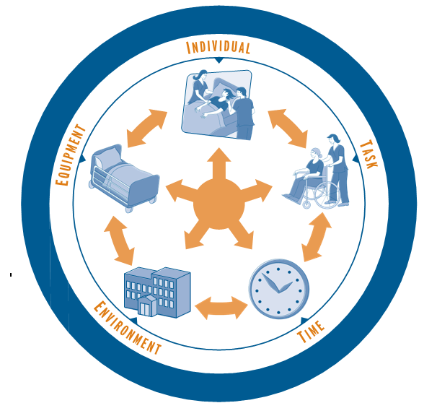
Consists of 5 factors that will affect how a client is moved:
Each factor needs to be considered, and allows a caregiver to organize how a transfer will be executed
The caregiver will adapt the transfer to respect the realities related to each factor
The Global Approach

Slide 5

Individual

Slide 6
Client’s need for assistance with a transfer
Client’s capabilities
Able to perform the natural movement required for the transfer Sufficient strength, balance and coordination in arms and legs to perform the transfer or use the equipment Able to choose and direct one’s own actions | No need for assistance

Slide 7

Task

Slide 8
Consists of 5 factors that will affect how a client is moved:
Each factor needs to be considered, and allows a caregiver to organize how a transfer will be executed
The caregiver will adapt the transfer to respect the realities related to each factor
The Global Approach

Slide 9

Time

Slide 10
Consists of 5 factors that will affect how a client is moved:
Each factor needs to be considered, and allows a caregiver to organize how a transfer will be executed
The caregiver will adapt the transfer to respect the realities related to each factor
The Global Approach

Slide 11

Environment

Slide 12
Consists of 5 factors that will affect how a client is moved:
Each factor needs to be considered, and allows a caregiver to organize how a transfer will be executed
The caregiver will adapt the transfer to respect the realities related to each factor
The Global Approach

Slide 13
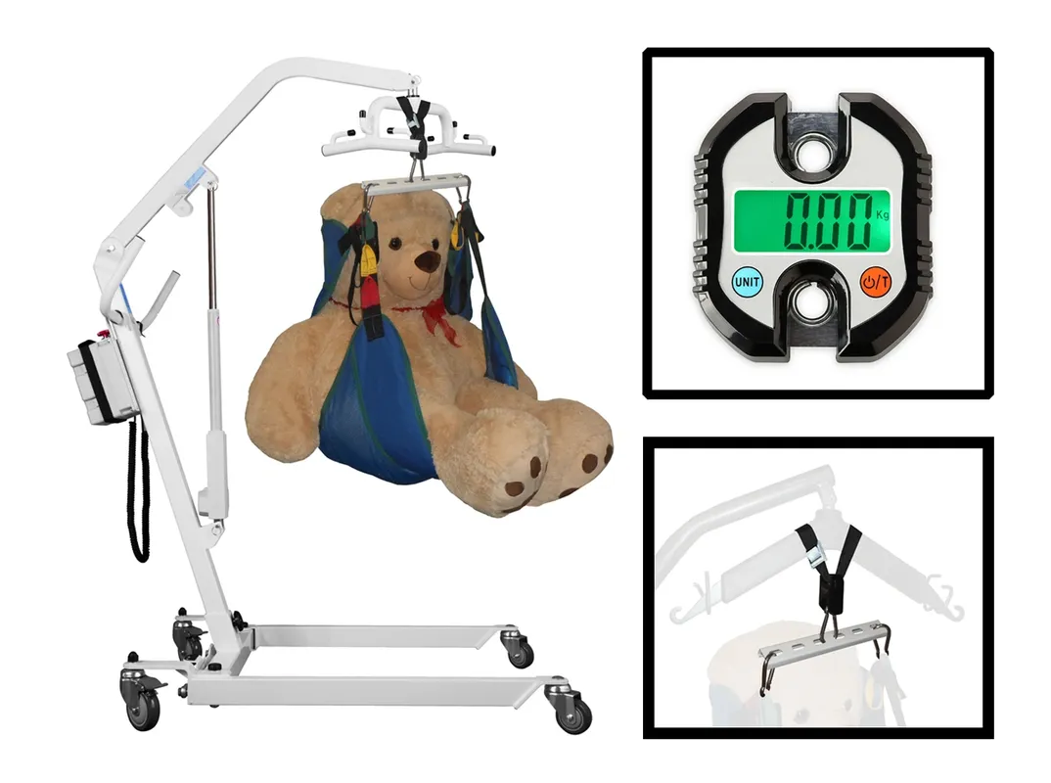
Equipment

Slide 14
Client’s need for assistance with a transfer
Client’s capabilities
Able to perform the natural movement required for the transfer Sufficient strength, balance and coordination in arms and legs to perform the transfer or use the equipment Needs help to choose and direct one’s actions: lacks initiative and motivation, is fearful, has memory problems, is disoriented about what movements to make, is apathetic, hesitant, etc. | Requires supervision

Slide 15
Client’s need for assistance with a transfer
Client’s capabilities
Inadequate strength to initiate the natural movement required for the transfer Weight bearing is possible. Balance and/or coordination problems Able to choose and direct one’s actions or must be helped to choose and direct one’s actions | Needs physical assistance to compensate for partial disability

Slide 16
Client’s need for assistance with a transfer
Client’s capabilities
Unable to perform the natural movement required for the transfer No weight bearing Unable to make a significant effort in the transfer Able or unable to choose and direct one’s actions. Sometimes this is related to a client’s cognitive functioning | Needs physical assistance to compensate for total disability

Slide 17
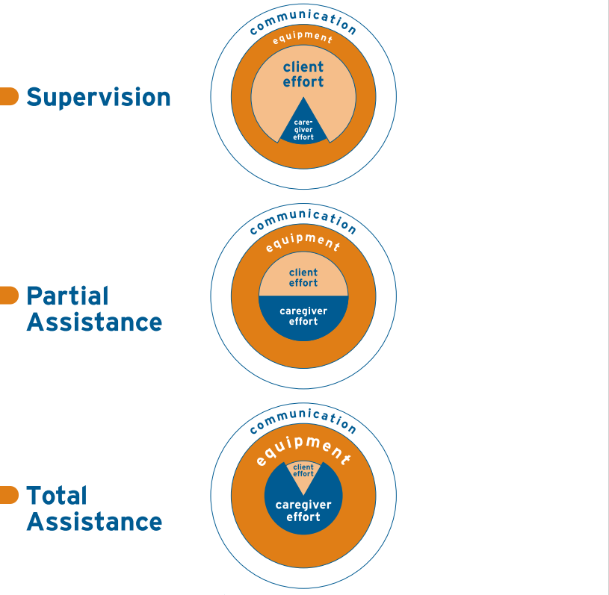
Levels of Assistance

Slide 18

Communication

Slide 19

Establish Good Communication With the Client
Before
Make Contact – eye contact (if appropriate)
Encourage him/her to participate to the extent of his/her abilities – explain what is going to happen and what he/she needs to do
Tell him/her the starting code
During
Remind him/her what to do, step by step
Encourage him/her
Make sure he/she is feeling alright and is able to continue
Maintain eye contact
After
Reflection with the client

Slide 20

Establish Good Team Communication
Before
Share relevant information about the client and the task at hand
Agree on:
-Who will lead the transfer
-Strategy, steps and role of each caregiver and the client
-Preparation of equipment and workspace
-Positioning, holds and movements
During
Speak one at a time
Give instructions and reminders about the steps
Stop when necessary
Give the start signal for each step
After
Exchange feedback about the transfer

Slide 21
Supervision
A client requires supervision when he/she needs help to choose and direct his/her actions:
lacks initiative and motivation
is fearful
has memory problems
is disoriented about what movements to make
hesitant or non-compliant

Slide 22
1. Find out about the client’s capabilities and condition
2. Check on their current status
3. Organize accessories, equipment, supports and adjust
4. Clear a path
5. Memorize the sequence of natural movements
6. Explain the transfer to the client
When supervising a client:

Slide 23
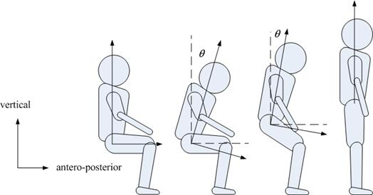
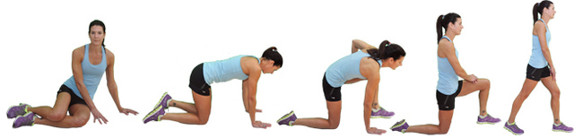
Natural
Movements

Slide 24
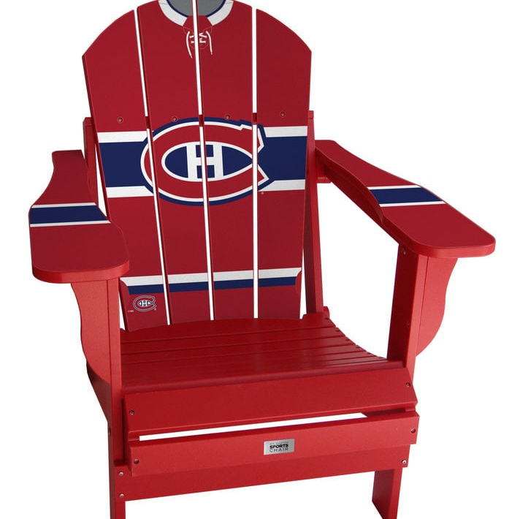
Imagine you feel asleep on a lawn chair (Adirondack) in the hot sun for a few hours. How would you get up?

Slide 25

Imagine you fell on very slippery wet ice. How would you get up?

Slide 26

Imagine your lying-in bed with a severe migraine and need to get up to go to the bathroom.

Slide 27
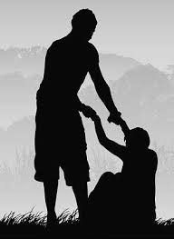
Partial Assistance
Partial assistance is required when a caregiver needs to compensate for the client’s disability, using the caregiver’s own balance, strength or coordination
The two critical variables for successful partial assistance are:
The client’s reaction
The caregiver’s safety

Slide 28
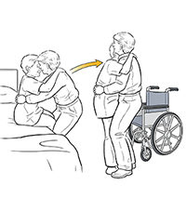
Partial Assistance
More effort is required by the caregiver than when a client needs minimal assistance:
Provide support
Create momentum (counterweight and weight transfer)
Stabilize the client’s position

Slide 29
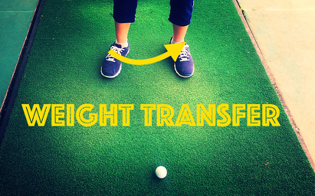

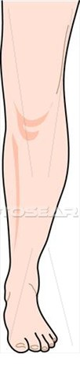
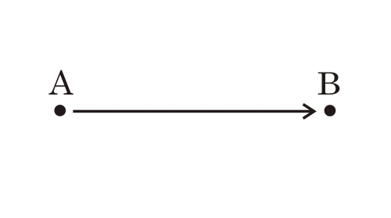
Counter-Weight and Weight-Transfer
Counter-weight refers to the use of a person’s body weight to apply force into movement, by countering with the weight of a client
Weight-transfer is when a person’s legs provide the energy required for a transfer, by shifting the person’s stabilized core from one leg to the other

Slide 30
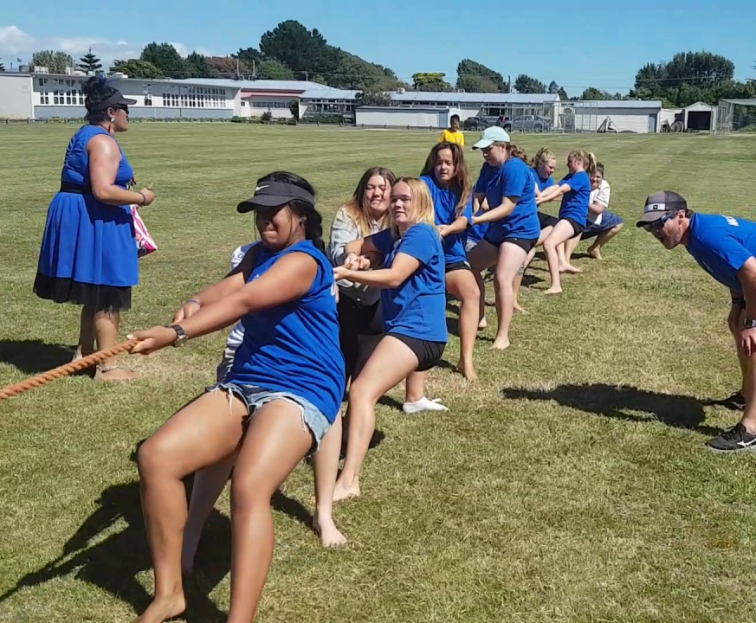


Slide 31

This video demonstrates moving a client who needs minimal assistance
Notes:
https://www.youtube.com/watch?v=N5QGhXT_dt8
Eric provides an explanation of weight and counter weight

Slide 32
Watch this video clip where a client is using the slide board
Notes:
https://www.youtube.com/watch?v=50SaLkCBb4w

Slide 33
Watch this video clip where a client is moved from the bed to a walker
Notes:
https://www.youtube.com/watch?v=_ftjZICLVto

Slide 34
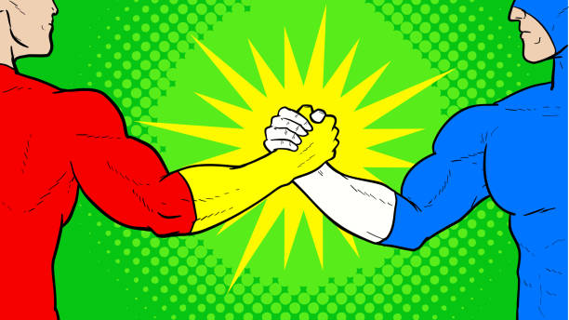
The grip!

Slide 35
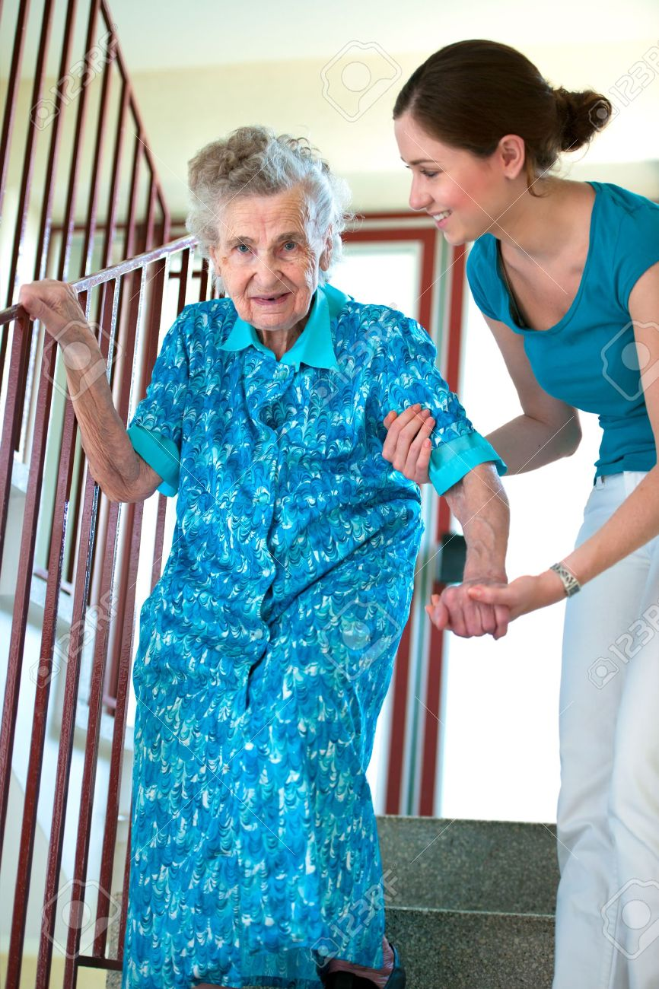
Steps Involved in Preparation
Important Client Information to Consider
Height and Weight
Capabilities:
  Physical (strength, endurance, balance)
  Sensory (sight, hearing, touch)
  Cognitive (understanding, confusion)
  Communication (language skills)
Motivation and cooperation
Pain and discomfort
What does the client need?
Client needs to use the bathroom
Client needs to walk downstairs
When does it need to be done?
Appropriate time of the day
Time available

Slide 36
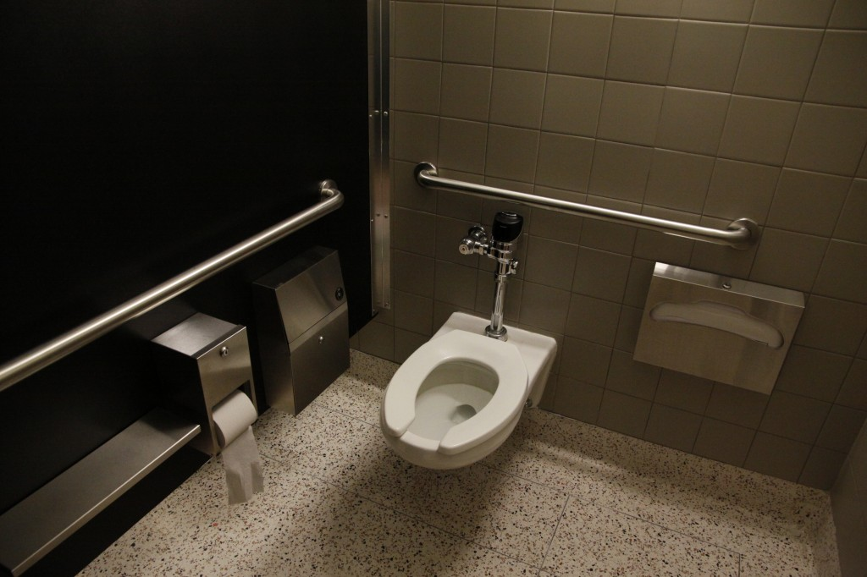
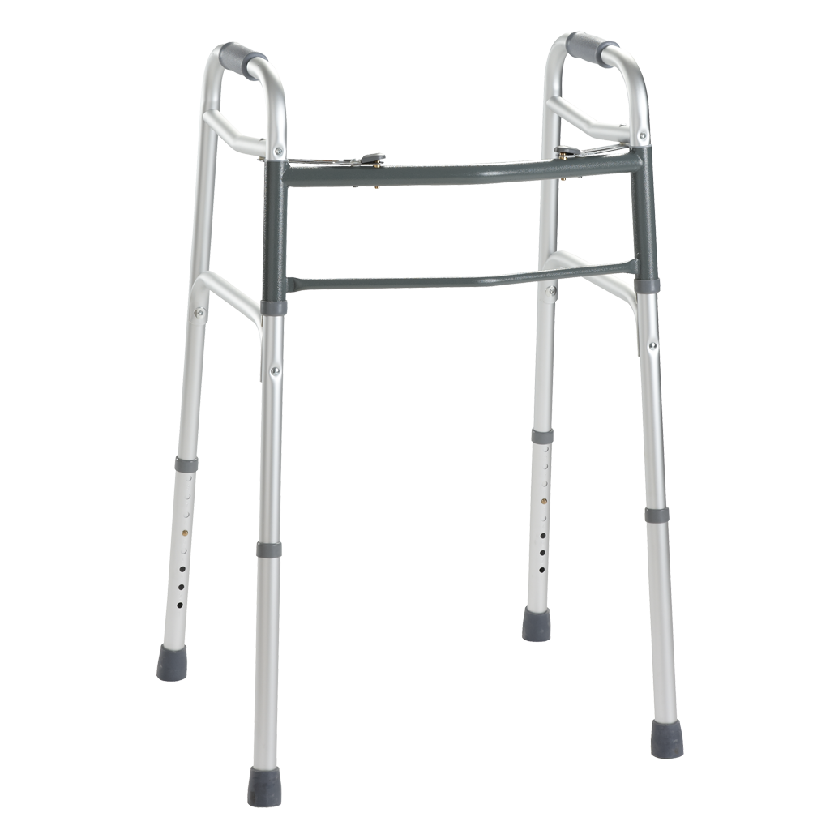
Steps Involved in Preparation
(Continued)
What equipment is available?
Well suited to the client’s condition
Available & in good condition
Adjusted or adjustable
Immobilized
Well placed, near by
Other accessories within reach
Mechanical lifting aids
What is the environment like?
Adequate space
Path free of obstacles
Adapted to the client’s condition
Floor clean, dry
Adequate lighting

Slide 37
The Principles of Safe Handling and Movement
The principles of safe handling and movement consist of techniques that, when applied, protect both the caregiver and client before, during and after a transfer

Slide 38


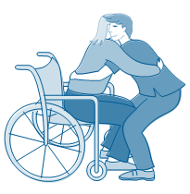
Positioning Principles
Feet apart
Feet pointed to facilitate movement
Back: No twisting
Straight back
Knees bent

Slide 39
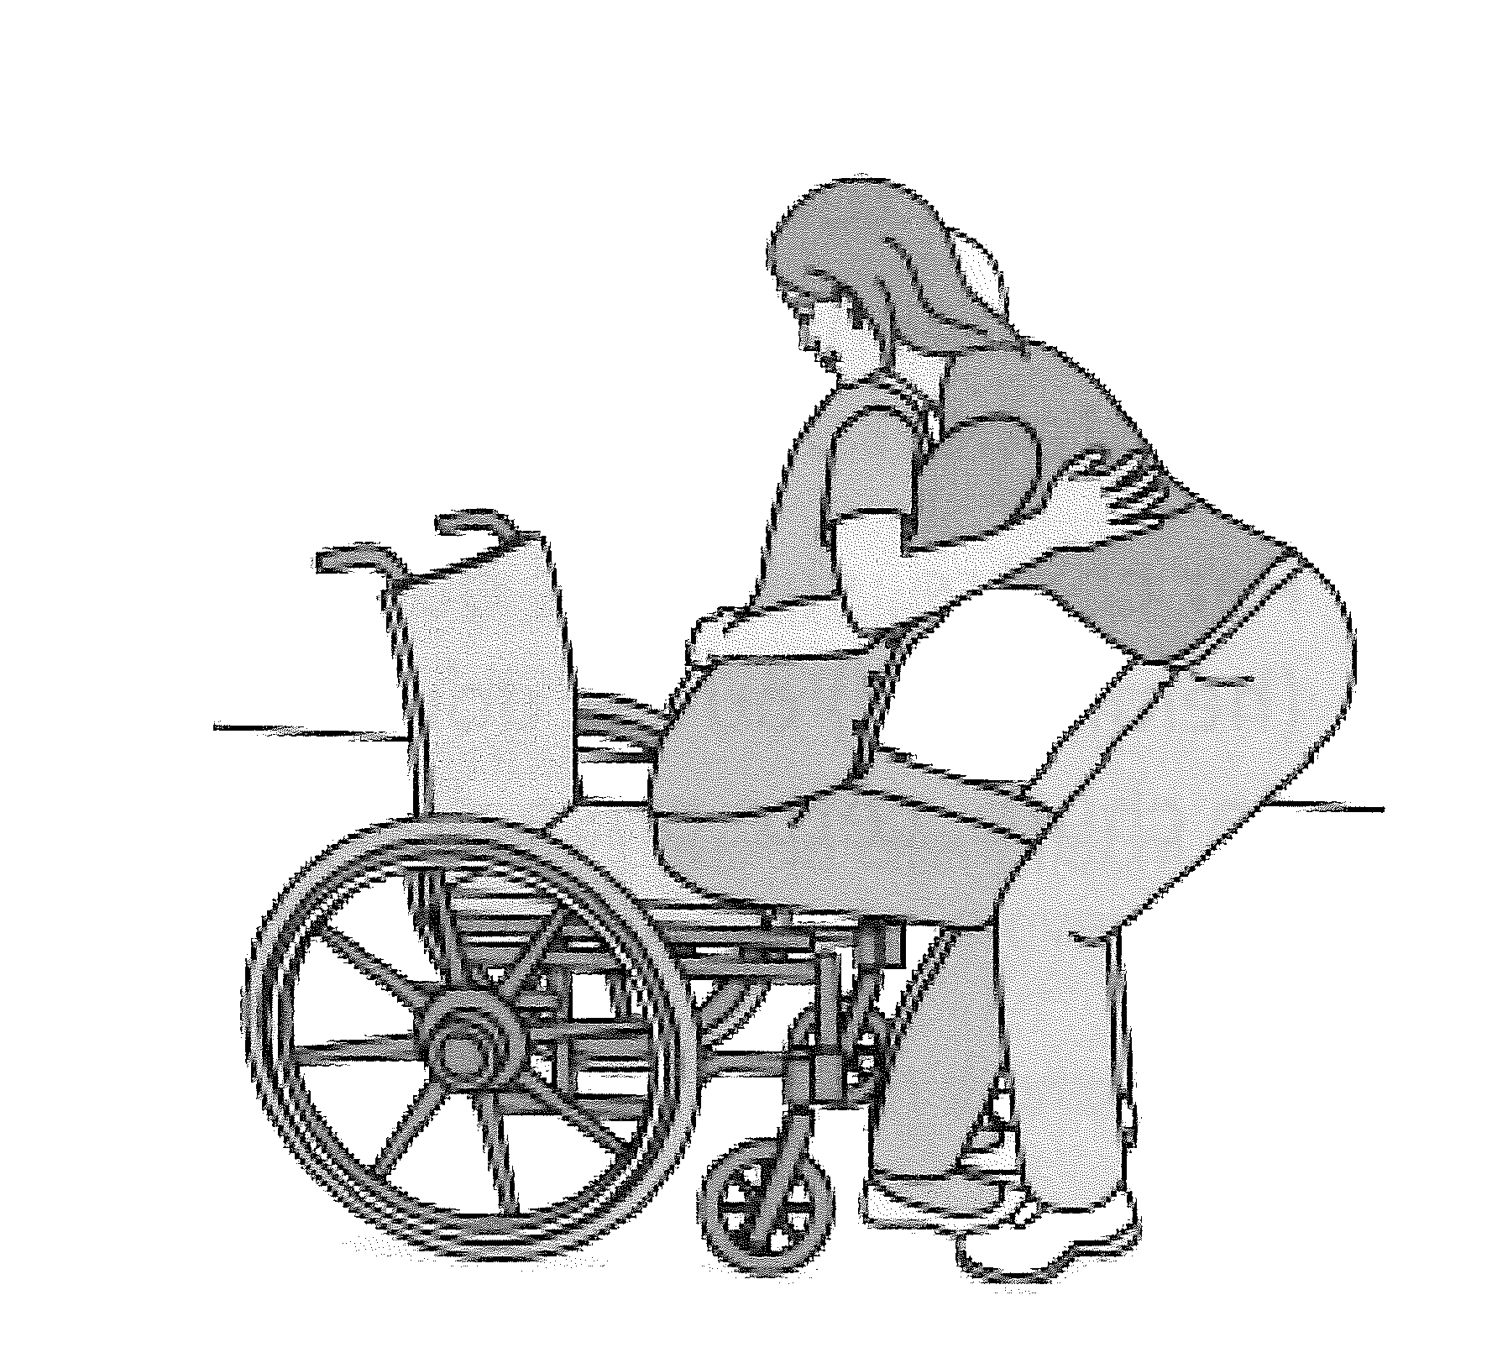
Positioned for Counterweight

Slide 40
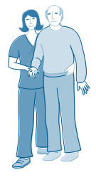
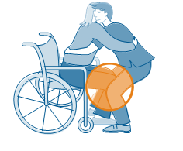
Holding Principles
Solid grip
Gentle hold
Close contact
Arms wrapped around client
Use handles
Block sliding points
Encourage client to participate

Slide 41
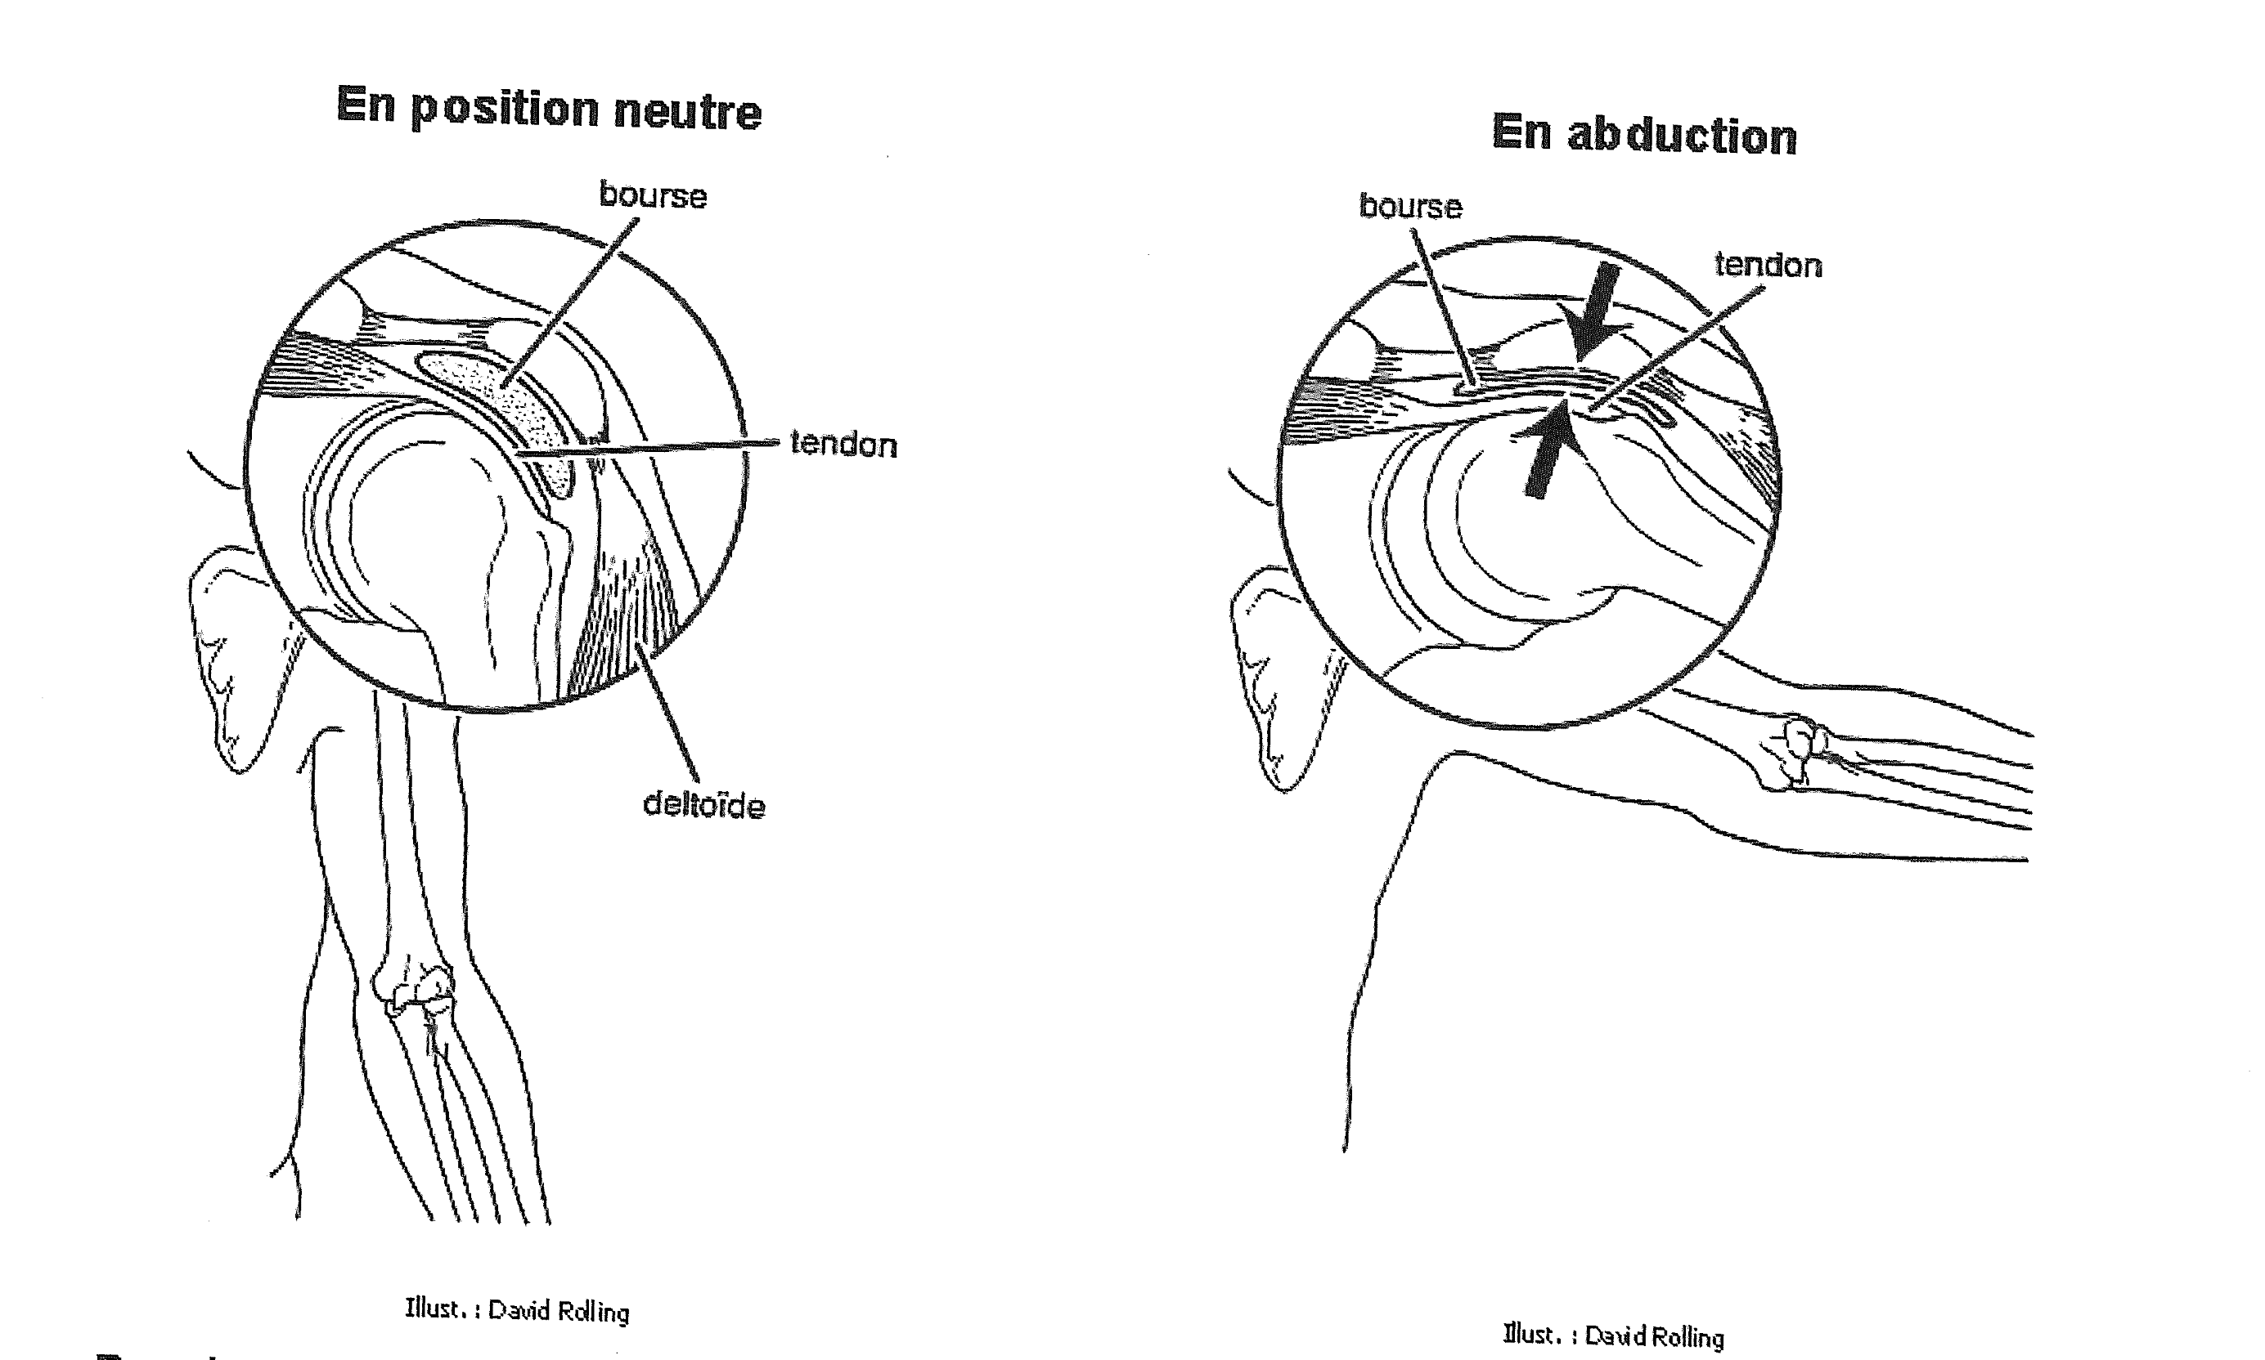
Carrying weight with arms at more than 30 degrees

Slide 42
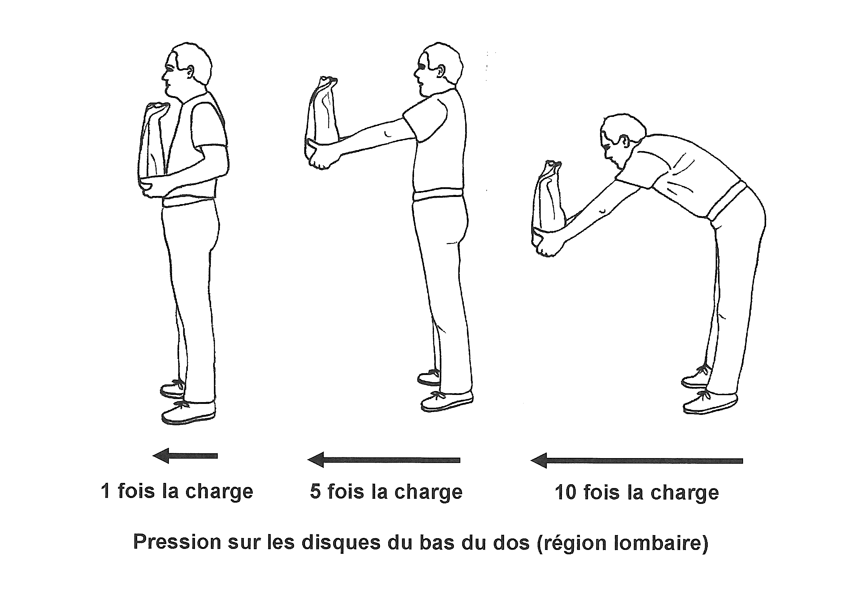
Carrying Weight away from body.

Slide 43
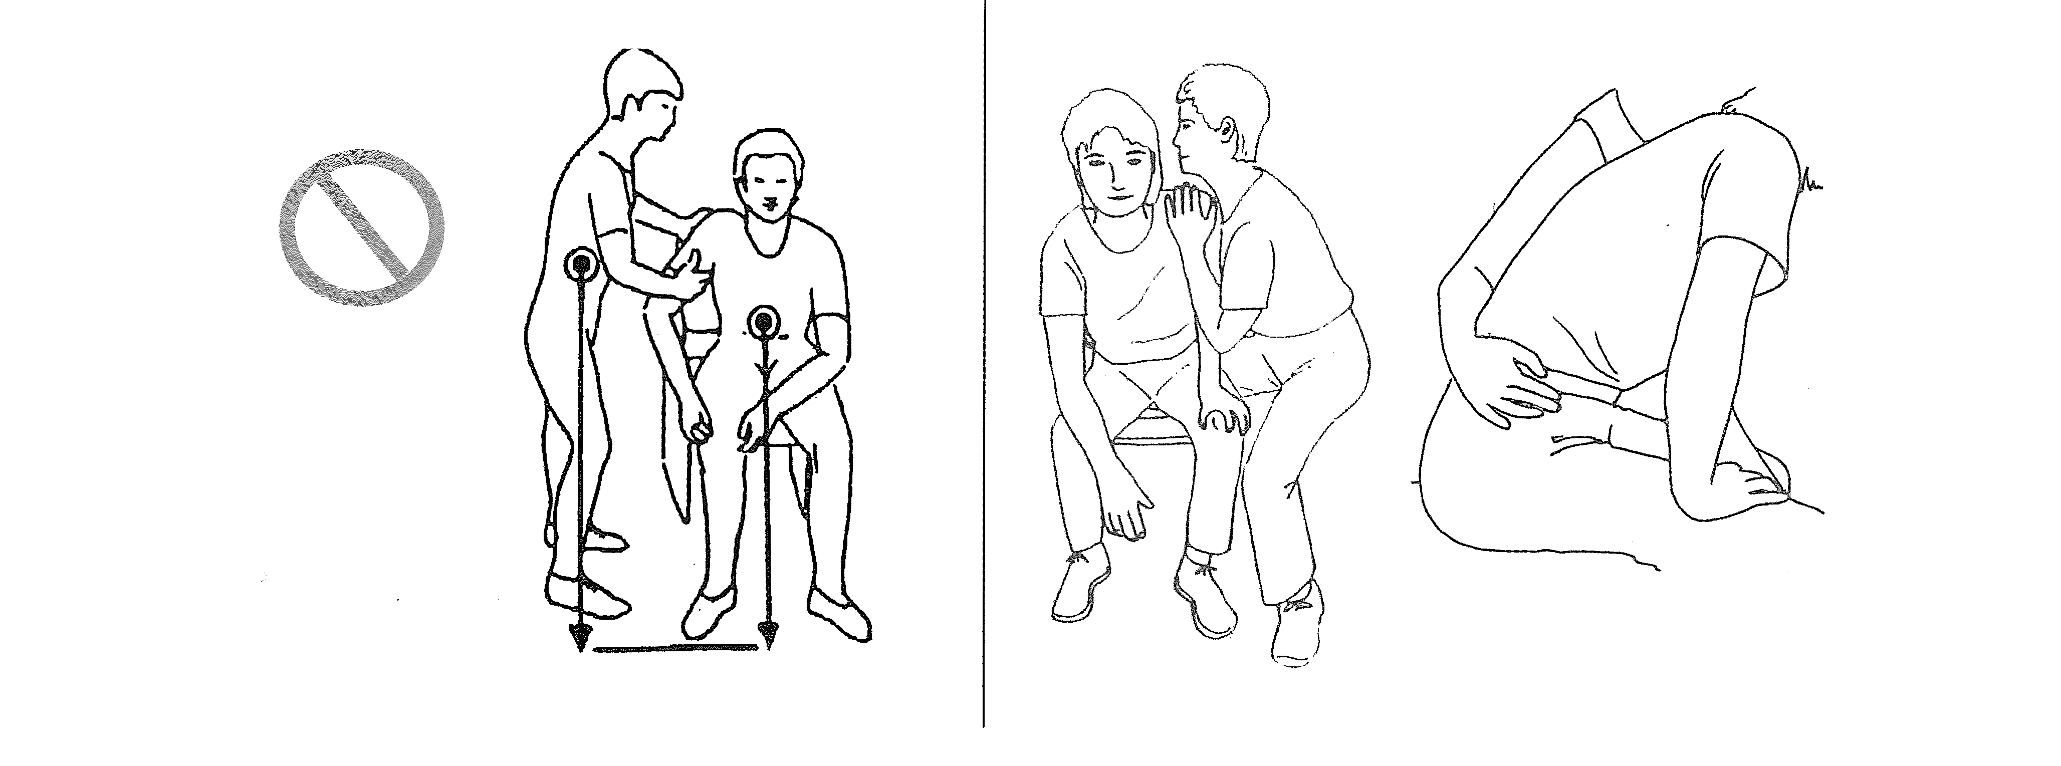
Don’t grab under arm
Enveloping Hold

Slide 44
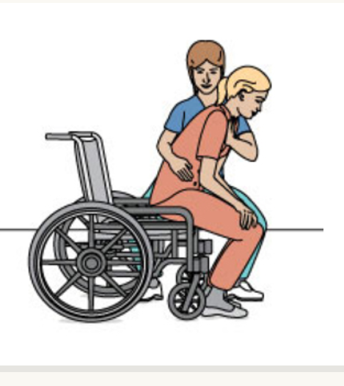
Enveloping Hold

Slide 45
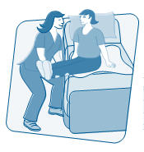
Movement Principles
Provide only as much assistance as is required
Tell the client what to do
Respect natural movements
Roll, slide, or pivot the client rather than lifting
Use weight transfers and/or counterweight to provide effort

Slide 46
Movement Principles
Continued…
Perform movements one at a time, step by step
Pull the client towards you rather than pushing

Slide 47
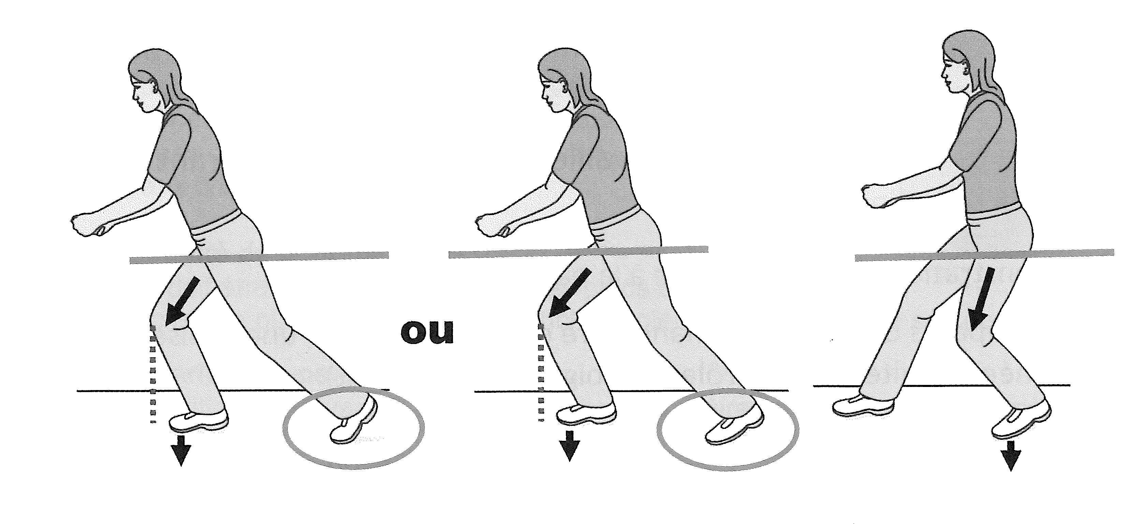
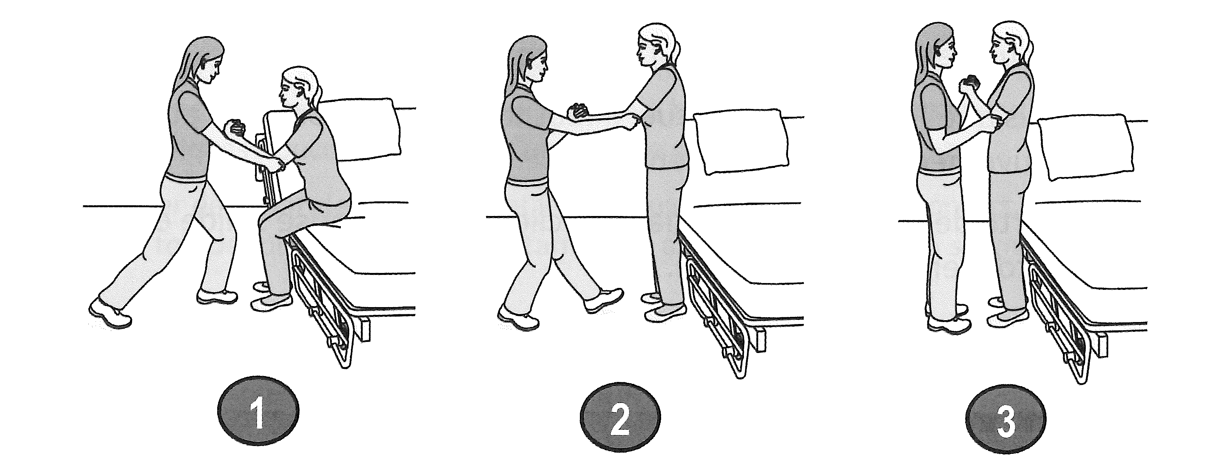
Weight Transfer Front to Back

Slide 48
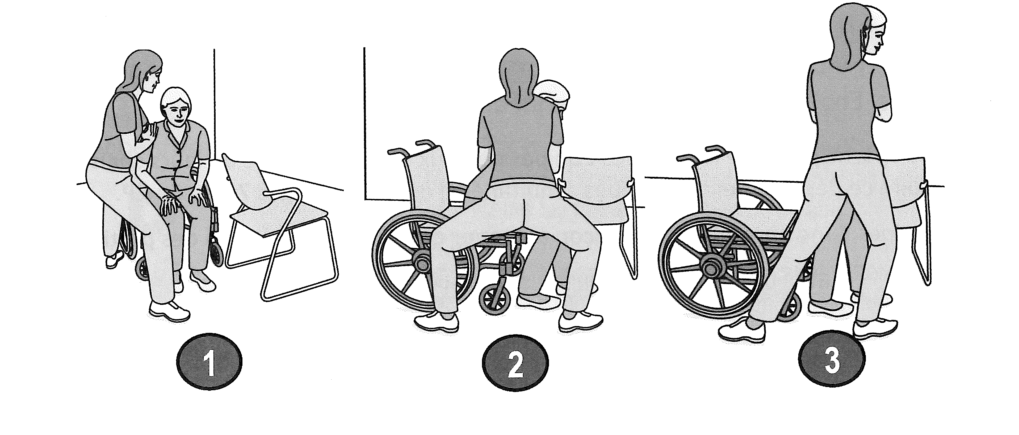
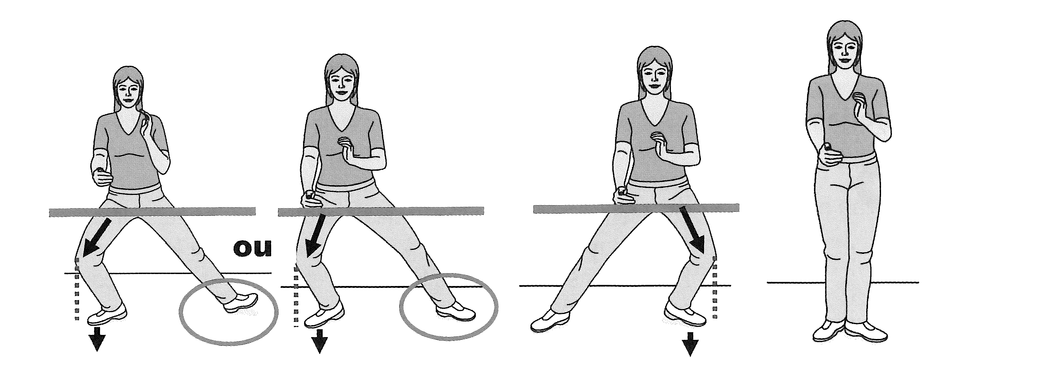
Weight Transfer Side to Side

Slide 49
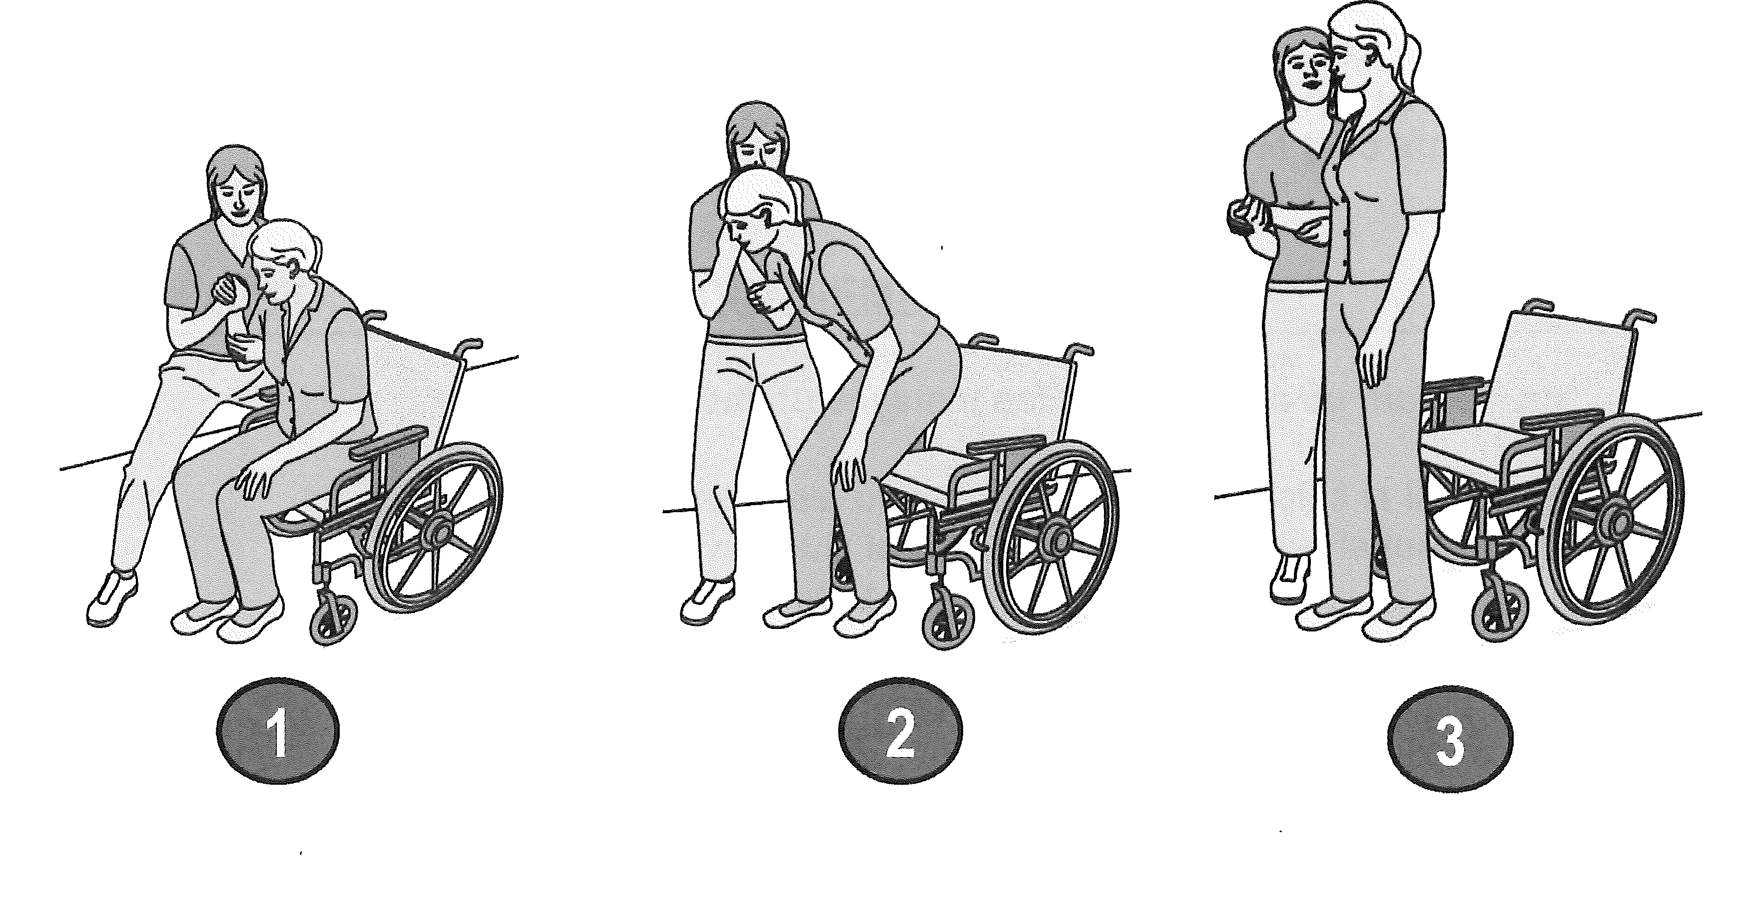

Slide 50



Sources of Danger
Before executing any movements with a client, it’s important to assess and identify if there are any factors that present a potential risk and eliminate or remove them
Risks may include:
Wet floor
Obstacles obstructing a path
A client who is confused and/or weak at a given moment
Notes:
Listen to the audio

Slide 51
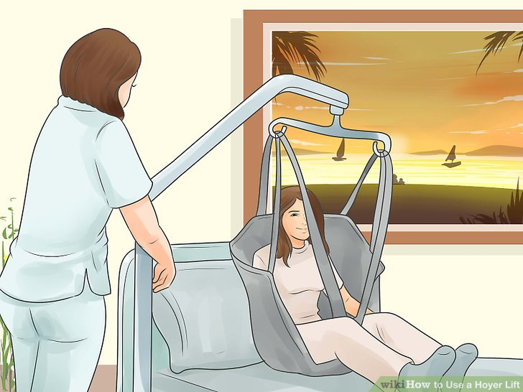
Complete Assistance
Complete assistance is required when a client does not have the necessary motor skills (strength, coordination) to perform major steps in a transfers. A mechanical lifting aid should be used, unless the client does not weigh a lot (a young child)
The client’s physical participation is minimal
Certain maneuvers have to be performed without mechanical assistance due to a particular work or environmental situation. Team work is necessary
Communication is vital
The client’s non verbal communication (relaxed face, expression of pain, fear, etc.) should be monitored

Slide 52
Equipment

Slide 53
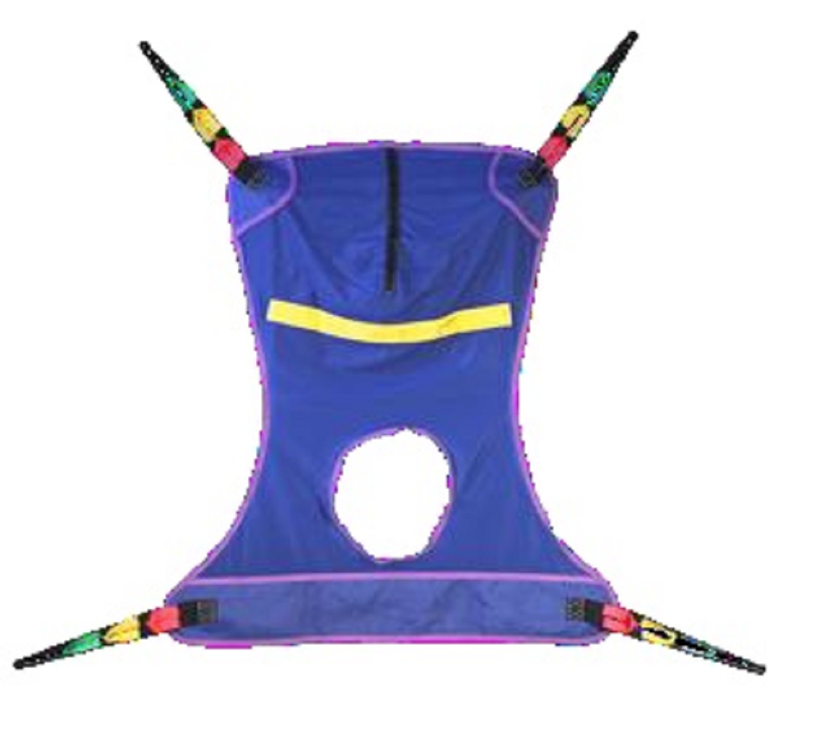
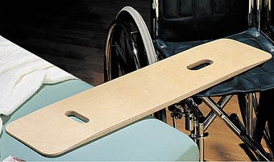
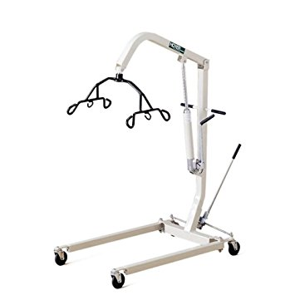
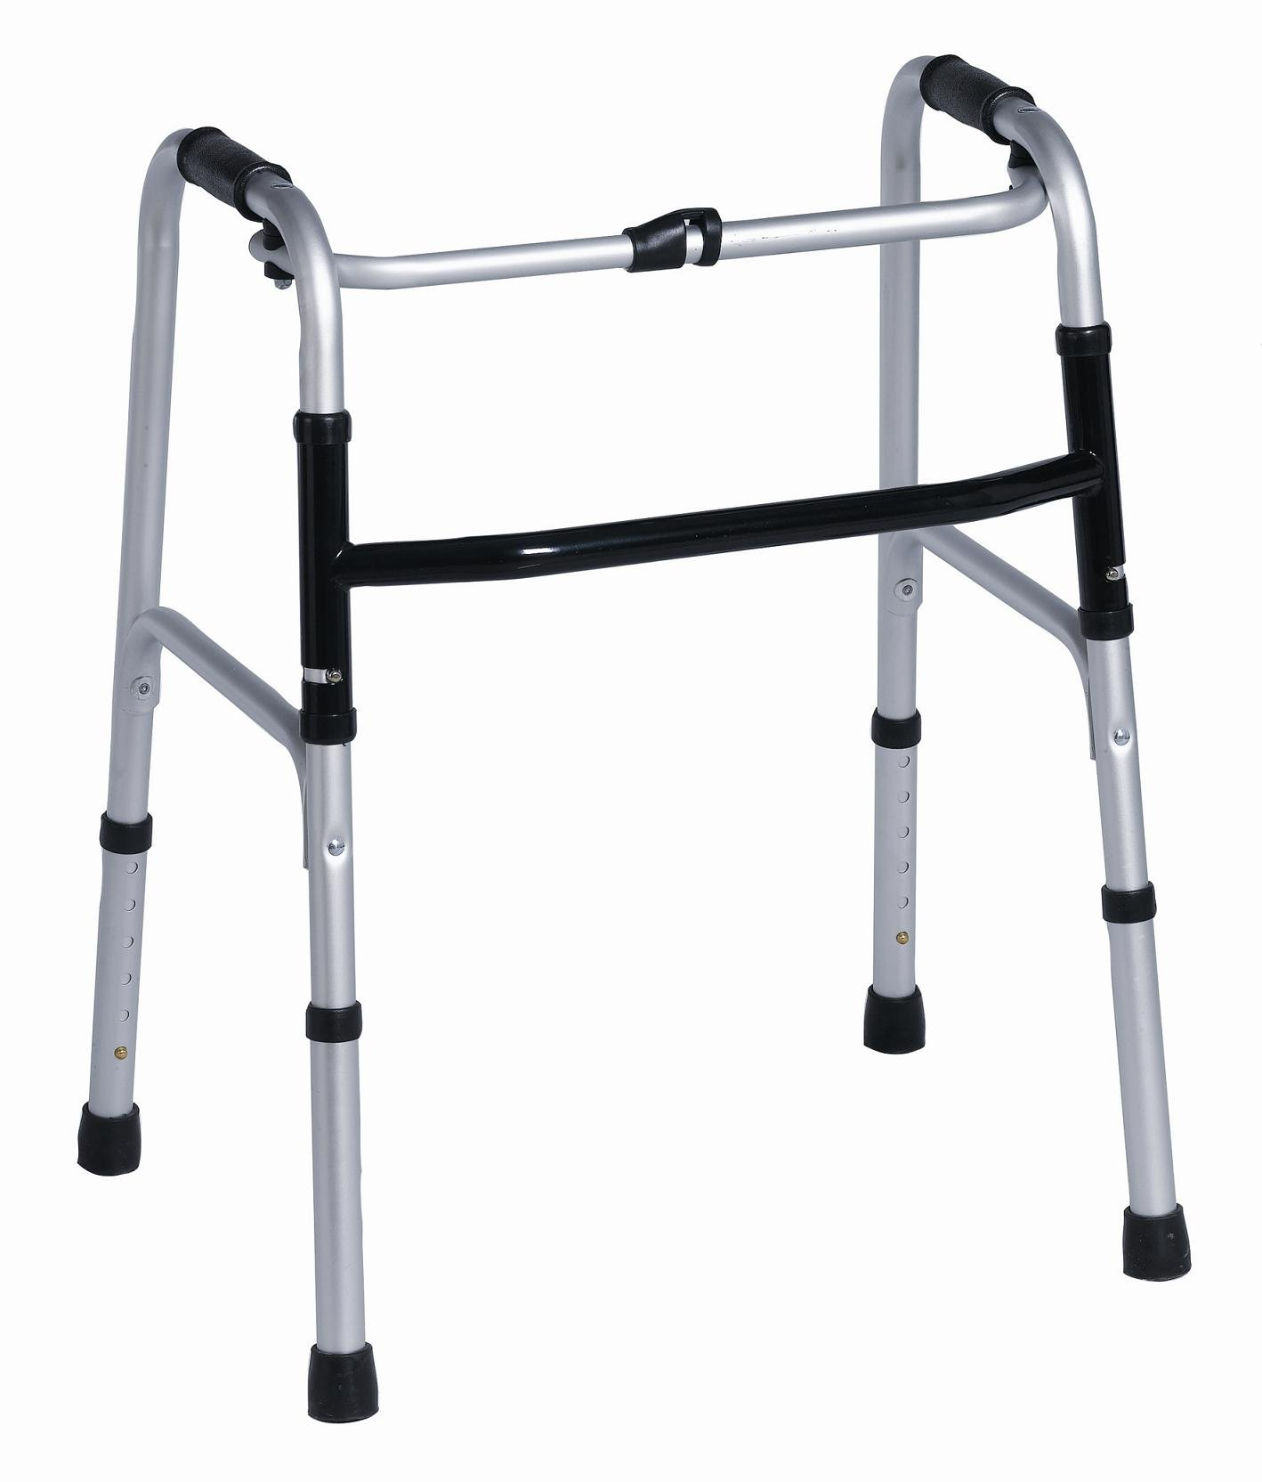

Slide 54
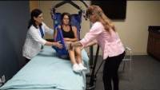
Hoyer Lift
Notes:
https://www.youtube.com/watch?v=jLetizMjNHg

Slide 55
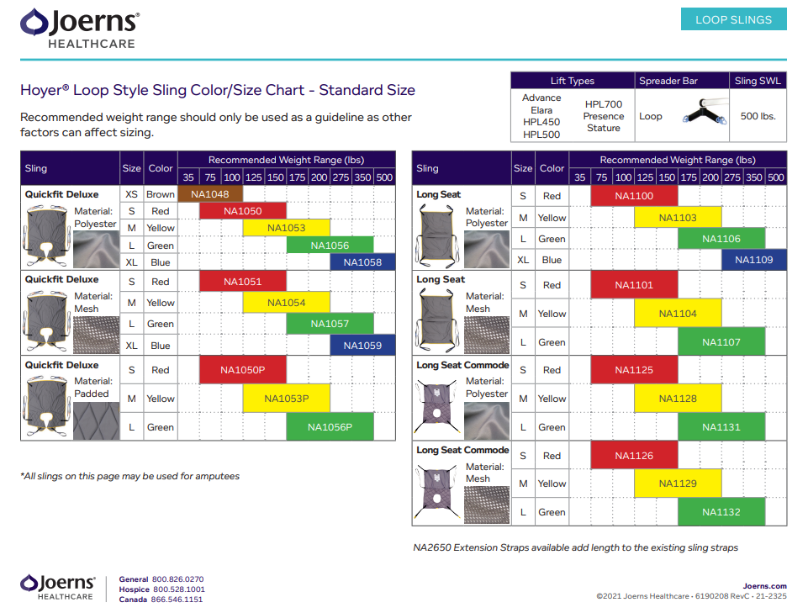

Slide 56
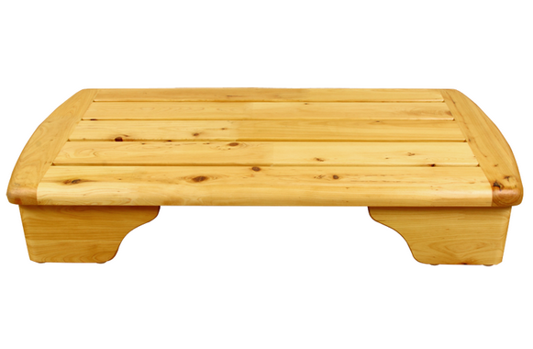
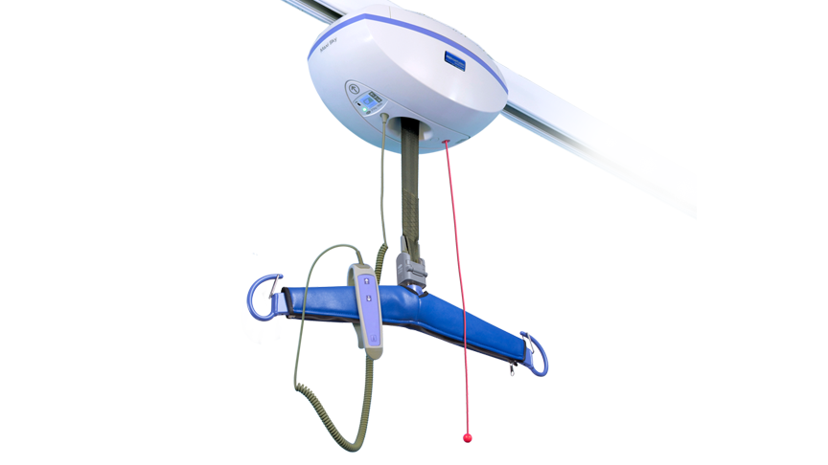
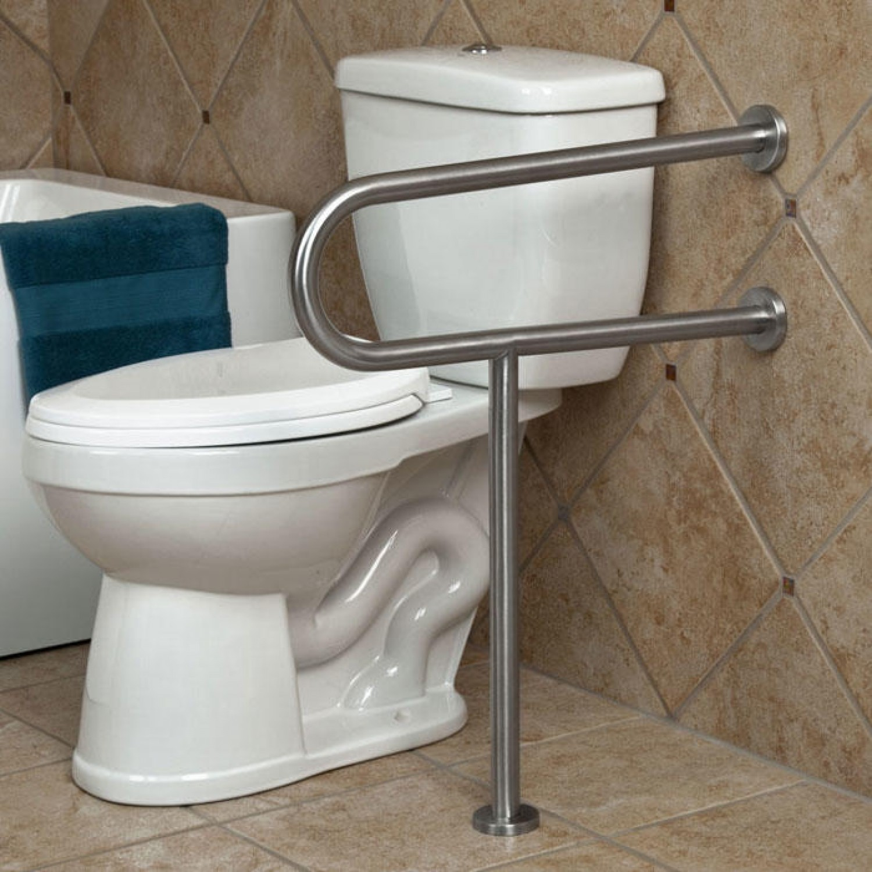
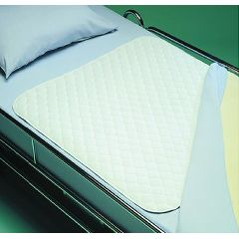

Slide 57
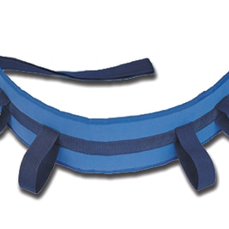
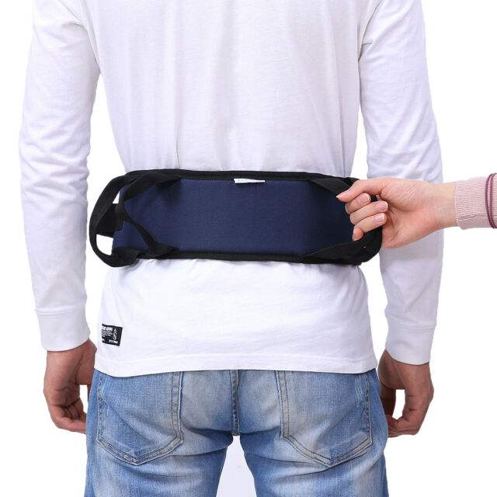

Slide 58
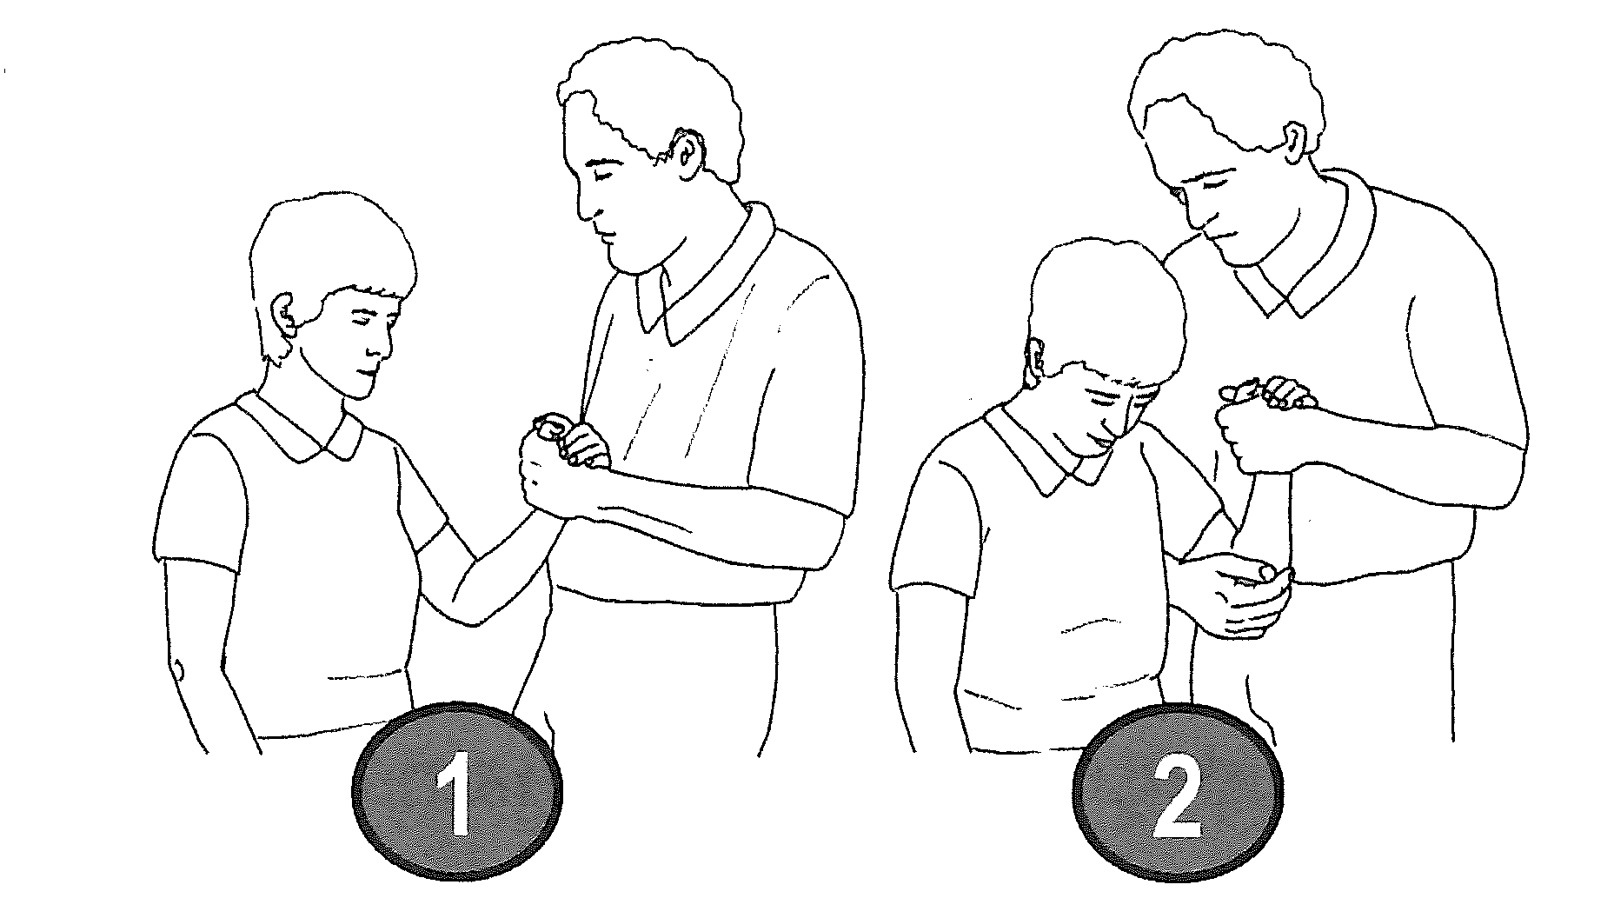
Enveloping arm

