Slide 1

02FL Adopt Safe Working Practices Part B
RAC Champlain College
SPECIAL EDUCATION TECHNIQUES
Cluster A: Social Participation

Slide 2
Resources to heIp with this competency
https://www.youtube.com/watch?v=ZsaorjIo1Yc
https://www.youtube.com/watch?v=XADIs-A1iiM
https://www.youtube.com/watch?v=uOzDGrcvmus

Slide 3
02FI Adopt Safe Working Practices (Part B)
02FL-3 Protect own psychological well-being and that of others
  Accurate recognition of stress factors
  Accurate recognition of distress indicators
  Appropriate choice of preventative methods
45% of the final grade for 02FL will be evaluated in this assignment

Slide 4
Written portion of the assignment
Signs of distress in clients / their family members
Community supports
Signs and factors of occupational burnout
Creation of a personal wellness plan

Slide 5
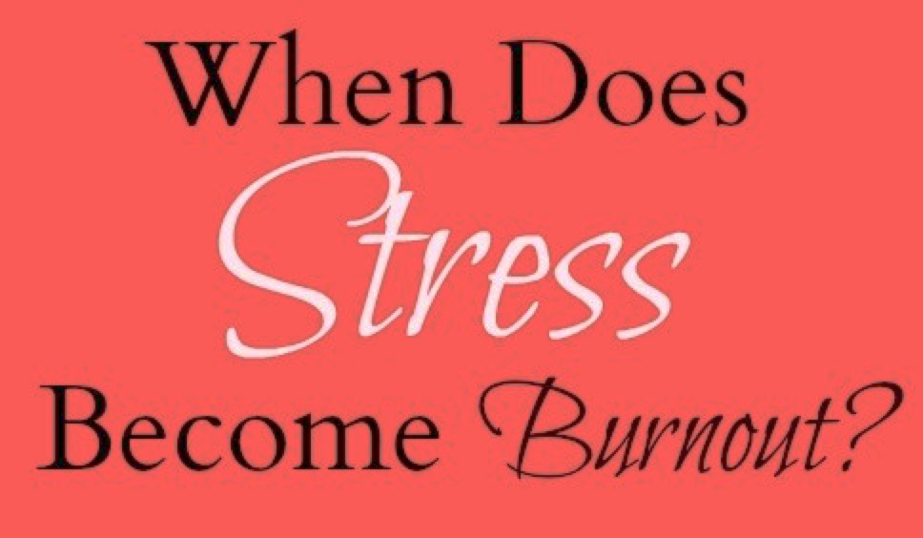
A small amount of Stress is Normal and Natural.
So, when does Stress become Damaging, Hurtful, or Diagnostic?

Slide 6
What is Stress ?
Stress can have a variety of definitions
It comes in different shapes, forms, types, kinds, frequencies, and intensities.
Like any other technical concept, Stress can be conceptualized in simple terms or in complex definitions, dynamics, and functions.
Burnout is a psychological term to describe the long-term experience of exhaustion, weariness, and diminished interest in daily life and activities.

Slide 7
Definitions:
Stress is a state of mental and physical tension, and pressured demand, caused by adverse situations, and resulting in disturbing emotions and symptoms.
In the world of physics and materials, a certain object becomes strained and stressed out when it is subjected to an extended pressure, uncontrolled use, job malfunction, or composition fatigue.
That is true of any organism or operational system, when it becomes overworked, overwhelmed, and over-saturated. [that is true of us humans for we are not machines]

Slide 8
== STRESS ==
Is a force, tension, or pressure, caused by a set of unpleasant events and unmanageable situations.
Stress Can Be:
External or Internal Based
Single or Multiple Episode
Real or Perceived (mentally)
Occasional or Chronic
Light or Intense in Nature
Benign or Life-threatening
Self–or Other-Generated
Mild, Moderate, or Acute
Positive or Negative

Slide 9
Two Types of Stress:
Distress (negative stress) e.g., Accident, Terminal Illness, Job Loss, Divorce, Disaster, Financial Break, Death of Loved-Ones, etc. versus
Eustress (positive stress) e.g., Moving Home, Graduation, Starting New Job, Preparing for Marriage, Traveling to New Location, etc.

Slide 10

What is Distress
Emotional, social, spiritual, or physical pain or suffering that may cause a person to feel sad, afraid, depressed, anxious, or lonely. People in distress may also feel that they are not able to manage or cope with changes caused by normal life activities or by having a disease, such as cancer

Slide 11
What are the Signs?

Slide 12
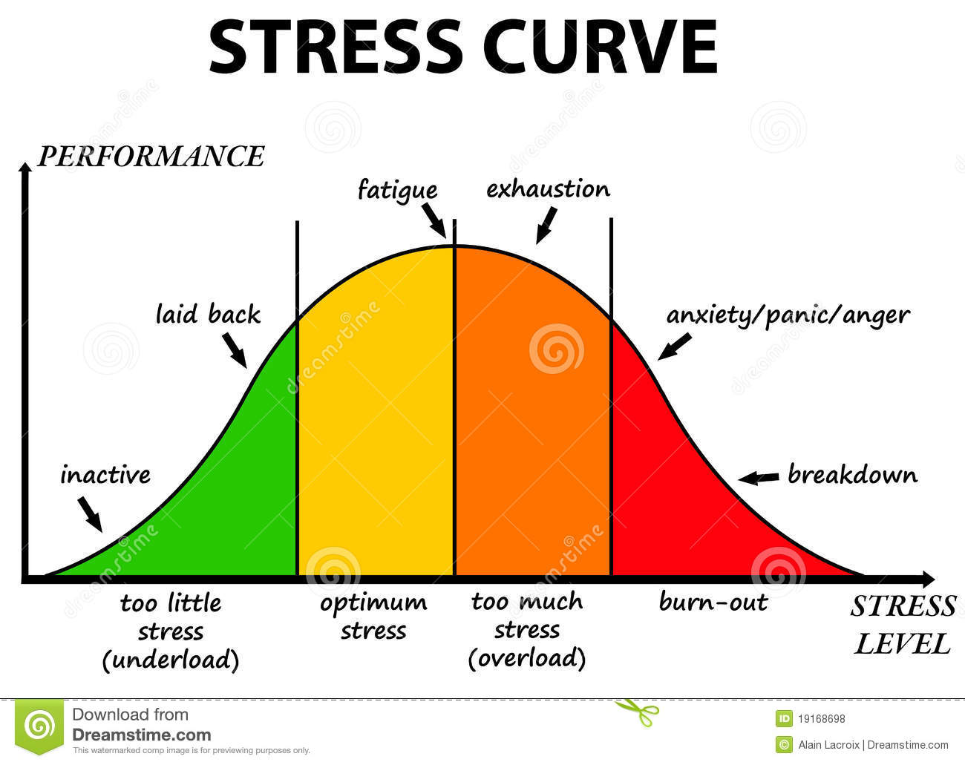

Slide 13
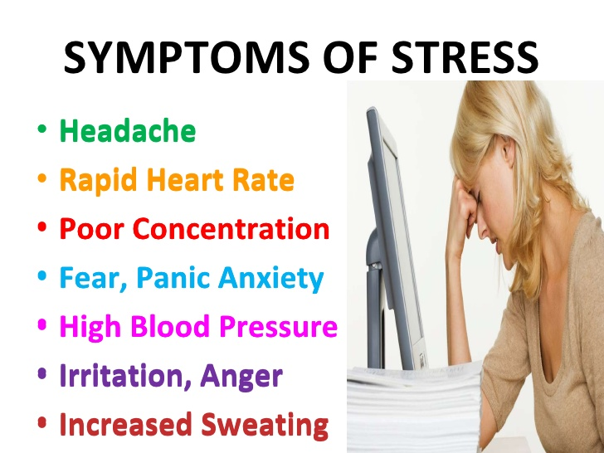
Sample of

Slide 14
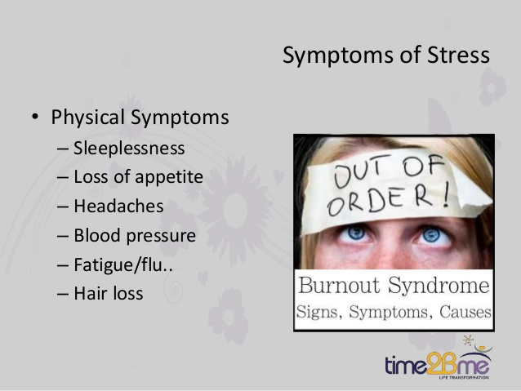

Slide 15
There are 3 main areas or sources that cause stress:
Lifestyle Habits and Practices
Workload & Work Environment
Personality Types and Innate Traits

Slide 16
Over Investment will certainly lead to
Diffusion & Depletion
Under Investment will certainly lead to
Low Impact & Ineffectiveness

Slide 17
An Over Empathy approach will certainly lead to Fusion results: no clear separation of minds or passions and no clear perspective or objectivity
An Under Empathy approach will certainly lead to Alienation results: no passionate connection but rather mechanical & impersonal relations

Slide 18
Perhaps, at times, totally avoiding
Burnout, is not possible.
Some of us have natural tendency and ability for
High Tolerance & Low Irritation and others simply have tendency for
High Irritation & Low Tolerance
So, Know Yourself & Keep Becoming Self-Aware.

Slide 19

Self-Awareness
Thinking
The
Professional
Feeling
Doing

Slide 20

Burnout
Burnout is a state of emotional and physical exhaustion caused by excessive and prolonged exposure to stress. It can occur when you feel overwhelmed and unable to meet constant demands. As the stress continues, we begin to lose interest and motivation, which led us to take on that role in the first place. Therefore, Burnout reduces our productivity, disturbs our inner equilibrium, and drains our energy, leaving us feeling increasingly depleted, helpless, resentful, pessimistic, and at times cynical.
Eventually, you feel that do not have anything more of value to offer or to give.

Slide 21
Stress
Emotions are over reactive
Burnout
Emotions are blunted, Flat
Produces helplessness and hopelessness
Produces urgency and hyperactivity
Loss of energy
Leads to anxiety disorders
Primary damage is physical
May kill you prematurely
Loss of motivation, ideals, and hope
Leads to detachment and depression
Primary damage is emotional
May make life seem not worth living

Slide 22
Burnout
Syndrome
Acute
Stress
Clinical
Depression
Anxiety
Disorders

Slide 23

All Helping Professionals are at Risk of
Stress Related Conditions,
Compassion Fatigue,
Secondary Trauma, and Burnout Symptoms,
Which may interfere with their daily functioning, performance, inner harmony, competency, and relationships with colleagues and family.
If unattended or untreated, these symptoms may develop into more serious diagnoses, like some form of Clinical Depression ,
Anxiety Disorder, or other mental health issue.

Slide 24
Response System to Stressful Situations
Fight or Flight Reaction
Stress Hormone “Cortisol”
Cortisol alters your immune system and suppresses the digestive function, reproductive system, and growth processes. This natural alarm is complex, and it communicates with regions of your brain, that control mood, motivation, and fear.
Through a combination of nerve and hormonal signals, your adrenal glands (which are located atop your kidneys) begin releasing a surge of hormones, including adrenaline and cortisol.
The long-term activation of this stress-response system — and the overexposure to cortisol and other stress hormones — can disrupt almost all your body's functions.

Slide 25
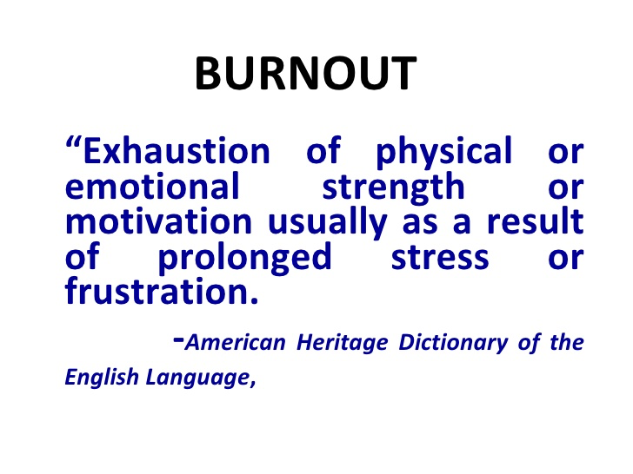
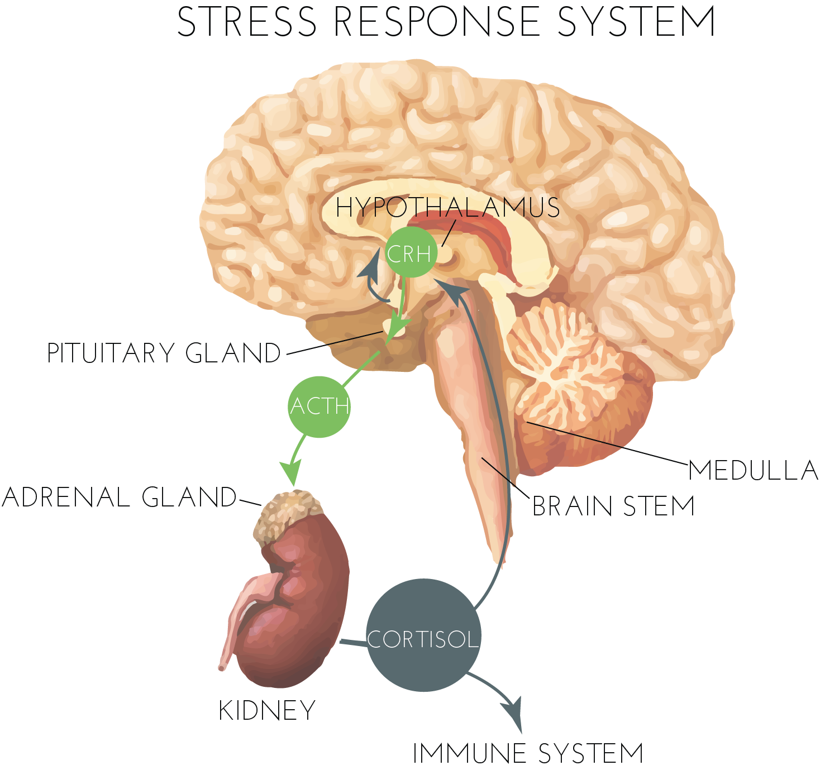
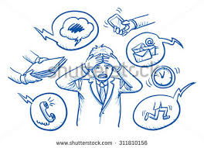

Slide 26
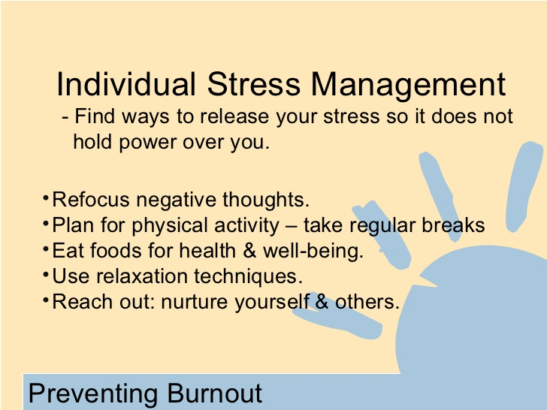

Slide 27
Burnout can cause significant physical, emotional, psychological, and spiritual damage to people.
Emotional signs and symptoms of burnout
Sense of failure and self-doubt
Becoming helpless, trapped, and defeated
Detachment, feeling alone in the world
Increasing attitude of cynicism and negative outlook
Sense of apathy & Decreased satisfaction and fulfillment in life …
Spiritual signs and symptoms of burnout
Sense of Hopelessness
Loss of Purpose and Meaning in Life
Inability to meditate or worship or practice spirituality
Crisis of Faith and Distance oneself from the Divine and God …

Slide 28

Some Behavioral Signs of Burnout
Withdrawing from responsibilities
Isolating yourself from others
Taking longer to get things done
Using food, drugs, or alcohol to cope
Taking out your frustrations on others
Skipping work or coming in late and leaving early
Experiencing irritability and over-reactions
Developing unhealthy habits and coping styles

Slide 29
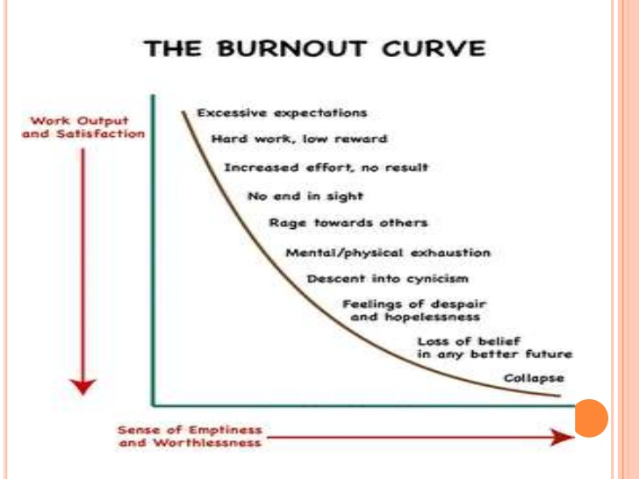

Slide 30

Client / their families
Distress and supports

Slide 31
“Compassion Fatigue”
Compassion Fatigue is a new emerging term in the scholarly literature. It is the condition of emotional and physical tiredness that results when helpers are caring and giving so much of themselves and keep showing extended MERCY !
It is like Secondary Trauma Effect but different in that Compassion Fatigue does not display any serious trauma-related symptoms.

Slide 32
Secondary Trauma (or) Vicarious Trauma
It can be described as indirect exposure to a traumatic event or after working with traumatized people (victims of trauma) for an extended period.
Helping professionals — like SCCS, counselors, nurses, therapists, physicians, rescue workers, police officers, social workers, lawyers, pastors, teachers, etc.— may experience vicarious trauma, when witnessing a trauma event, or when helping and showing empathy to others, the survivors of tragedies, suffering, disasters, and pain. So, the helpers themselves become overwhelmed with some traumatic stress symptoms and mental agonies.

Slide 33
family members / caregivers and burnout

Slide 34
Supports / resources

Slide 35
Burnout prevention tips
Start the day with a relaxing ritual. Rather jumping out of bed as soon as you wake up, spend at least fifteen minutes meditating, writing in your journal, doing gentle stretches, or reading something that inspires you.
Adopt healthy eating, exercising, and sleeping habits. When you eat right, engage in regular physical activity, and get plenty of rest, you have the energy and resilience to deal with life’s hassles and demands.
Set boundaries. Don’t overextend yourself. Learn how to say “no” to requests on your time. If you find this difficult, remind yourself that saying “no” allows you to say “yes” to the things that you truly want to do.
Take a daily break from technology. Set a time each day when you completely disconnect. Put away your laptop, turn off your phone, and stop checking email.
Nourish your creative side. Creativity is a powerful antidote to burnout. Try something new, start a fun project, or resume a favorite hobby. Choose activities that have nothing to do with work.
Learn how to manage stress. When you’re on the road to burnout, you may feel helpless. But you have a lot more control over stress than you may think. Learning how to manage stress can help you regain your balance.
https://www.slideshare.net/drasimrana/burnout-syndrome-among-critical-care-physicians

Slide 36
Deep & Slow Breathing.
Watch your posture when sitting or standing.
Eat Healthy, drink lots of fluids.
Stay active, Keep moving, even short brisk walks, & basic stretching several times a day.
Good Time Management.
Letting go of small irritations.
Mindfulness Practices: Acceptance, Compassion, Forgiveness, Humility, Meditation, Peaceful attitude, …

Slide 37


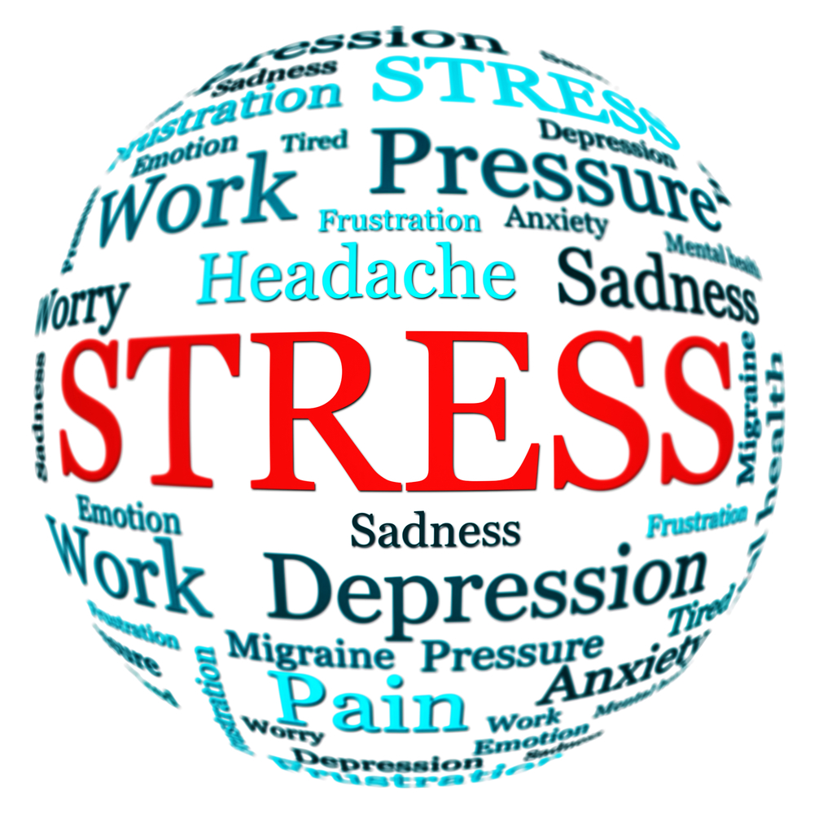
Stop your Track, Step Back, and See your Trajectory.
Try to Keep things into Perspective and always Look for the big Picture.
Watch your Movements, unconscious Reactions, and Breathing patterns.
Acknowledge the challenges, and the Negatives, yet try to Focus on the Positives.
Watch what runs into your Head and what you often Tell Yourself.
Develop Healthy Self-Talk & Beneficial Inner Dialogue. Replace defeating scripts.
Work on having Reasonable and Realistic Expectations (always review them).
Remember where your Strengths Lie and where your Good Abilities Are!

Slide 38


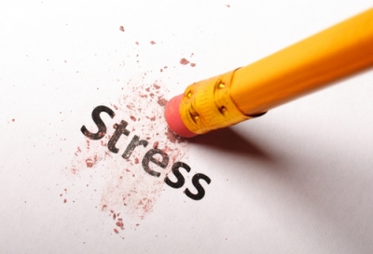

Slide 39

Additional Tips for Self-Care:
• Realize that it is both moral and ethical to properly monitor and care for yourself as you care for others.
• Adopt Positive Strategies and make slow gradual changes, one at a time. Be Focused and Intentional at each change.
• Invest time in appreciating arts, beauty, nature, and music.
• Develop an attitude of gratefulness

Slide 40

Becoming Healthier & More Efficient
Prevention is better than Intervention
Health Management
Relationship Management
Temptation Management
Details Management (money, demands, etc.)
Distractions Management (including digital, etc.)
Serenity Management (existential concerns, spirituality, inner peace, prayer life, etc.)

Slide 41
Wellness Plan

Slide 42
Wellness Plan
Good wellness plans incorporate a biopsychosocial approach, addressing biological (physical health), psychological (mental/emotional well-being), and social (relationships, community) needs to help manage the unique stressors of the SET role, such as emotional work, heavy workload, and supporting clients with special needs.
Wellness Plan: Self-Care Focus
Goal: Prioritize personal well-being to reduce stress and prevent burnout, emphasizing rest, mindfulness, and physical health.
Target Needs: Managing emotional exhaustion

Slide 43


