Slide 1

02FX Prepare an Intervention Plan
Cluster D: Intervention Planning

Slide 2
Resources to help with this competency
http://www.youtube.com/watch?v=YsD7G9Pc__o
https://www.youtube.com/watch?v=zLNr-2k9NjQ

Slide 3
02FX Prepare an intervention plan
02FX-1 Analyze the situation (25%)
Collection of relevant information
Accurate identification of strengths, difficulties, needs and interests
Appropriate inventory of available resources
02FX-2 Agree on the conditions of the intervention plan (50%)
Relevance of the intervention objectives
Consensus on intervention methods
Clear agreement on the division of roles and responsibilities
Realistic timeframe planning
02FX-3 Prepare the intervention plan (25%)
Rigorous application of professional writing standards
Clear written description of collaborative agreements

Slide 4
02FX Design an Intervention Plan
Written proposal:
Client profile
Risk and protective factors
Baseline data to document presenting problem
Need/ goal / objectives
Approaches
Inter-disciplinary team

Slide 5
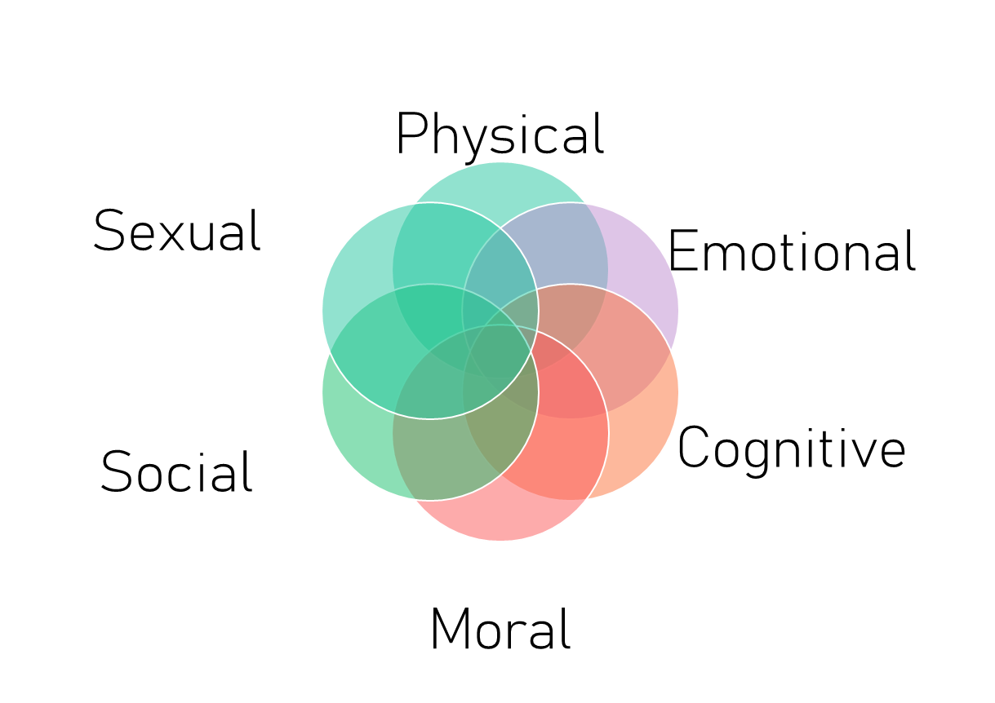
Client profile reminders
Review 02FM notes
Write observably and objectively

Slide 6

PHYSICAL DOMAIN
Mobility: degree, limits and possibilities
Motor: gross motor skills, fine motor skills, body positioning, laterality,
Abilities: permanent disability, temporary disability; ability to adapt and compensate

Slide 7
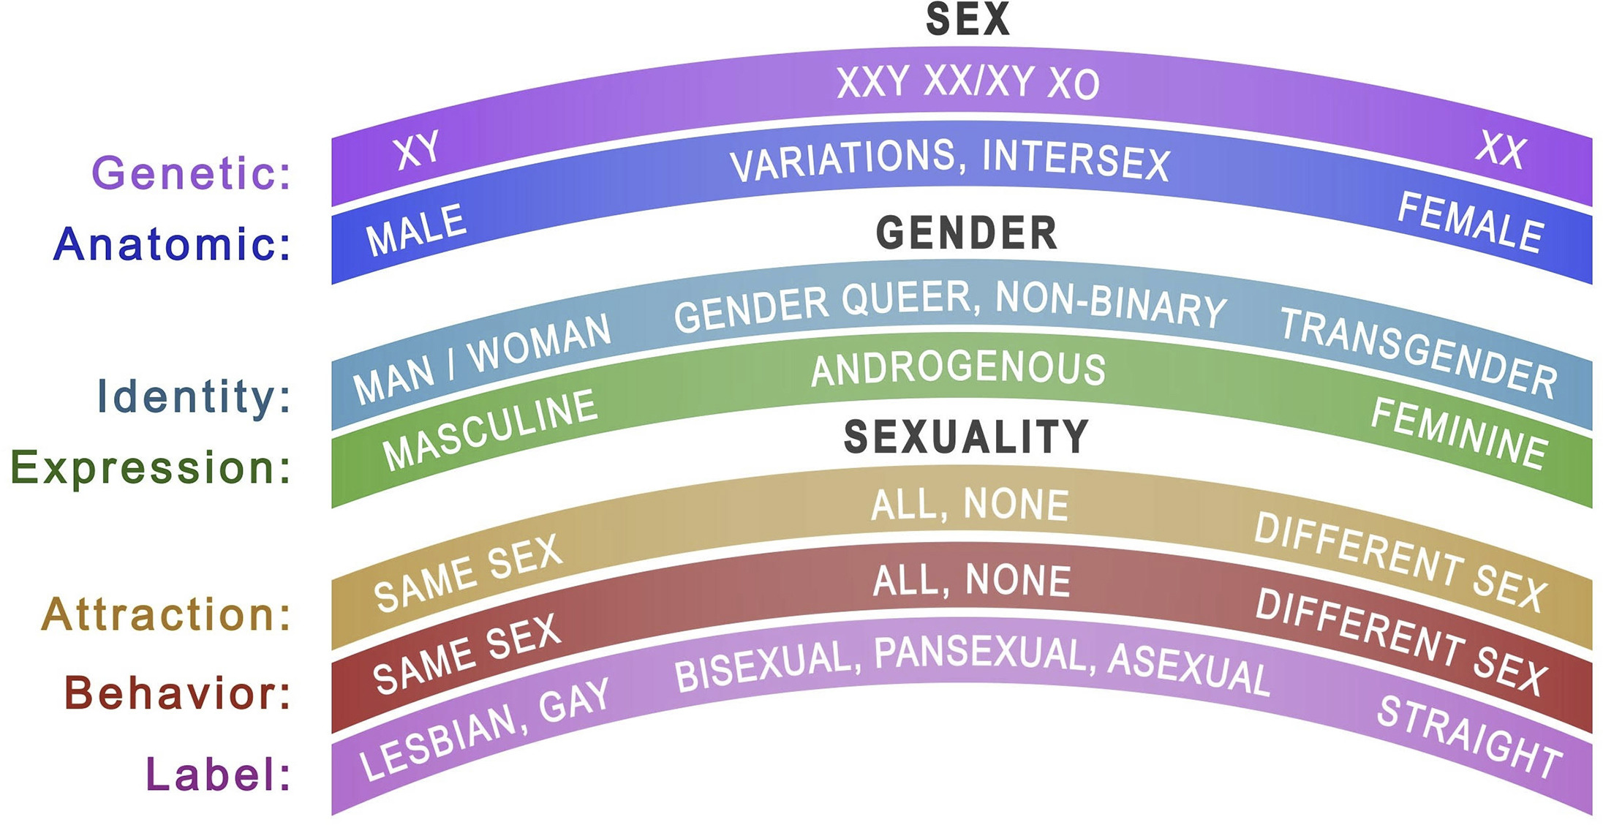
SEXUAL DOMAIN
Knowledge: body, bodily functions, pleasure, intimacy, contraception, reproduction
Boundaries, safety
Cultural or religious beliefs
Identification
Expression
Attraction
Sexual trauma

Slide 8
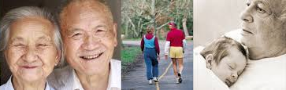
AFFECTIVE / SOCIAL/MORAL DOMAIN
Social: social interactions, social cues, social communication
Emotional (affective): self concept, emotions
Moral: values, ethics

Slide 9
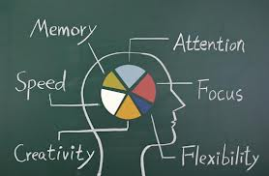
COGNITIVE DOMAIN
Executive functions: planning, strategizing, setting priorities
Decision-making: personal care, safety, health care, legal, career, family, relationship issues
Abilities: Memory, knowledge, comprehension, application, analysis, evaluation

Slide 10
All systems can impact our clients, acting as either a risk factor or a protective factor
We always need to assess/ be mindful of their impact on our client

Slide 11
Physical factors
Set up of a room / learning space
Services being offered
Changing social workers every 3 months
Limited accessibility
Calm down room locations
Windows/ air quality

Slide 12

Example:
ABC school has 22 classrooms spread over 2 floors. There are stairs at either end of the corridor. The walls are painted white with 1 blue bulletin board on the wall between each class. There are 6 sets of fluorescent lights down each hallway. On average half of the lights are burnt out or burning out. Each classroom has 4 10 feet windows. The windows have metal bars across them and the windows have been painted shut.
Jimmy using a wheelchair means that he cannot access the second floor without being carried. This is a risk factor because he cannot accompany his class independently and will therefore feel left out of activities which take place upstairs. Due to Jimmy’s sensory system the lights flickering act as a risk factor as Jimmy closes his eyes and is unable to steer his wheelchair independently, leaving him to rely on others to change classes.

Slide 13
The actions demonstrated by Social factors / systems
Care givers
Siblings
Peers
Friends
Teacher
Social worker
SET
Co workers

Slide 14
Example
Joey lives with his mother, her boyfriend (Frank), his grandmother and his two older brothers. His mother works 3 jobs and he sees her on weekend mornings or late at night when she comes in to say goodnight. Mom’s boyfriend drives him to school and picks him up. Joey’s oldest brother Jimmy makes his lunch and does his homework with him
Frank is a protective factor because he is consistent about getting Joey to school and listens to his day which makes Joey feel important and valued. This impacts his self concept in a positive way. Jimmy helping him with his homework and making his lunch can also be protective as these actions lead to Joey feeling cared for and decreasing his own stress. Mom is a risk factor because she is only able to see him 2 mornings a week or late at night due to working 3 jobs. Her absence is a risk factor because it may lead to Joey having an insecure attachment with her.

Slide 15

SET Intervention planning
Types of interventions

Slide 16
Types of interventions
Crisis intervention
Behaviour intervention plan
Preventative intervention plan
Rehabilitative plan

Slide 17
SET Intervention plan:
What it is not:
A tool like a visual schedule or a reinforcement schedule
It is not academic (IEP)
Not a crisis or behaviour plan
What it is:
Pre-determined, INDIVIDUALIZED plan
SET/agency domain
Done over at least 3 months – to a year

Slide 18
Interventions and mandate of the SET
Some intervention plans are created by other professionals and can implemented by the SET:
For example:
Speech and language interventions (can only be created by the SLP)
Motor planning / motor skills / sensory processing (can only be created by the PT, OT or Kinesiologist)
Sexual (can only be created by the Sexologist)

Slide 19
The SET interventions
Social abilities
Affective / emotional skills
Cognitive / executive function skills
Practical: ADLs/ IADLs

Slide 20

THE INTERVENTION PLAN
An effective intervention plan involves a number of steps. OADIE is one effective model that may be used for therapeutic intervention plans.
O: Observe (gather information)
A: Assess and analyze (assess the data to determine the function, identify needs)
D: Develop and design (identify goals, method/ activities and tools)
I: Implement (put the plan into action)
E: Evaluate and reflect (how did it go?)

Slide 21

OADIE steps: holding the whole plan together
OBSERVE
EVALUATE
ANALYZE
IMPLEMENT
DESIGN
OBSERVATION > ANALYSIS > NEED
NEED > GOAL
GOAL > OBJECTIVES
OBJECTIVES > SESSIONS
SESSIONS > EVALUATION

Slide 22
Step 1: Observe: gather information objectively
TASKS:
Read files
Collect data (anecdotal + quantitative)
Interview professionals, family members and client
Identify strengths, interests, and challenges
Create baseline data report

Slide 23
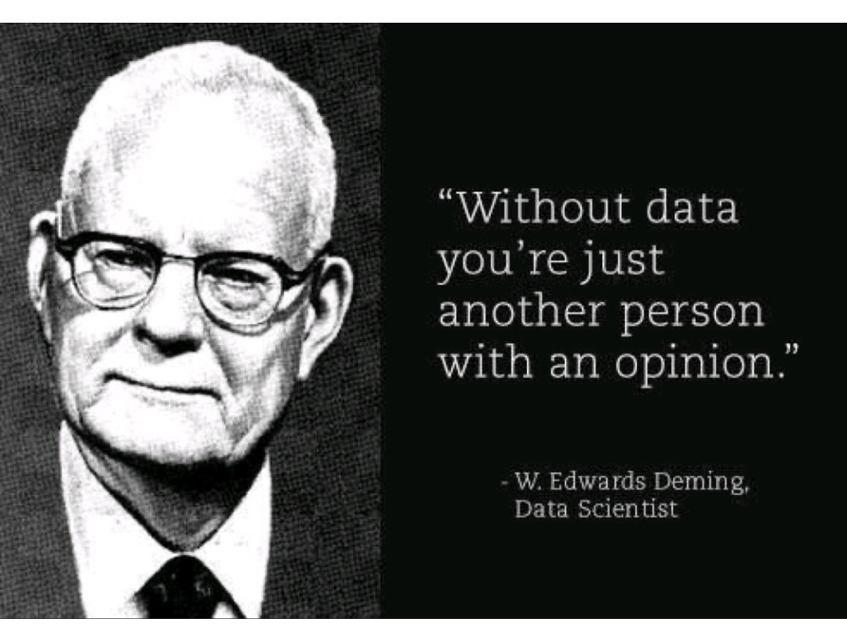
Baseline
Skills from 02FM
Write observably &objectively
How are you going to measure (prove) that the presenting problem is real?
Need at least 3 days of data

Slide 24
Baseline: what are we actually seeing?
Specific moments in time
Observable behaviours
Context matters (when, where, with whom)
Patterns across situations
When we take a baseline, we are not interpreting, assessing or analyzing yet.
We are simply noticing what is happening, in real, concrete, observable terms.
Baseline data helps us make sure the presenting problem is clearly grounded.

Slide 25
Baseline data example
DATE | TIME | ACTIVITY | PRESENTING PROBLEM | DURATION | SUPPORT
March 3 | 10:15 | Transition to recess | Liam cried, covered ears, shook his head when asked to line up | 5 min | Visual prompting
March 5 | 1:30 | Cleanup | Yelled “no”, pushed materials | 7 min | Verbal prompting
March 6 | 11:45 | Lunch transition | Sat on floor when asked to come to the table | 4 min | Verbal prompting

Slide 26
Step 2: Assess and Analyze: moving from observation to understanding
This is where we begin to ask “why?” What does the theory tell us about why this might be happening?
What patterns do we notice?
When does this happen most often?
What might the client be experiencing?
What might be going on in the client’s larger system that might be impacting them?
What do we know about the theory?

Slide 27
Step 2: Assess and Analyze: analyzing why the behaviour occurs to determine the priority need
TASKS:
Determine patterns in data
Determine possible reasons
Determine priority need
Ensure the need falls within the mandate of the agency and the SET

Slide 28
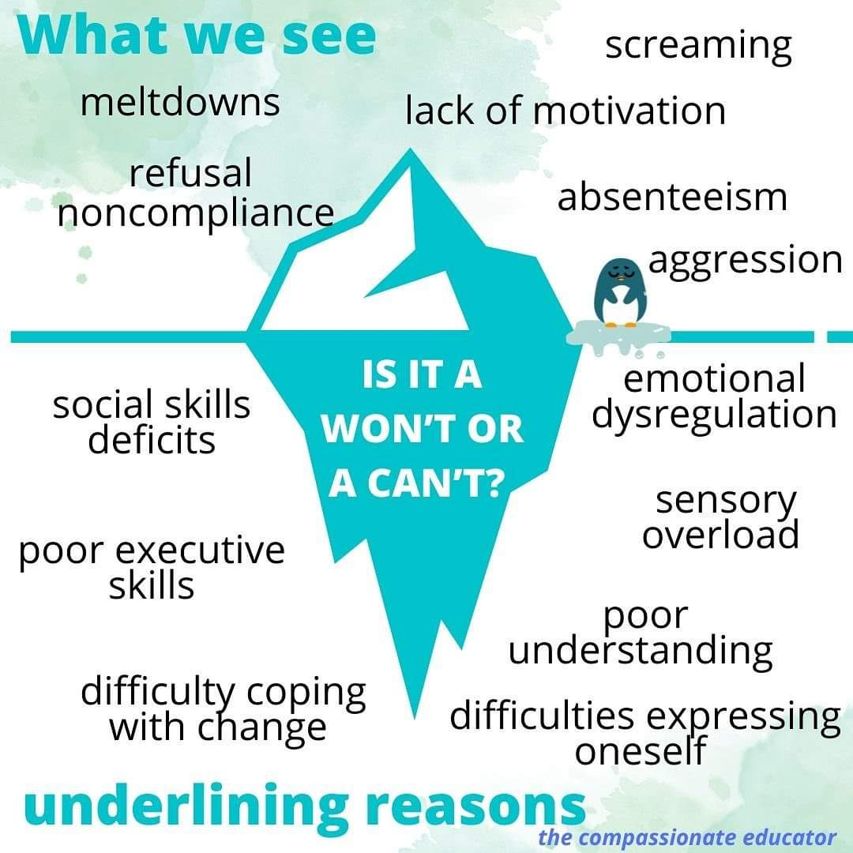
Identification of the priority need
Needs come from the underlying reasons for the presenting problem
In cluster C you learned about the client characteristics

Slide 29
Identification of the priority need: choosing where to focus
Several possible reasons may exist
We choose one priority need per intervention plan
The need should be:
Clear
Within the SET role
Linked to functioning
We can’t work on everything at once, so choose one priority need. This gives us direction and anchors the entire intervention plan.

Slide 30
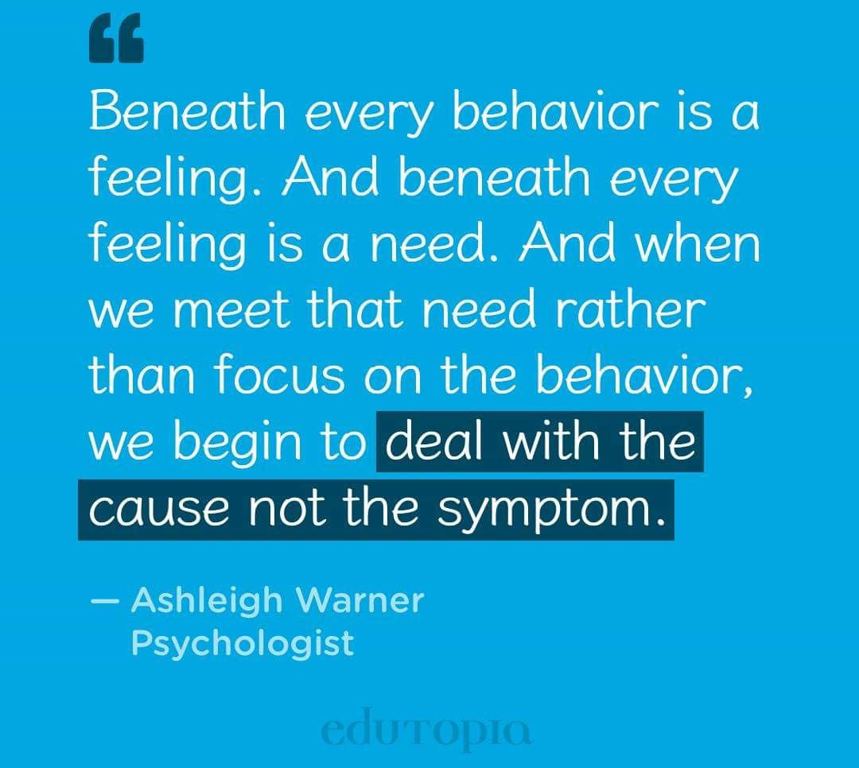
Example:
Presenting problem: Sam walks around the classroom during math
Possible reasons:
He may be bored (difficulty self regulating)
He may not understand what is being asked (difficulty with problem solving skills)
He may not know how to start (difficulty with executive function skills)
May not know how to ask for help (difficulty communicating his needs)

Slide 31
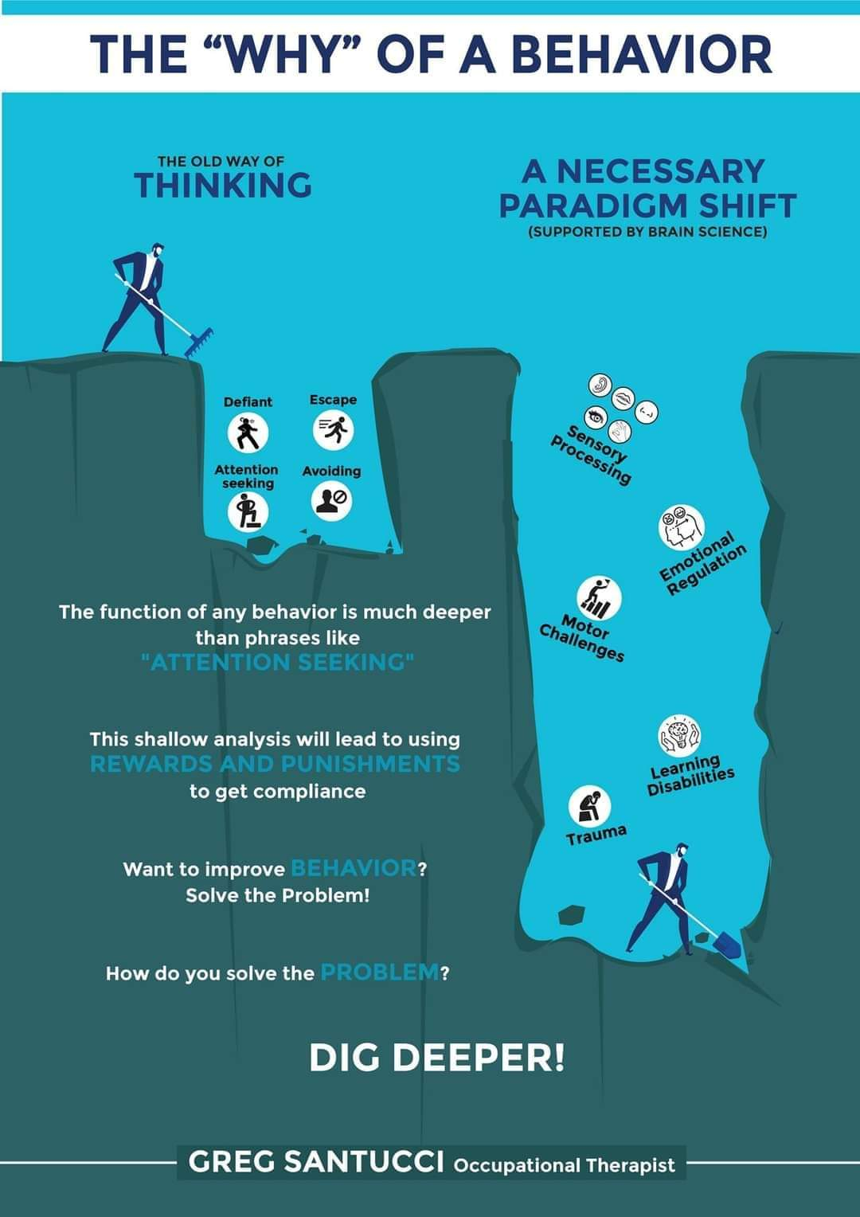
Example: drinking alcohol every morning
Difficulty communicating emotions
Difficulty with executive function skills
Difficulty with emotional regulation
Negative self concept

Slide 32
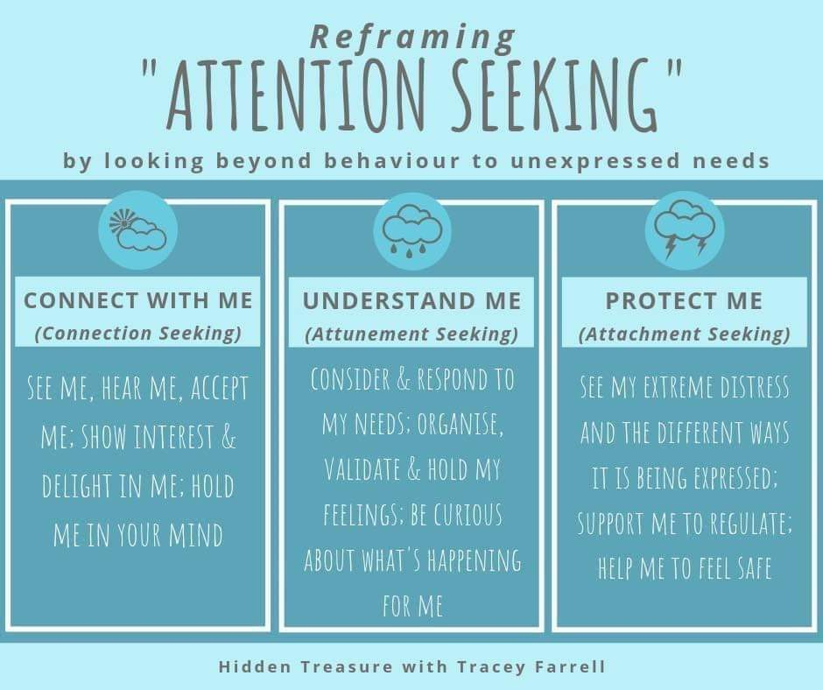
There is no such thing as negative or positive attention. Keep evaluating – why is this person trying to connect?

Slide 33
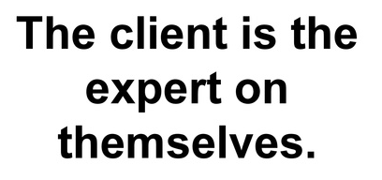
Clients need to be involved in the creation of their IP
When possible, discuss the goal and method with the client
Client’s must give consent to care after the age of 14

Slide 34
Step 3: Design and Develop: Setting the goal and objectives; creating the methodology
TASKS
Write goal and objectives for sessions
Research methodology
Decide on activities for sessions
Create materials and deciding on logistics

Slide 35

NEED leads to GOAL + session OBJECTIVES

Slide 36

Writing goals
“Who…will do…What”
Stated in broad terms; a statement of what the client intends to achieve as a result of the intervention plan
A goal is a positive vision for the future
Directed toward the client gaining more autonomy
Client is the subject of the goal. (The client will….not the SET will….)
Identify one goal. Do not use the word “and” in a goal.
Notes:
GOALS
A goal is a brief statement of the change you expect to see in the client, (behavioral, affective, knowledge, ADL skills)
Goals should be more than the elimination of pathology. They should be directed towards the client learning, relearning or maintaining functional skills and behaviors.
The client (or the client’s family) must be the subject of each goal. Neither you nor any other staff member or staff intervention should be mentioned.
Identify one goal at a time, and make each goal one sentence. Do not use the word “and” in a goal statement.

Slide 37
Examples of goals
Poor goal: The client will stop drinking.
Better: The client will use functional self regulation skills. (Client is learning something different.)
Poor goal: The client will stop negative self-talk. (Client does not learn something different or use something differently; client just avoids something that he or she already knows.)
Better: The client will have a positive self concept (Now client learns something different that is incompatible with the old behaviour.)

Slide 38

Examples of goals
The client will…
Communicate his wants and needs at school
Use executive function skills to complete IADLs
Play cooperatively with peers
Use pragmatics when communicating with peers
Use social norms in the cafeteria

Slide 39
Writing objectives
Who will do what under what criteria or condition
Objective = a specific skill, knowledge or behaviour that the client must acquire.
Objectives may or may not be a sequential series of steps that help reach the long-term goal.
Must be stated so clearly that anyone would know when they saw it.
You cannot see someone learn or see her “self-esteem”. But you can hear that person identify 10 positive things about herself.
One way of knowing whether you have a goal or an objective is to use the “see Johnny” test:
“If you can see Johnny do it, then it’s an objective; if you can’t, then it’s a goal.”

Slide 40
Formula for developing an objective for your sessions
CLIENT’S NAME
WILL
Identify
Describe
Demonstrate
WHAT
HOW OFTEN, BY WHEN
OBJECTIVE
Identify
Describe
Demonstrate
3 of her values
With visual support by the end of session 2
OBJECTIVE
Jane Will

Slide 41
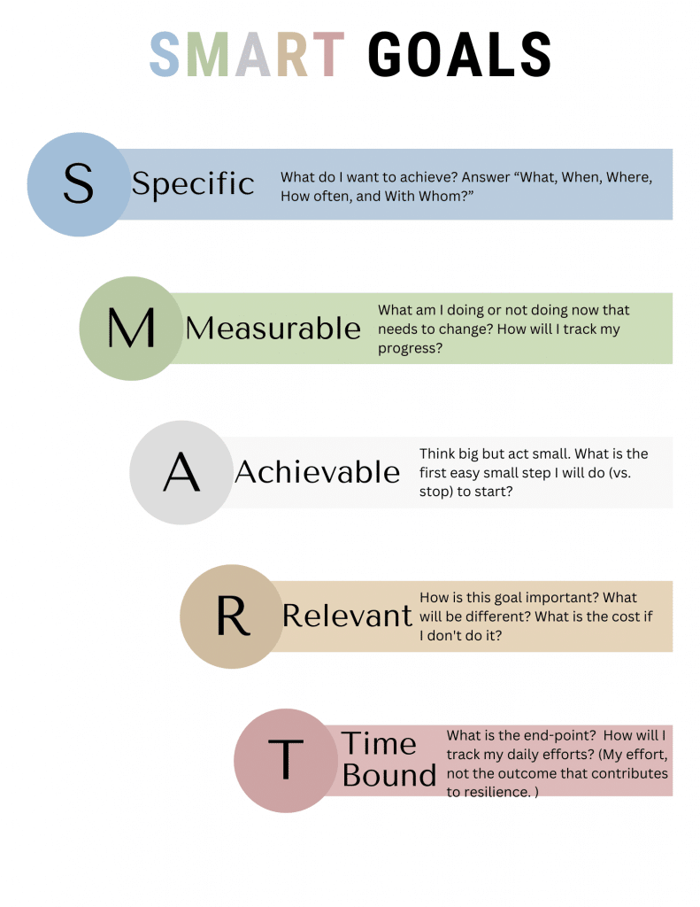
SMART objectives
Objectives are written IN SMART FORMAT

Slide 42
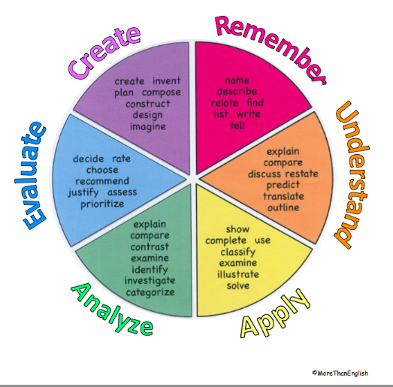
BLOOM’S TAXONOMY:
COGNITIVE DOMAIN

Slide 43
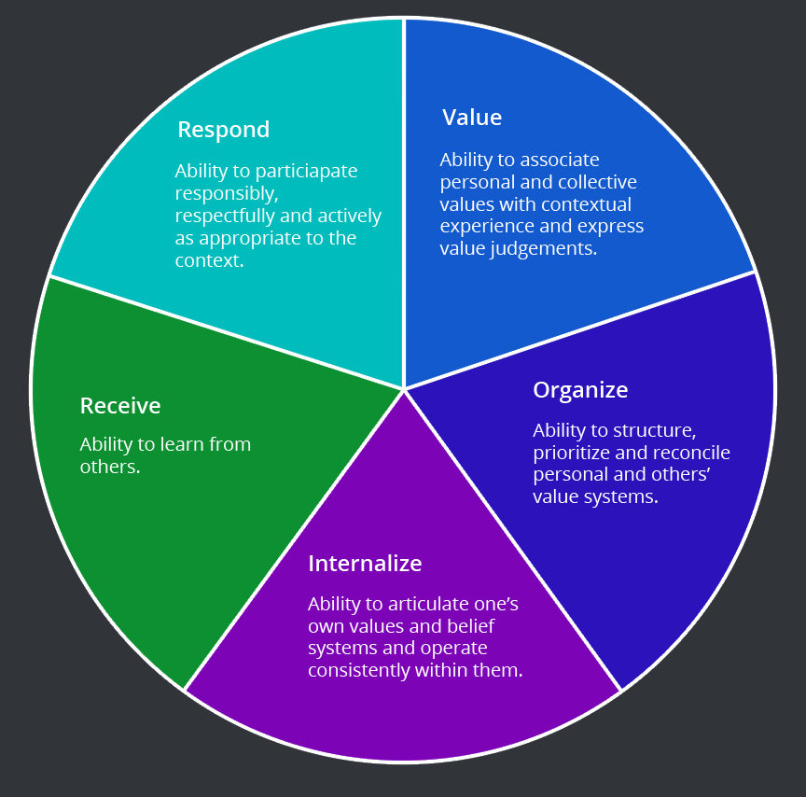
BLOOM’S TAXONOMY:
AFFECTIVE DOMAIN

Slide 44
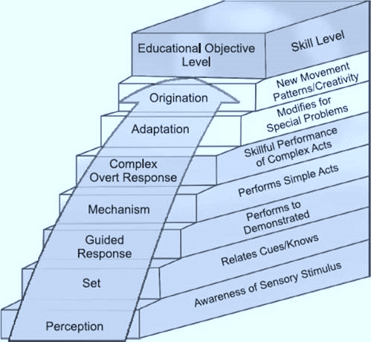
BLOOM’S TAXONOMY:
PSYCHOMOTOR DOMAIN

Slide 45

method
Sessions are done one on one in a controlled, calm environment

Slide 46
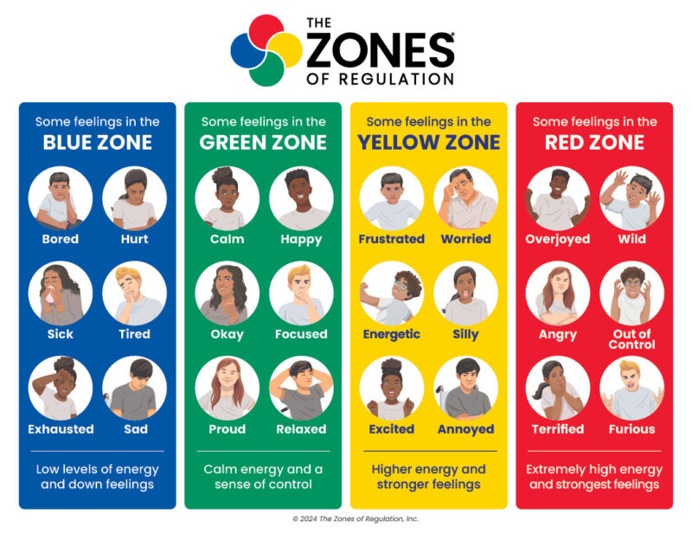
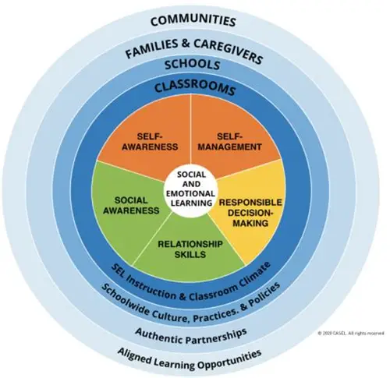
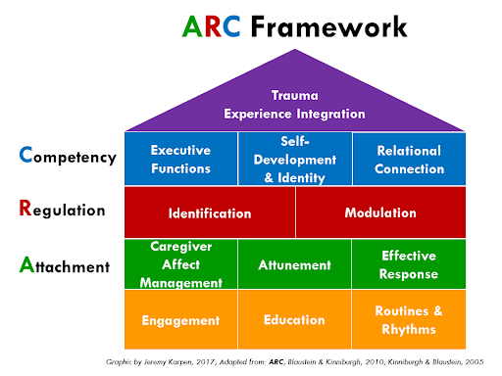
Research intervention frameworks
NEED: SELF REGULATION
Possible frameoworks:
Zones of Regulation
ARC
CASEL

Slide 47
Methodology: building the sessions
FOUR therapeutic activities for each objective which:
Are completed 1 on 1 in a controlled environment
Are tailored to this client (their interests, their learning style, their level)
Build on each other (session 1 is introduction, session 2 takes into account what was learned in session 1 and so on)
All activities are working on helping the client meet that specific objective.
Client remains at the center: the client is doing most of the activities, with the SET supporting the client.

Slide 48
Activities in sessions
What does your client like to do?
What is their best way of learning?
How long is their attention span?
What are you working on?
Making videos, comic strips, scrapbooks, scavenger hunts, mirror validations, role plays, board games, slam poetry, obstacle course, crosswords …..

Slide 49
Step 4: Implement: run sessions with client one on one outside of their daily routine
TASKS
Write session plans
Adapt session to address emerging needs
Use techniques, strategies, communication skills to support client
Collect data
Evaluate progress
Adapt objectives
Adapt method

Slide 50
When implementing sessions things do not always work out
Be prepared to adapt in the moment
Have back up plans
Remember the objective – the activity is not the objective
Collect data
Self reflect

Slide 51
Step 5: Evaluate: evaluate the goal
Once all sessions are complete:
TASKS:
Collect new data
Speak to professionals, family, client to determine change / progress
Self reflect
Set new goal

Slide 52
Effective intervention plans…
Are flexible and adjustable, and reviewed and revised on an on-going basis in order to respond to the client’s changing strengths and needs.
Consider the client’s culture, religious beliefs and other dimensions of diversity
Are written using respectful, judgement-free language.
Are holistic and consider the client as a whole person with strengths, abilities, needs and preferences.
Are informed by the reflections and contributions of those who know the client best, as well as professionals with specific expertise.
Prioritize the elimination of barriers to success and nurtures the client’s autonomy, independence, personal empowerment, self-determination, and social interactions.
Supports the client to function in the classroom, home, community and wider society.

Slide 53

Working with others: who supports this work?
Different professionals bring different expertise
Collaboration supports consistency
The client’s environment matters
No intervention happens in isolation. We are always part of a larger system around the client.

Slide 54
Working with others: choosing professionals
Who has expertise related to this need?
Who is already involved?
How can they support this intervention?
What can they contribute?

Slide 55
Bringing it all together
A coherent, integrated intervention plan includes:
Clear presenting problem
Strong baseline data
Focused priority need
Aligned long-term goal and short-term SMART objectives
Structured sessions aimed at achievement of objectives
Thoughtful collaboration
When all of these pieces align, the plan becomes relevant, purposeful, and effective.

