Slide 1

Cluster D:
Intervention Planning
Overview

Slide 2
Cluster D consists of four evaluations
02FX Prepare an Intervention Plan
Evaluation 1: 02G3 Carry out an Adapt/Rehabilitation intervention plan + Client Choice #1
Evaluation 2: Exam with Client Choice #2
Evaluation 3: 02FX Carry out prevention intervention plan + Client Choice #3

Slide 3
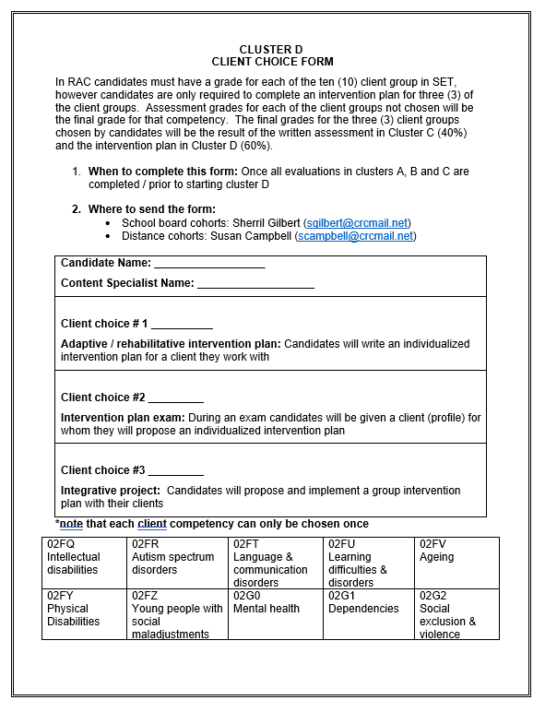
Before starting any evaluations…..
Download and complete the client choice form.
Send this form to Sherril Gilbert if you are with a school board cohort (sgilbert@crcmail.net) or Susan Campbell if you are with a distance group (scampbell@crcmail.net)

Slide 4

Once received the content specialist checks your folder to ensure all work is up to date
They will send you a note giving you the go ahead to start your intervention plans

Slide 5
02FX Prepare an Intervention plan
This intervention plan is a proposal for an individual intervention plan
It should be done with a client you currently work with
Candidates are evaluated on their ability to analyze the client’s situation, propose a clear and relevant S.E.T. intervention plan
Candidate are also evaluated on their ability to write professionally and clearly

Slide 6
Evaluation 1: 02G3 Adaptation & Rehabilitation + Client Choice #1
This is a complete individual intervention plan
Candidates may choose to use the same client from 02FX
Candidates will be evaluated on two competencies: Carry out adaptation and rehabilitation interventions as well as their first client choice
Candidates will complete a full session report and evaluate the effectiveness of the session
Candidates will be evaluated on their ability to evaluate, and self reflect on their intervention planning skills

Slide 7
Evaluation 2: Client Choice #2
This assessment is in the form of an exam
After successfully completing Evaluation 1, candidates will book a three (3) hour time block on zoom with the content specialist
Candidates will be shown a client profile relating to their second client choice
Candidates will complete a proposal for an individual intervention plan using the evaluation 2 worksheet and their notes
Candidates will be evaluated on their ability to assess a client’s need and propose a relevant S.E.T. intervention plan

Slide 8
Evaluation 3: 02FW Prevention + Client Choice #3
Pre-plan
Candidates will be assigned a content specialist
Discussion
Candidates will identify three (3) clients they currently work with who share a common need
Observation
Candidates will create client profiles and collect data for all three (3) clients
Candidates will complete a research paper and intervention plan proposal
Implement
Candidates will implement the group intervention plan
Evaluate
Candidates will present their intervention plan on zoom to content specialists and candidates
Final grades
Candidates will receive two (2) grades: a grade for 02FW + a grade for their final client choice
Design

